Slide 1


NACARSOFT · TERMINAL WEB
Your server terminal,
in the browser. No SSH.
Browser
Tablet
Phone
desktop
iPad
iPhone
HTTPS · WebSocket · TLS
NSTerm publishes the shell as a web application: it opens in any browser, from a laptop, a tablet or a phone, over HTTPS. And internal consoles are published through the reverse proxy, with their own login and audit.
NSTerm
web session + PTY
SEE FEATURES →
Shell on the server
Internal apps
>
own PTY, with each user's account
reverse proxy with login and audit
HTTPS only · No SSH keys · A single binary
connections by browser, tablet and phone
sessions · apps · groups · audit · proxy

Slide 2
EL PROBLEMA
SSH access to the server does not scale
Every operator carries their own SSH client, keys and tunnels: sessions cannot be audited and the internal console stays outside the access policy.
01
Keys per person
02
No central identity
A keyring nobody maintains. Rotation becomes a quarter-end project.
Everyone gets in as they can. No user, no role, no expiry.
03
No audit
04
Loose consoles
The SSH login leaves no useful trace: nobody knows what ran or from where.
The intranet is published on its own, bypassing the access policy.
• A clipboard and a text box
• No access control
• Untraceable consoles
Nacarsoft Soluciones Informáticas S.L. · nacarsoft.com · nsterm

Slide 3
QUÉ ES
The server shell, as a web application
NSTerm is a multi-session web terminal in a single binary: the administrator publishes applications (command, arguments, directory, environment and size), users open them in tabbed terminals over WebSocket and every process is tracked as a session.
0
1
SSH keys to manage
binary, no dependencies
✓
xterm terminals in the browser, with tabs and reconnection
✓
Sessions with PID, user, IP, country, browser and child processes
HTTPS
3
✓
The command runs on the server, with the user the administrator picks
the only network need
kinds of device
✓
Internal consoles published by reverse proxy, with login and RBAC
Nacarsoft Soluciones Informáticas S.L. · nacarsoft.com · nsterm

Slide 4
ARQUITECTURA
How a keystroke travels, step by step
1
2
3
4
5
Browser
Web session
Check
PTY on the host
Live output
xterm.js: key, mouse and scroll travel over WebSocket.
Cookie + JWT: the user is already authenticated and role-bound.
Group quota, active app and allowed target before opening.
The command starts with the assigned user and its environment.
The output returns to xterm and is recorded as a session.
⚠ The session lives on the server: if the browser closes, the process keeps running and can be picked up later.
HTTPS and WSS only
No shell on the client
Auditable session
Nacarsoft Soluciones Informáticas S.L. · nacarsoft.com · nsterm

Slide 5
SIN SSH
No SSH: HTTPS is enough
No sshd, no keys, no bastion, no tunnels. NSTerm speaks WebSocket over TLS and the command runs on the server itself.
Access | SSH client + private key | Browser with a session cookie
Identity | The user's public key | Panel user, group and role
Audit | At best, auth.log | Log per session, user and IP
Quotas | None | Max sessions per user and group
Internal consoles | Tunnels and port forwarding | Reverse proxy with RBAC
For the user | Install and configure a client | Open a URL
The only network requirement is a reverse proxy with HTTPS on port 11030.
Nacarsoft Soluciones Informáticas S.L. · nacarsoft.com · nsterm

Slide 6
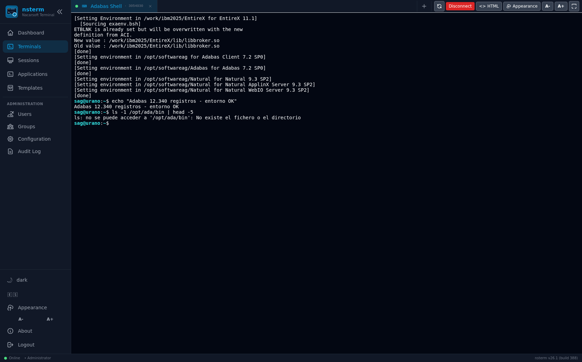
CONEXIONES
From the desktop browser
xterm.js with the server character set and colours
Tabs: several terminals at once, with name and PID
Reconnection: reload the page and the session is picked up
Full screen, font sizing and HTML mirror
Shortcuts and Natural function keys (PF) when the app asks for them
No plugin
No PuTTY Java
Bookmarks and favourites
A real terminal in the browser, with the session PID on the tab.
Nacarsoft Soluciones Informáticas S.L. · nacarsoft.com · nsterm

Slide 7
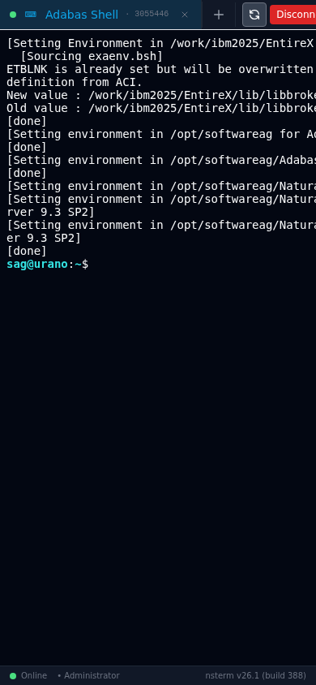
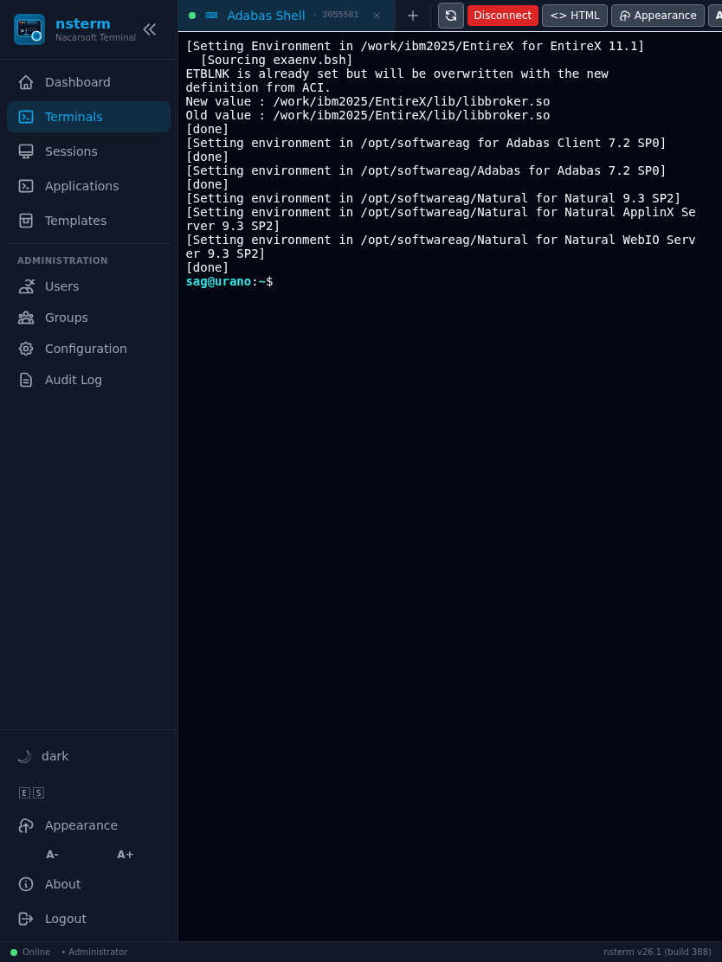
MÓVIL Y TABLETA
Also from the tablet and the phone
The same session, with the layout adapted to the screen width
On-screen keyboard with the keys the app needs
Long press and text selection over the command output
Ideal for one-off queries and on-call duty away from the desk
The very same link works on the PC, the tablet and the phone.
Tablet: 834 px, a comfortable working width.
Phone: 390 px, the terminal adapts without losing commands.
Nacarsoft Soluciones Informáticas S.L. · nacarsoft.com · nsterm

Slide 8
PROXY INVERSO
Reverse proxy: publish your internal consoles
Beyond terminals, NSTerm publishes internal web applications: it exposes an http/https URL through NSTerm itself, inheriting the login, the per-group RBAC and the audit.
Browser
NSTerm
Internal app
https://term.company.local
login + RBAC + audit
https://intranet:8443/app
Only admin-defined URLs: the user never types one
Host allowlist, private-IP and cloud-metadata blocking
Link rewriting and WebSocket support on the backend
Per-application body limit and response timeout
The internal console leaves the network and goes through the very same login as the terminal.
Nacarsoft Soluciones Informáticas S.L. · nacarsoft.com · nsterm

Slide 9
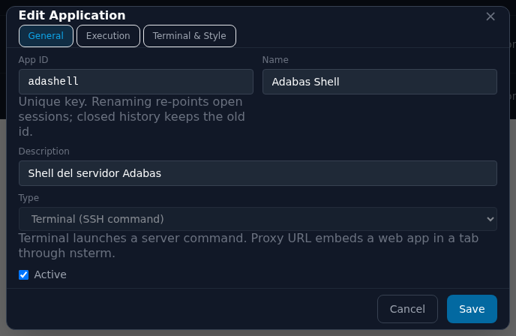
ADMINISTRACIÓN
Applications: the admin decides what is published
Command, arguments, working directory and environment
Terminal size (cols/rows) or fit to the container
Colour scheme, icon, logo and application colour
System user it runs as: fixed or the connected user's account
Session timeout, HTML design and Natural keys
A user only sees the applications assigned to their groups.
The application editor: id, name, description, type and state.
Nacarsoft Soluciones Informáticas S.L. · nacarsoft.com · nsterm

Slide 10
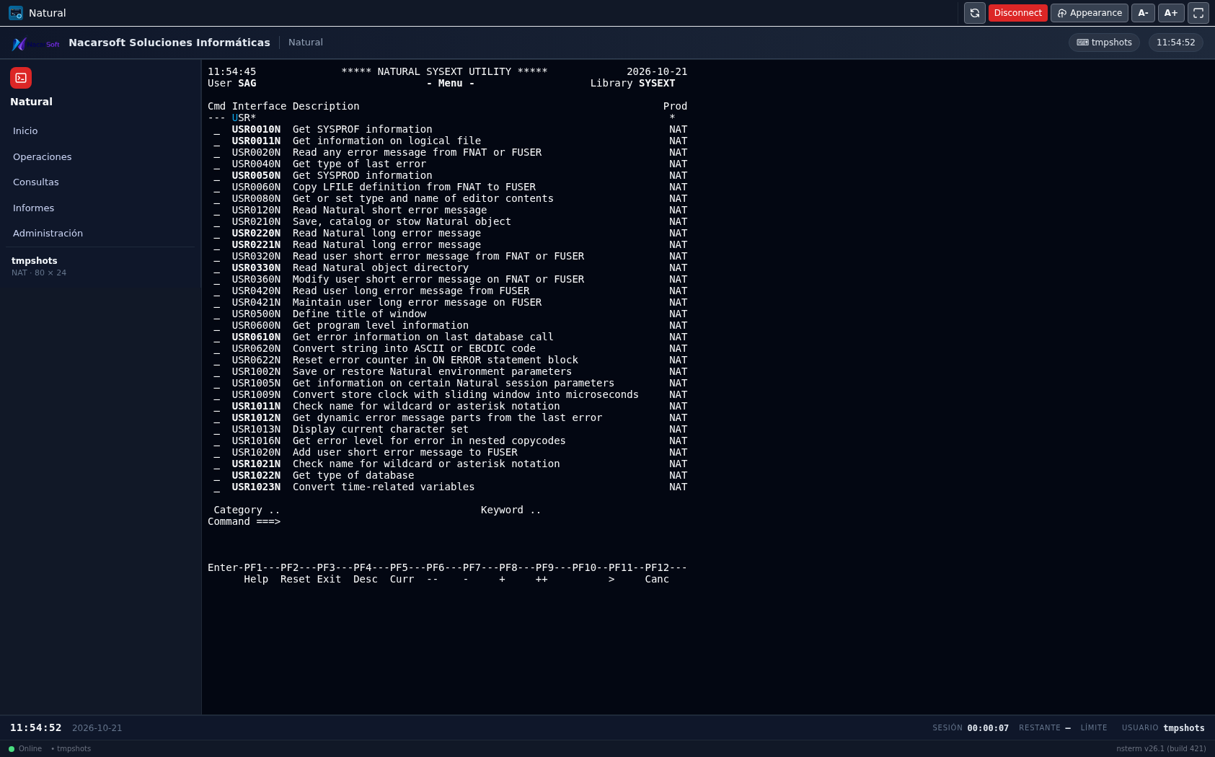
PLANTILLAS
Templates: the terminal with a web application look
Header, side containers and status bar with your own HTML and CSS
Corporate logo and name, taken from the server configuration
PF1..PF12 buttons that send the key to the session
Live values: clock, date, session time and remaining time
The CSS runs isolated: it cannot break the NSTerm interface
Eleven example templates are created on install: assign the one you want to each application.
The same application, with a corporate header, side menu and a status bar with the clock.
Nacarsoft Soluciones Informáticas S.L. · nacarsoft.com · nsterm

Slide 11
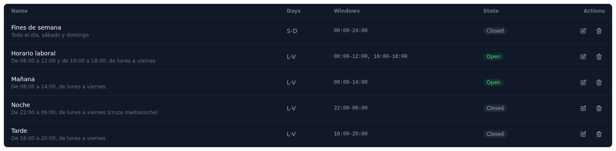
HORARIOS
Schedules: the application is only available in its window
Schedule templates: morning, afternoon, night, weekend
Outside the window the app shows as Closed on the dashboard
The server blocks it: it cannot be opened bypassing the panel
Window per day, several windows and night shifts
Administrators are subject to the schedule as well
The available schedule templates and their current state.
Console access becomes office hours, instead of always being open.
Nacarsoft Soluciones Informáticas S.L. · nacarsoft.com · nsterm

Slide 12
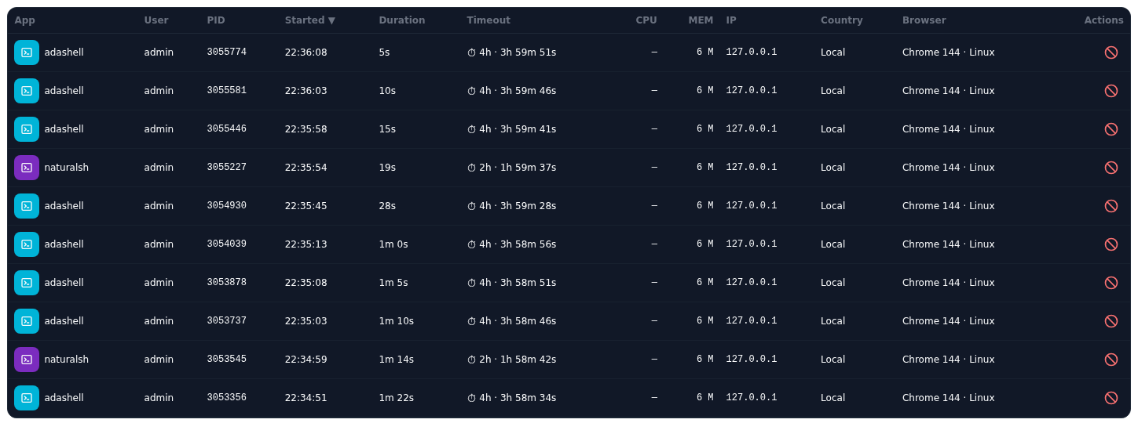
SESIONES
Every session is a process, and it is recorded
Application, user, PID, start and duration of every session
IP, country and browser of whoever opened it
Child processes: what the command has spawned
CPU, memory and the configured session timeout
Kill the session asking for a reason, which goes to the log
Sessions: who runs what, from where and since when.
The table updates live over WebSocket: no need to reload.
Nacarsoft Soluciones Informáticas S.L. · nacarsoft.com · nsterm

Slide 13
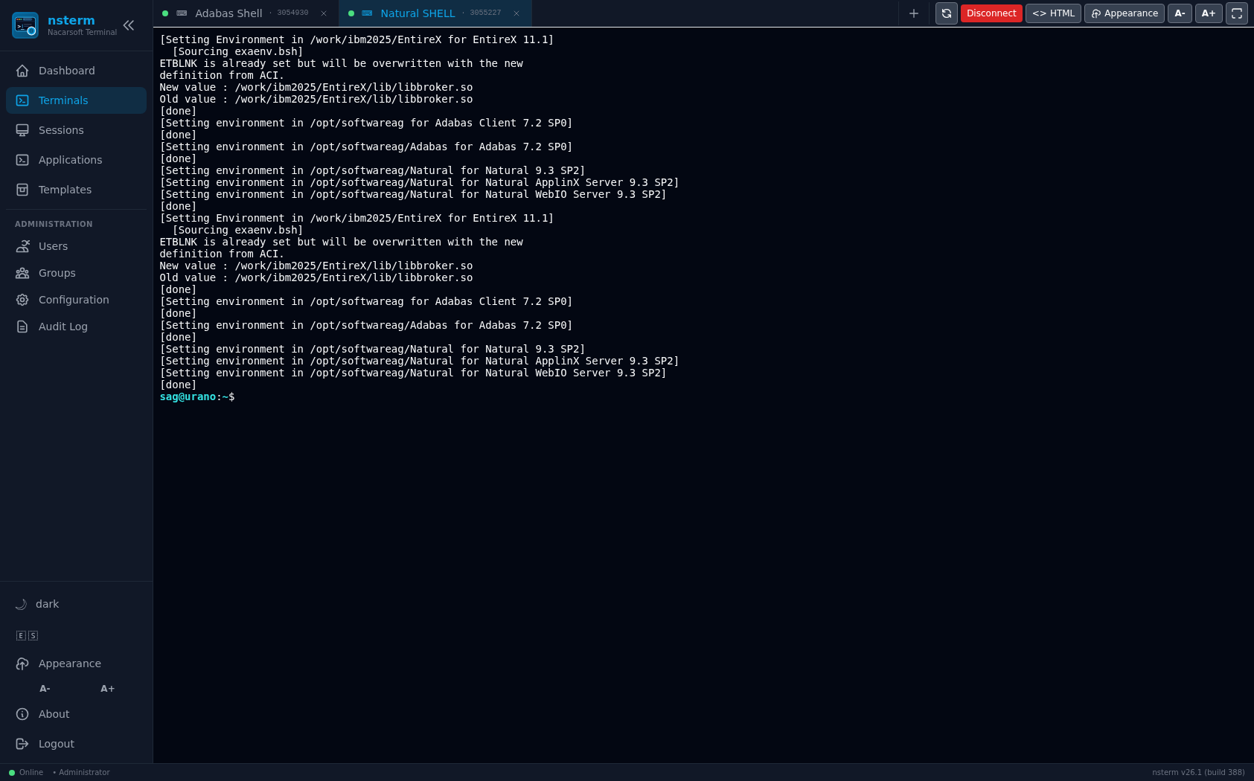
MULTITERMINAL
Several terminals, one window
A new tab without losing the previous session
Each tab with its own PID and application name
Automatic reconnection after a network drop
The session state, visible in the tab bar
Tabs: one terminal per session, all in the same window.
Nacarsoft Soluciones Informáticas S.L. · nacarsoft.com · nsterm

Slide 14
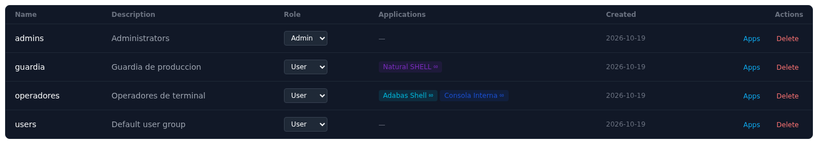
USUARIOS Y GRUPOS
Users, groups and session quotas
A user belongs to groups; the group defines the role
Each group has its applications assigned
Quota of simultaneous sessions per user and application
Past the quota, the terminal warns and opens no session
User administration: alias, email and state
Groups: role, assigned apps and the maximum sessions per user.
The same application can live in several groups, with different quotas.
Nacarsoft Soluciones Informáticas S.L. · nacarsoft.com · nsterm

Slide 15
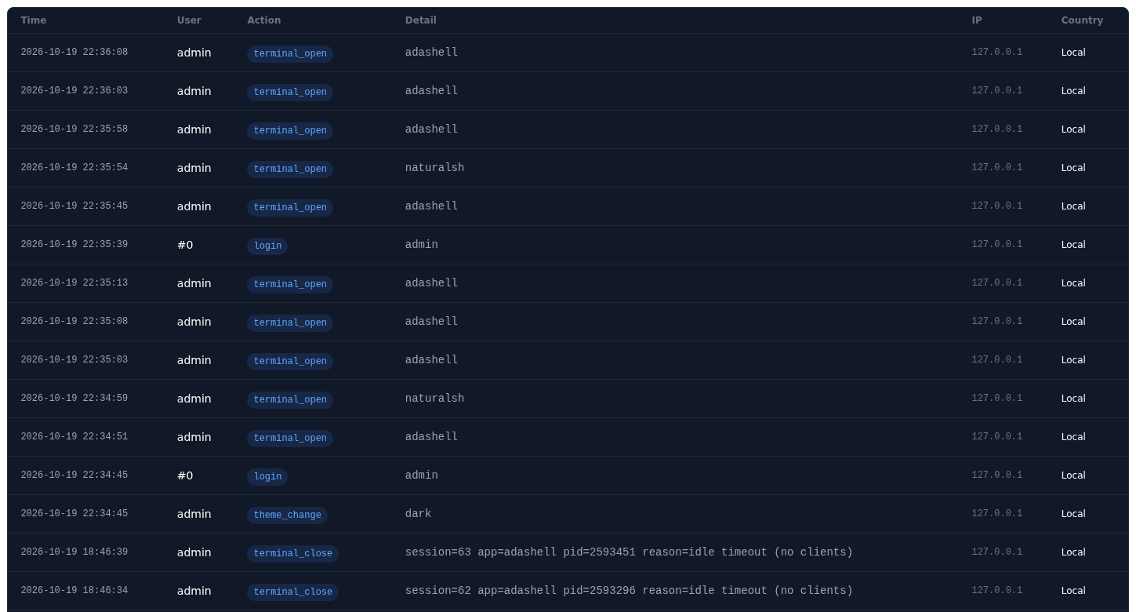
SEGURIDAD
Who opened what, and it is recorded
Logins, app creations, group changes and session endings
Mandatory reason when closing somebody else's session
Optional LDAP or Active Directory, alongside local users
Password policies: expiry, early warning and history
Session token with configurable expiry and HttpOnly cookie
Audit log: logins, applications, groups and session endings.
Machine-signed license and a 30-day trial.
Nacarsoft Soluciones Informáticas S.L. · nacarsoft.com · nsterm

Slide 16
GETTING STARTED
From zero to a web terminal, in three steps
1
Create the environment
REQUIREMENTS
nsterm init /opt/nsterm: it creates config.yaml, the SQLite database, the logs and the admin user.
Linux (RHEL 8 / 9)
A single binary, no dependencies
SQLite for state and audit
Reverse proxy with HTTPS in production
Port 11030 (configurable)
2
Publish the reverse proxy
Terminate TLS at the proxy and forward to https://server:11030. The server itself is not touched.
3
Publish the shell
Create the application (command, args, directory and environment) and assign it to the groups that need it.
No SSH: no need to open port 22, deploy keys or touch the sshd configuration.
nsterm init /opt/nsterm → nsterm start --config /opt/nsterm → https://term.company.local
Nacarsoft Soluciones Informáticas S.L. · nacarsoft.com · nsterm

Slide 17
FREQUENTLY ASKED
The questions we hear most
Is it really true that no SSH is needed?
Who runs the command?
Yes. The browser talks HTTPS and WebSocket with NSTerm and the command runs on the server with its own PTY. sshd is not involved.
The admin decides: a fixed system user or the Linux account mapped to the connected user. NSTerm verifies the sudoers permissions.
Can I publish an internal website?
What if the browser closes?
Yes: create a Proxy URL application with its target and assign it to groups. Users open it with their session and with no direct access to the URL.
The session stays alive on the server. When you come back, the tab is restored and re-attached to the same process, with its PID.
How is usage limited?
Can it integrate with Active Directory?
Each group has a maximum of simultaneous sessions per user and application. Past it, the terminal warns and opens no new session.
Yes: LDAP/AD is optional and lives alongside local users. The user is mapped to their Linux account for the PTY.
Nacarsoft Soluciones Informáticas S.L. · nacarsoft.com · nsterm

Slide 18
Your server, in the browser
and with its own audit trail
Try NSTerm with your environment: we set it up with your applications and watch it run.
Guided demo
Try it in your environment
Let's talk about your case
nacarsoft.com · support@nacarsoft.com
Nacarsoft Soluciones Informáticas S.L. · nacarsoft.com · nsterm

