Slide 1


NACARSOFT · FILE SORTING
Sort, merge and
join your files the
mainframe way.
Input files
fixed length or delimited
nssort speaks the /OPTION syntax of SyncSort: external sorting, merging, joining and reformatting, with a static binary and no intermediate files.
Sorted and joined
/FIELDS, /MERGE, /JOIN
SEE THE FEATURES →
SyncSort syntax · External sorting · Merge and join · One single binary

Slide 2
THE PROBLEM
Mainframe sort scripts do not travel to Linux
The code that sorts, merges and joins files has been running for years on the mainframe, and there is nothing to replace it with after migrating to Linux.
1
2
3
Jobs that will not compile
Intermediate copies
Format differences
A JCL with SORT and MERGE has no Linux equivalent, and rewriting it is a months-long project.
Sorting with shell tools means going through temporary files: disk, time and errors.
EBCDIC, fixed lengths, positional fields: every adaptation is a new source of errors.
nssort accepts the same /OPTION syntax and runs it on Linux, with a single binary and no intermediate files.
Nacarsoft Soluciones Informáticas S.L. · nacarsoft.com · nssort

Slide 3
WHAT IT IS
Nacarsoft's SyncSort-compatible sorting engine
nssort implements the operational subset of SyncSort: copy, external sorting, merge, join, reformat, derived fields and aggregation.
The syntax is the one your team already knows: /INFILE, /OUTFILE, /FIELDS, /MERGE, /JOIN, /KEYS. And because it is a static binary, it runs on any Linux with nothing to install.
nssort
Sorting, merging and joining
SyncSort abbreviations accepted
External sorting by fields and keys
Merging (/MERGE) and joining (/JOIN)
Reformatting, derived fields and aggregation
1
0
100%
static binary
intermediate files
SyncSort syntax
Nacarsoft Soluciones Informáticas S.L. · nacarsoft.com · nssort

Slide 4
HOW IT WORKS
From the command to the result, with no intermediate steps
A single process reads, sorts and writes: workspace is only used when the file does not fit in memory.
1 · Read
2 · Sort
3 · Write
Fixed record (RECORDLAYOUT FIXED) or delimited (DELIMITEDRECORDLAYOUT), with the coding you declare.
By fields (/FIELDS), by keys (/KEYS) or by SyncSort logical order, with adjustable memory and workspace.
Writes straight to the /OUTFILE, and merges or joins the files you pass in.
With /STATISTICS you get the detail of the run: records read, skipped and written.
Nacarsoft Soluciones Informáticas S.L. · nacarsoft.com · nssort

Slide 5
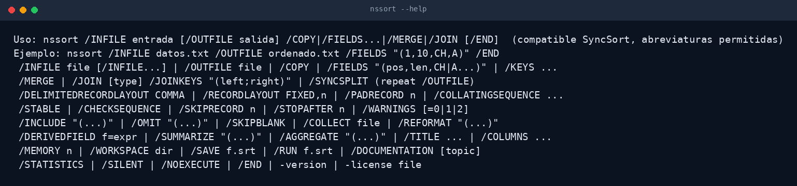
THE TOOL
The same syntax as always
SyncSort options with abbreviations accepted: exactly what your JCL uses, with no adaptation.
Unchanged /FILE options
A static binary
No dependencies
Real output of nssort --help
Nacarsoft Soluciones Informáticas S.L. · nacarsoft.com · nssort

Slide 6
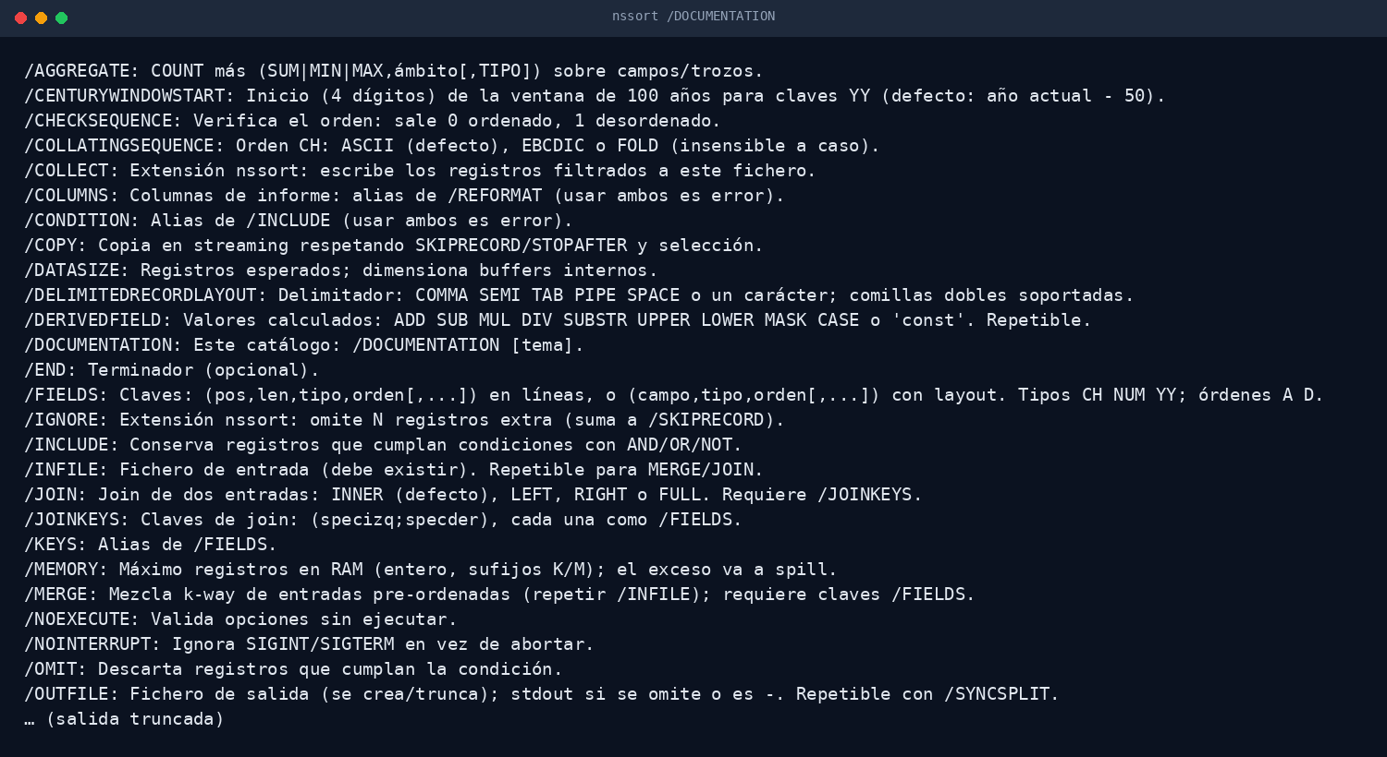
DOCUMENTATION
The whole catalogue, inside the binary
nssort ships its own documentation: every option with its description and its example, available offline.
Every option
Usage examples
Reference document
Real output of nssort /DOCUMENTATION
Nacarsoft Soluciones Informáticas S.L. · nacarsoft.com · nssort

Slide 7
FEATURES
What it does, point by point
The operational subset of SyncSort, in a binary that depends on nothing.
Compatible /OPTION syntax
External sorting
✓
With abbreviations accepted: /INFILE, /OUTFILE, /FIELDS, /KEYS, /MERGE, /JOIN… exactly as on the mainframe.
✓
Sorts files that do not fit in memory using workspace (/WORKSPACE) and sized buffers.
Streaming copy
Merge and join
✓
/COPY with SKIPRECORD, STOPAFTER and field selection, without materialising the whole file.
✓
/MERGE with several input files and /JOIN with type (INNER, LEFT, RIGHT) and /JOINKEYS.
Reformat and derived fields
Aggregation and summary
✓
/REFORMAT, /DERIVEDFIELD and /TITLE to build the output the next process expects.
✓
/SUMMARIZE and /AGGREGATE with COUNT, SUM, MIN and MAX over fields or slices.
Codepages and formats
Control and traceability
✓
EBCDIC/ASCII, RECORDLAYOUT FIXED or delimited, /PADRECORD, /COLLATINGSEQUENCE and /SKIPBLANK.
✓
/NOEXECUTE to validate without writing, /STATISTICS for the detail and /CHECKSEQUENCE to verify the order.
Nacarsoft Soluciones Informáticas S.L. · nacarsoft.com · nssort

Slide 8
KEY OPTIONS
The parameters used every day
The full catalogue is in nssort /DOCUMENTATION.
/INFILE <file>
/OUTFILE <file>
/FIELDS "(pos,len,CH|A)"
Input file. It can be repeated to merge several files.
Output file. With /SYNCSPLIT it is repeated for each input.
Sort fields: position, length and type (CH or A).
/KEYS <key>
/MERGE
/JOIN [type]
Extra sort keys to order by several columns.
Merges several already sorted input files.
Joins two files, with /JOINKEYS "(left;right)".
/RECORDLAYOUT FIXED,n
/STATISTICS · /NOEXECUTE
Fixed-length record, or delimited with /DELIMITEDRECORDLAYOUT.
Run detail and validation without writing anything.
Nacarsoft Soluciones Informáticas S.L. · nacarsoft.com · nssort

Slide 9
USE CASES
Where it is used every day
The same use cases we solve with customers in banking, healthcare and the public sector.
01
02
03
04
Migrating a sort job
Nightly processes
Joining catalogues
Mainframe interchange
Bring the SORT from a JCL to Linux without rewriting the logic.
Chain sorting, merging and joining in cron, with the same code as always.
Join two files by key to build a reference table.
Sort and format EBCDIC files to send them to the host system.
Nacarsoft Soluciones Informáticas S.L. · nacarsoft.com · nssort

Slide 10
GETTING STARTED
Install and sort in five minutes
Requirements
Install and first run
Linux x86-64 (RHEL 8 or RHEL 9)
Static binary: no dependencies
Workspace for large sorts
Fixed-length or delimited input files
Product licence or the 30-day trial
# Install the suite
./install.sh --prefix /opt/ns
# Sort by one field
nssort /INFILE data.txt /OUTFILE sorted.txt \
/FIELDS "(1,10,CH,A)" /END
# Merge and join
nssort /INFILE a.txt /INFILE b.txt \
/OUTFILE c.txt /MERGE /END
The licence is resolved from $NS_LICENSE_FILE, next to the product data or in /opt/ns/licenses/. Without one: 30-day trial.
Nacarsoft Soluciones Informáticas S.L. · nacarsoft.com · nssort

Slide 11
FREQUENTLY ASKED QUESTIONS
What customers always ask
Is it SyncSort compatible?
Does it need intermediate files?
It implements the operational subset: /INFILE, /OUTFILE, /FIELDS, /KEYS, /MERGE, /JOIN, /COPY, /REFORMAT, /SUMMARIZE and more, with abbreviations accepted.
No. It sorts using memory and workspace (/MEMORY and /WORKSPACE) and writes straight to the /OUTFILE.
How do I validate it before running?
Does it work with EBCDIC?
With /NOEXECUTE it checks the syntax and the selection without writing anything, and /CHECKSEQUENCE verifies the order of the output.
Yes: /COLLATINGSEQUENCE accepts ASCII, EBCDIC and FOLD (case-insensitive), and /RECORDLAYOUT defines the record format.
Nacarsoft Soluciones Informáticas S.L. · nacarsoft.com · nssort

Slide 12
NEXT STEP
Bring your jobs
and stop rewriting
the sorting.
NSSort at a glance
SyncSort /OPTION syntax
External sorting with no intermediate copies
Merge, join and reformat
A static binary, no dependencies
Ask for a demo with your JCL: we show the very same job running on Linux, with nssort.
REQUEST A DEMO →
nacarsoft.com · support@nacarsoft.com · +34 910 038 502
Nacarsoft Soluciones Informáticas S.L. · nacarsoft.com · nssort

