Slide 1


NACARSOFT · NATURAL IDE
Write Natural in
the browser. Without
touching the core.
Natural fuser
objects, DDM, maps and data areas
NSNatIDE opens your Natural fuser as a web IDE: explore the 8,000 objects, edit the code, review with AI, version with Git and deploy SYSOBJH packages between environments.
NSNatIDE
SEE THE FEATURES →
FUSER explorer · Natural editor · AI review · Git · SYSOBJH packages

Slide 2
THE PROBLEM
The Natural nobody wants to touch
Natural code is still the heart of many systems, but the tools to maintain it stayed behind thirty years ago.
1
2
3
Editing only at the desk
No change control
Promoting blind
One programmer, one machine and a licence per seat: the knowledge never gets shared.
No history, no branches, no comparison between versions: every promotion is a risk.
No traceability between what runs in DEV, TST and PRD, nor of who changed what.
NSNatIDE turns Natural maintenance into team work, with traceability from end to end.
Nacarsoft Soluciones Informáticas S.L. · nacarsoft.com · nsnatide

Slide 3
WHAT IT IS
The Natural IDE in the browser
NSNatIDE connects over SSH to the Natural fuser of your environments and turns the DDM into a web IDE: the object explorer, the code editor, the compiler output, Git, AI and package deployment.
All of it in the browser and with your team's permissions: every object, every change and every deployment is audited.
NSNatIDE
The Natural IDE on the web
Full FUSER explorer
Natural editor with compile and output
AI-assisted review
Git, SYSOBJH packages and deployment
0
1
100%
installations on the desktop
environment per person
audited changes
Nacarsoft Soluciones Informáticas S.L. · nacarsoft.com · nsnatide

Slide 4
HOW IT WORKS
From the fuser to the environment, under control
One place to read, change, version and promote your Natural code.
1 · Connect
2 · Edit and review
3 · Version and deploy
SSH to the fuser (local or remote) and read the DDM: objects, formats, data areas.
Editor with highlighting, compile, output and AI-assisted review.
Commit to Git, build the SYSOBJH package and deploy with traceability.
Every action is audited: who, what, when and in which environment.
Nacarsoft Soluciones Informáticas S.L. · nacarsoft.com · nsnatide

Slide 5
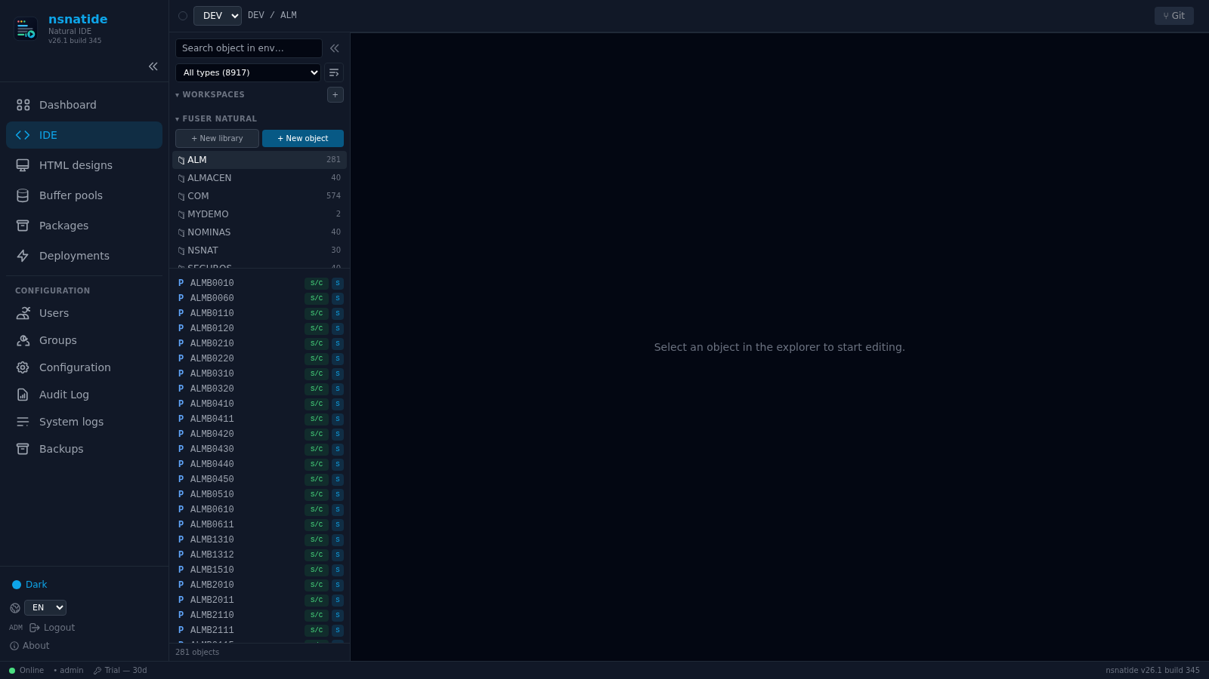
THE EXPLORER
Your whole fuser, on screen
The complete tree of libraries and objects in the Natural fuser, with the state of every object (source, catalog) and instant search.
Objects, DDM, maps and LDA
Search by name or DDM
Nothing to install on the desktop
Real NSNatIDE console: the FUSER explorer
Nacarsoft Soluciones Informáticas S.L. · nacarsoft.com · nsnatide

Slide 6
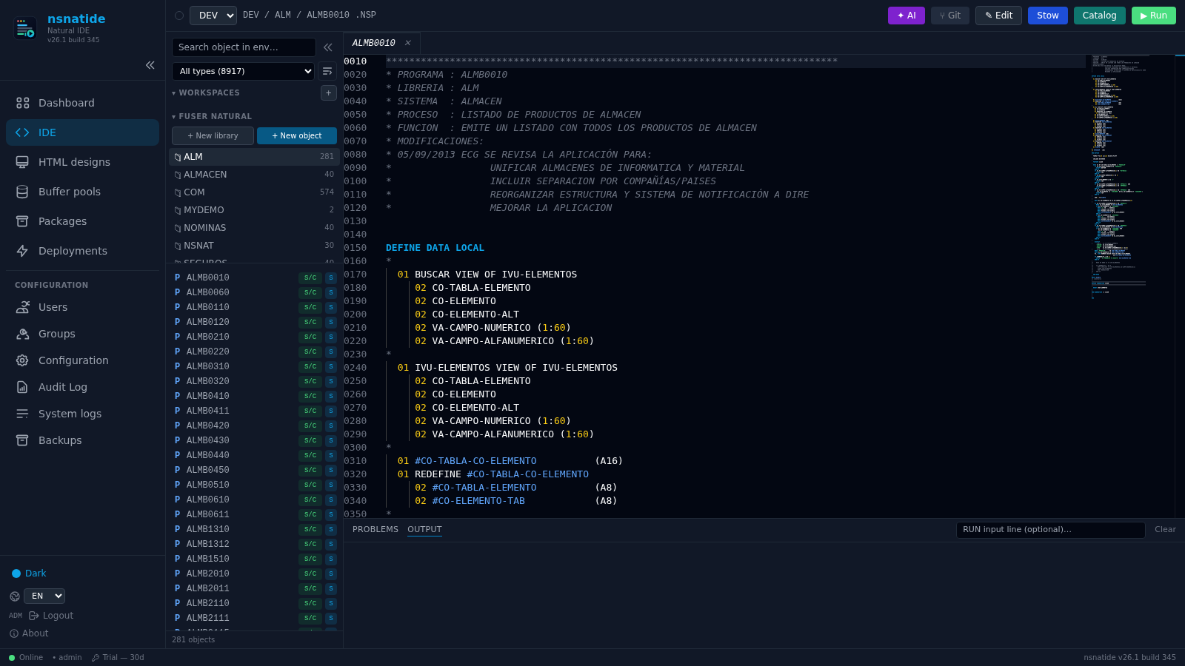
THE EDITOR
Real Natural, in the browser
Editor with syntax highlighting, minimap, compilation and compiler output: the write–compile–fix cycle without leaving the tab.
Highlighting and minimap
Compiler output
Save, stow and run
Real Natural code open in NSNatIDE
Nacarsoft Soluciones Informáticas S.L. · nacarsoft.com · nsnatide

Slide 7
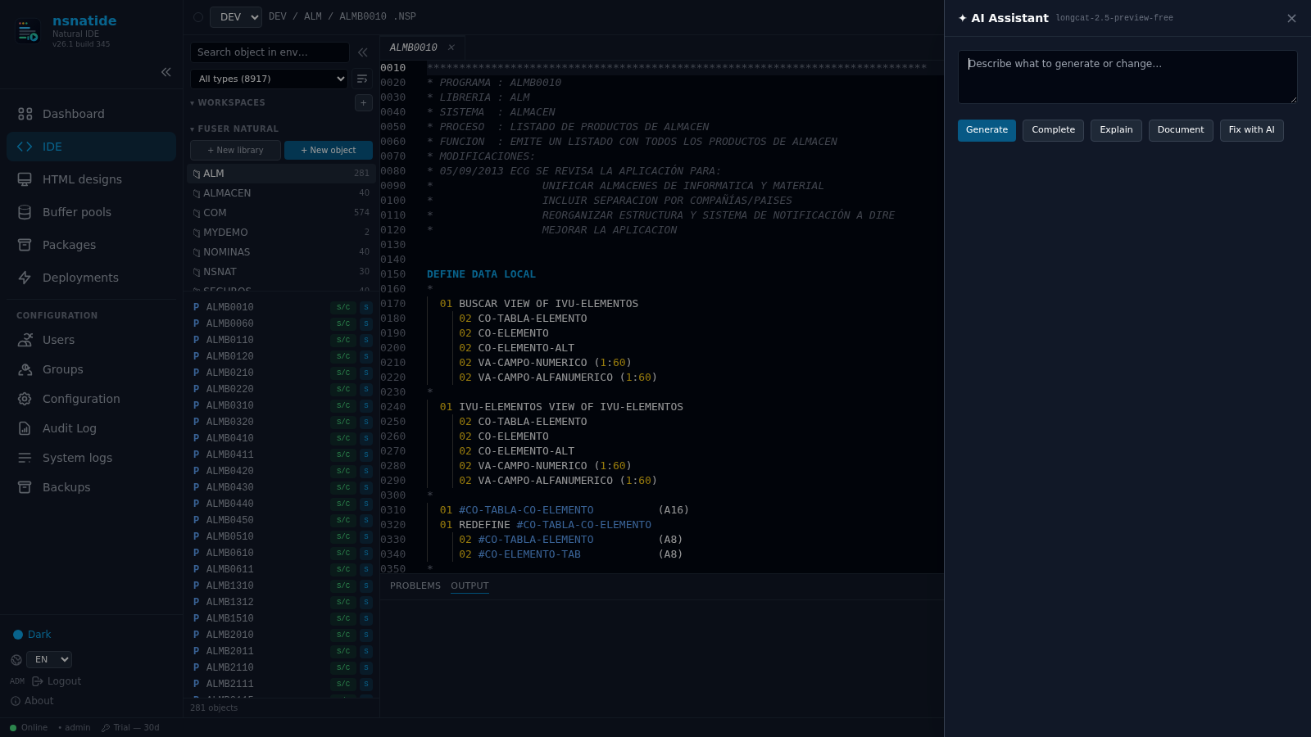
AI ASSISTANT
A second opinion on the code
The assistant generates, completes, explains, documents and fixes the open object, with the code and the DDM as context.
Generate and complete
Explain and document
Fix with AI
NSNatIDE AI panel over the editor
Nacarsoft Soluciones Informáticas S.L. · nacarsoft.com · nsnatide

Slide 8
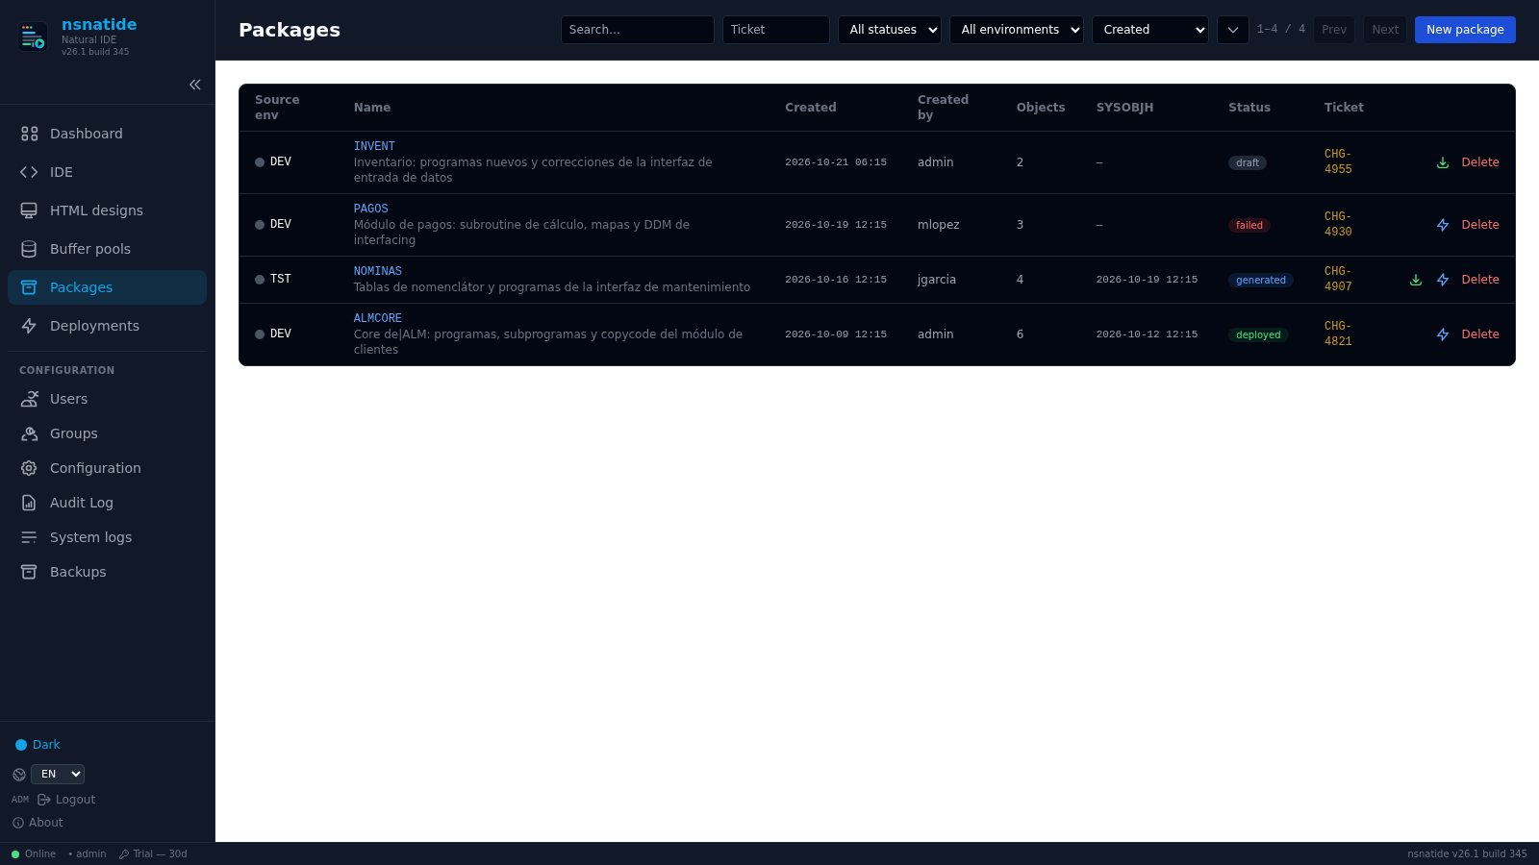
PACKAGES
Promotions with SYSOBJH and a ticket
Compose a package with the objects that changed, generate the SYSOBJH transport and leave it ready to deploy to the target environment.
Composition by library
SYSOBJH transport
Ticket and traceability
NSNatIDE distribution packages
Nacarsoft Soluciones Informáticas S.L. · nacarsoft.com · nsnatide

Slide 9
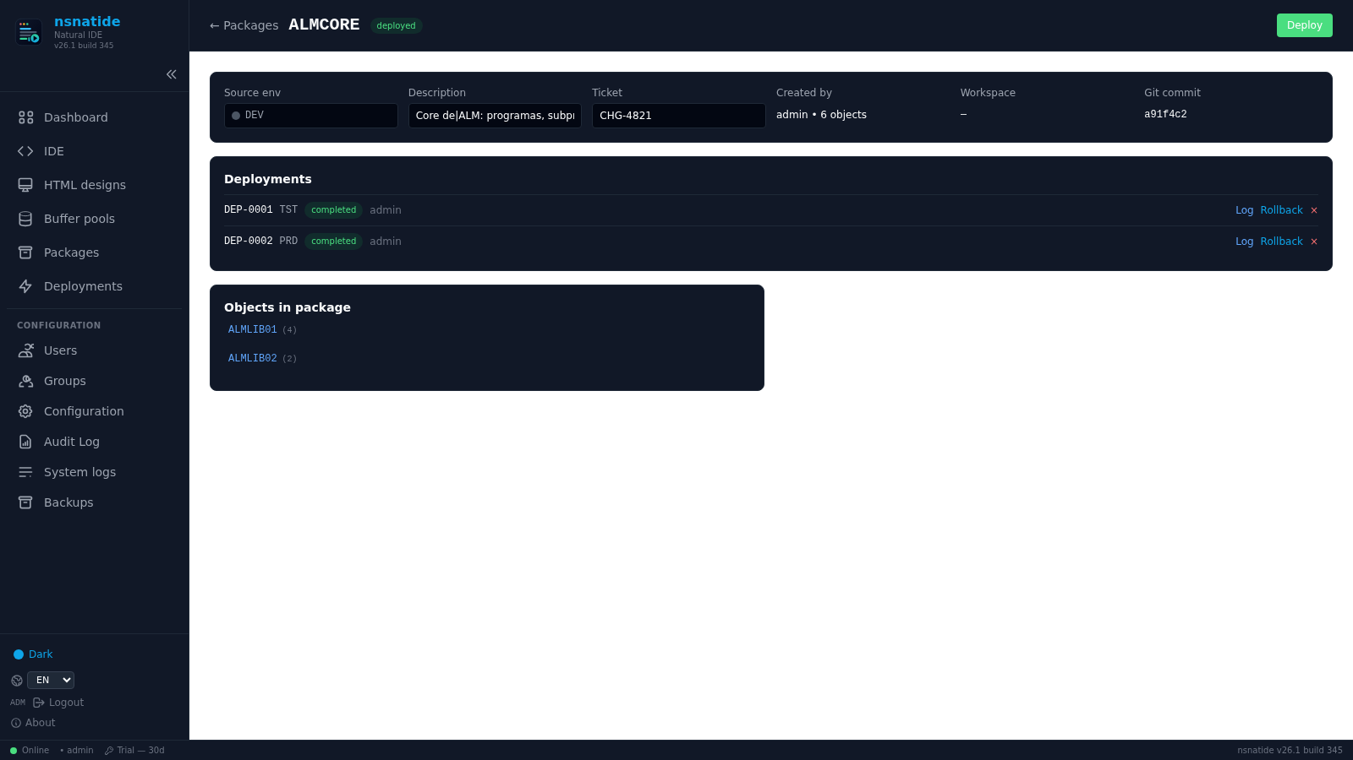
DEPLOYMENT
Every promotion, with its own history
The package detail shows the deployments to each environment, with their log, their result and the option to roll back.
Log of every deployment
Rollback available
Linked Git commit
Package detail with its deployments
Nacarsoft Soluciones Informáticas S.L. · nacarsoft.com · nsnatide

Slide 10
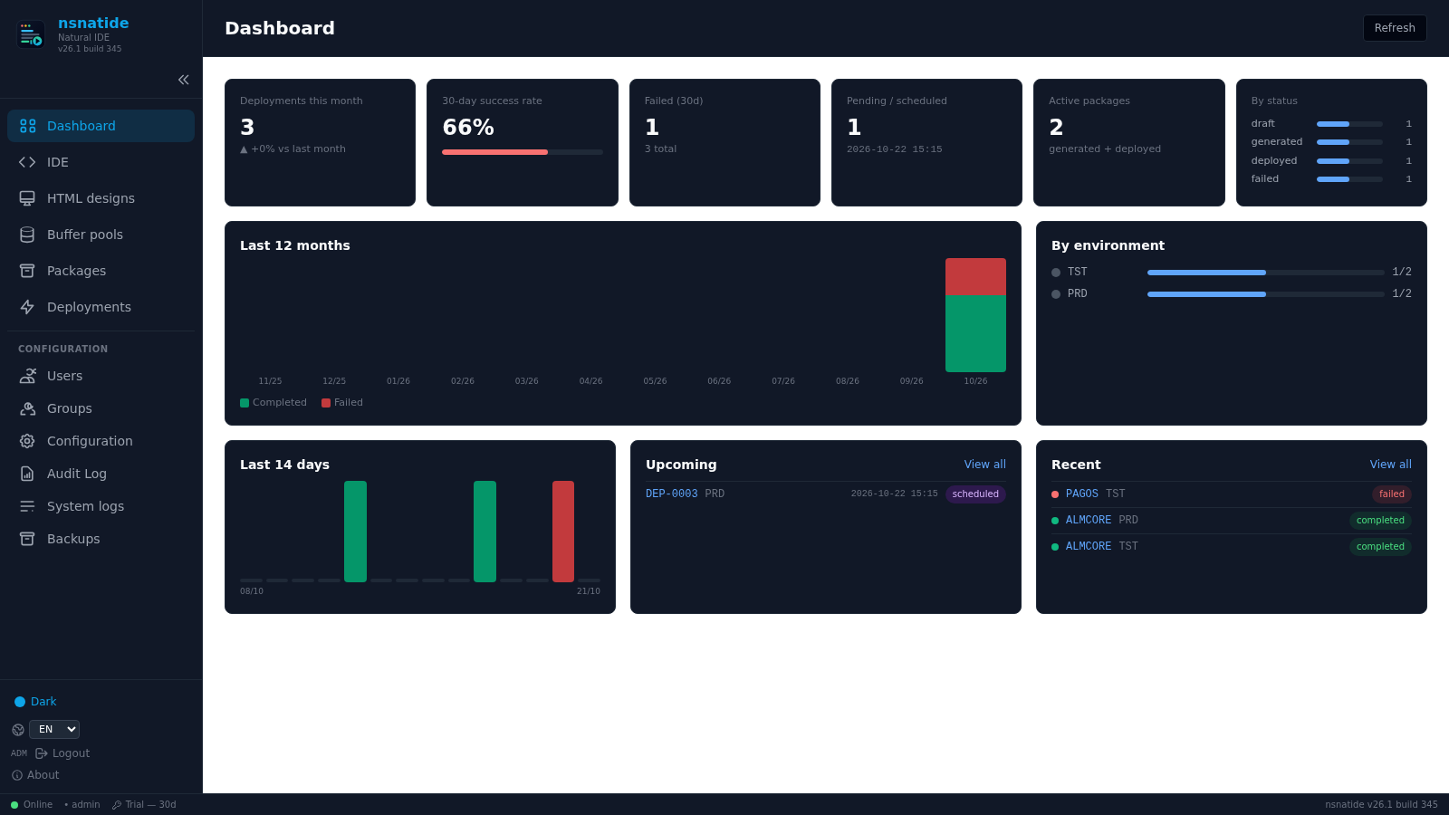
OPERATIONS
The state of your environments at a glance
Dashboard with the month's deployments, the success rate, the history per environment and the upcoming scheduled runs.
30-day success rate
History per environment
Upcoming deployments
NSNatIDE control panel
Nacarsoft Soluciones Informáticas S.L. · nacarsoft.com · nsnatide

Slide 11
FEATURES
Everything you can do
A full inventory of what NSNatIDE puts within the team's reach.
✓
Full FUSER explorer
✓
Complete Natural editor
✓
Compile and output
Libraries, objects, programs, subprograms, copycode, maps, DDM, LDA/PDA/GDA and HTML data areas.
Syntax highlighting, minimap, line numbers, find and replace, go to line, vim mode and autosave.
Compiles the object and shows the compiler output in the same screen, with the error number and line.
✓
AI assistant
✓
Integrated Git
✓
Workspaces
Generate, complete, explain, document and fix with AI, with configurable model and temperature.
Commits, branches, version comparison and per-object history, over the environment repository.
Group objects into a workspace, with its packages and deployments attached.
✓
SYSOBJH packages
✓
Deployments and rollback
✓
Backups
Composition by library, SYSOBJH transport, linked ticket and optional target compile.
Immediate or scheduled, with log, result and one-click rollback.
Per-module snapshots with immediate recovery and downloadable backup package.
✓
Compare and copy
✓
Buffer pools and audit
✓
Users, groups and RBAC
Compare libraries and objects between environments, and copy libraries in a controlled way.
State of the core buffer pools and a full audit trail of every team action.
Permissions per resource and action, with the system roles already defined.
Nacarsoft Soluciones Informáticas S.L. · nacarsoft.com · nsnatide

Slide 12
USE CASES
Where it pays off
The same use cases we solve with customers in banking, healthcare and the public sector.
01
02
03
04
Modernise without rewriting
Control the promotions
Train the team
Recover in time
A real IDE for the code that already exists, with a distributed team.
Packages, SYSOBJH, ticket and log: what goes where and why.
Any programmer logs in with their own user and learns your Natural from home.
Per-module snapshots and rollback: the incident is contained in minutes.
Nacarsoft Soluciones Informáticas S.L. · nacarsoft.com · nsnatide

Slide 13
GETTING STARTED
Install and connect in one day
Requirements
Install and first run
Linux x86-64 (RHEL 8 or RHEL 9)
SSH access to the Natural fuser server
NaturalOBJ and the compile tools in the PATH
Git in the environment (optional, recommended)
Product licence or the 30-day trial
# Install the suite
./install.sh --prefix /opt/ns
# Initialise the IDE directory
nsnatide init ./data
# Start and connect to the fuser
nsnatide start ./data --port 11033
# → in Configuration: environments, fuser, AI and Git
The console is protected by users, groups and RBAC; the audit log records every change. Without a licence: 30-day trial.
Nacarsoft Soluciones Informáticas S.L. · nacarsoft.com · nsnatide

Slide 14
FREQUENTLY ASKED QUESTIONS
What customers always ask
Does it write to the core?
Does it replace the development environment?
The editor works on the fuser over SSH with your environment's permissions. Deployment is always an explicit, audited package.
No: the team still programs in Natural. What changes is where they program, how they version and how they promote.
Do we need a licence per seat?
What if the code is old?
No: there is one product licence plus console users with permissions. The per-seat cost disappears.
It does not matter: the IDE works with the existing DDM. With AI, documentation and change summaries, old code becomes readable.
Nacarsoft Soluciones Informáticas S.L. · nacarsoft.com · nsnatide

Slide 15
NEXT STEP
The Natural they
already have, with an
IDE people use.
NSNatIDE at a glance
Full FUSER explorer and editor
AI, Git, packages and deployments
Audit trail and per-resource RBAC
Backups and immediate recovery
Ask for a demo with your own fuser: we show your explorer, your editor and a package promoted end to end.
REQUEST A DEMO →
nacarsoft.com · support@nacarsoft.com · +34 910 038 502

