Slide 1


NACARSOFT · ADABAS / NATURAL SUITE
Java · ERP · web · scripts
Your Adabas data,
exposed as a REST API
NSNatAPI
REST gateway over Natural
NSNatAPI turns your Natural subprograms into secure REST endpoints: Bearer tokens, RBAC, auditing and multi-environment. No EntireX, no RPC broker, not a single line of business logic rewritten.
NATURAL
Your .NSN subprograms
SEE HOW IT WORKS →
ADABAS
Your data, untouched
26.1 build 185 · 2 execution modes · ~1–5 ms per call
One Natural subprogram, two execution paths

Slide 2
THE PROBLEM
Adabas is a great data store, but it is not an API
01
02
03
The silo
The toll
The risk
Your data lives in Adabas and is reached through Natural subprograms. For a web app, an ERP or a phone, that is not a contract: it is an INTEGRATION.
The usual way is EntireX or an RPC broker: licences, a broker to run and maintain, and a deployment that breaks the day something changes.
Exposing Natural to the network without control: no tokens, no scopes, no auditing, no concurrency or time limits.
• Without an API, every app rebuilds the connection
• With EntireX, the infrastructure is the project
• Without control, security is a problem
Nacarsoft Soluciones Informáticas S.L. · nacarsoft.com · nsnatapi

Slide 3
WHAT IT IS
A gateway, not a proxy
NSNatAPI sits between your applications and Natural. Your business programs stay exactly the same .NSN: they are not rewritten, not compiled by nsnatapi, and their contract never changes. What changes is how callers reach them.
0
1–5 ms
EntireX, brokers or
daemons in Natural
per call in session
mode (measured)
✓
REST endpoints defined in the console: method, path, environment, program and fields.
✓
Two execution modes per endpoint: batch (ephemeral process) or session (persistent pool).
2
195k
✓
Bearer tokens scoped per endpoint, with expiry, revocation and IP allowlist.
✓
Admin console with RBAC (roles and groups), TOTP 2FA and hot configuration.
execution modes
per endpoint
calls audited in
the certification
✓
Every call audited with metadata only: never the request or response bodies.
Nacarsoft Soluciones Informáticas S.L. · nacarsoft.com · nsnatapi

Slide 4
ARCHITECTURE
From application to data: two paths, one program
Consuming services
Java / Backend
ERP
Scripts & cron
Microservices
Web portal
Mobile app
iPaaS / SOAP
NSNatAPI — REST gateway
REST /api/ext
REST /api/ext · Bearer + RBAC · rate limit · auditing · interactive OpenAPI
HTTP 200 · rc · output · duration_ms
BATCH MODE
SESSION MODE
One ephemeral Natural process per call
Pool of persistent sessions that open the connection
LOGON → CALLNAT → FIN. Total isolation. 30–90 ms.
LOGON to the library and the session STAYS OPEN, reused. 1–5 ms.
NATURAL
Natural runtime · NSNAT libraries · NATBP buffer pool · FUSER per environment
Open connections: 1 per pooled session (one buffer-pool user each)
ADABAS
Business files: READ / WRITE / ST
Same .NSN subprogram, same contract, same data. Only the caller of the connection — and how long it is kept — changes.
Nacarsoft Soluciones Informáticas S.L. · nacarsoft.com · nsnatapi

Slide 5
HOW IT WORKS
From the HTTP request to your subprogram
1
Authenticate
2
Resolve
3
Bind
4
Execute
5
Envelope
Bearer nstm_…: hash, scope, expiry, revocation, CIDR and rate limit.
Method and path template pick the endpoint; the token decides whether it may call it.
Path captures + query/body → a single line ≤240 joined with the endpoint separator.
Stub NX000042 (batch) or the NSRPDRV driver (session) calls your .NSN with CALLNAT.
The reply comes back fragmented and is reassembled into output, with rc and duration.
curl -H "Authorization: Bearer nstm_…" \
http://host:11032/api/ext/v1/saldo/001234
HTTP/1.1 200 OK
{ "ok": true, "rc": 0,
"output": "SALDO 1234.56",
"duration_ms": 22 }
HTTP 200 = it ran. The business error travels in rc: the client always tells the two apart.
output · rc · data · duration_ms
Nacarsoft Soluciones Informáticas S.L. · nacarsoft.com · nsnatapi

Slide 6
EXECUTION MODES
Two modes, one program contract
BATCH (default)
SESSION (opt-in)
One Natural process per call
Pool of persistent Natural sessions
Start-up
~30–90 ms on every call
Start-up
~1–5 ms with a warm pool
Isolation
Total: a new process per call
Isolation
Session shared across calls
CPU / start-up
High under heavy load
CPU / start-up
Low: the pool is reused
Risk
None: ephemeral process
Risk
A fatal error recycles the session (automatic)
Best for
Low/medium traffic, strict isolation
Best for
Polling and high-frequency lookups
Pick the mode per endpoint, in the console (Endpoints → Execution mode) or via API with exec_mode.
Nacarsoft Soluciones Informáticas S.L. · nacarsoft.com · nsnatapi

Slide 7
THE NATURAL MODULE
Your programs do not change. Only the input and the output.
0010* CPOLIZA - policy lookup
0020DEFINE DATA PARAMETER
00301 #PARM-IN (A) DYNAMIC
00401 #PARM-OUT (A) DYNAMIC
00501 #RESP (I4)
0060END-DEFINE
0070RESET #PARM-OUT #RESP
0080* ... your business logic ...
0090MOVE 'BAL 1234.56' TO #PARM-OUT
0100MOVE 0 TO #RESP
0110END TRANSACTION
0120END
✓
Three parameters, always
#PARM-IN (A) DYNAMIC, #PARM-OUT (A) DYNAMIC and #RESP (I4). The house convention.
✓
End with END
Never STOP or LOGON: in session mode they would kill the driver.
✓
No state between calls
No globals or AIVs; always END TRANSACTION or BACKOUT.
✓
Short name
A-Z0-9-_, max 8 characters, uppercase.
nsnatapi never recompiles your programs: it only generates and compiles the stub or driver that calls them.
Nacarsoft Soluciones Informáticas S.L. · nacarsoft.com · nsnatapi

Slide 8
RESPONSES
The business decides the outcome; HTTP only carries it
HTTP 200 · the envelope
Response modes
ok
true
The call ran
output only. rc is what matters.
text
rc
0
Business #RESP: 0 = ok, >0 = business error
output
"BAL 1234.56"
Raw #PARM-OUT text (verbatim)
fields
The program returns separated positions and the endpoint types them into data.
data
{ "balance": 1234.56 }
Only in the fields and json modes
duration_ms
22
Call duration
json
The program returns valid JSON and nsnatapi validates and publishes it in data.
rc ≠ 0 is still HTTP 200. The client tells a business error from a technical failure.
Machine API error codes
400
401
403
404
413
429
502
503
504
Nacarsoft Soluciones Informáticas S.L. · nacarsoft.com · nsnatapi

Slide 9
SECURITY
Every request goes through a filter
Bearer tokens
Console RBAC
TOTP 2FA
192 bits, SHA-256 hash with pepper, per-endpoint scope, expiry, revocation, rotation and CIDR allowlist.
Roles → groups → users. Permissions are the union. No is_admin. Anti-lockout for the last admin.
Optional second factor per account, with password confirmation to disable it.
Strict validation
Auditing without bodies
Licence and network
Everything reaching Natural or the FUSER is validated: no shell with user data, no path traversal.
Every call leaves metadata: environment, library, mode, PID, duration, error. Never the body.
Without a valid licence, login and the machine API answer 403. Only loopback is a trusted proxy by default.
Nacarsoft Soluciones Informáticas S.L. · nacarsoft.com · nsnatapi

Slide 10
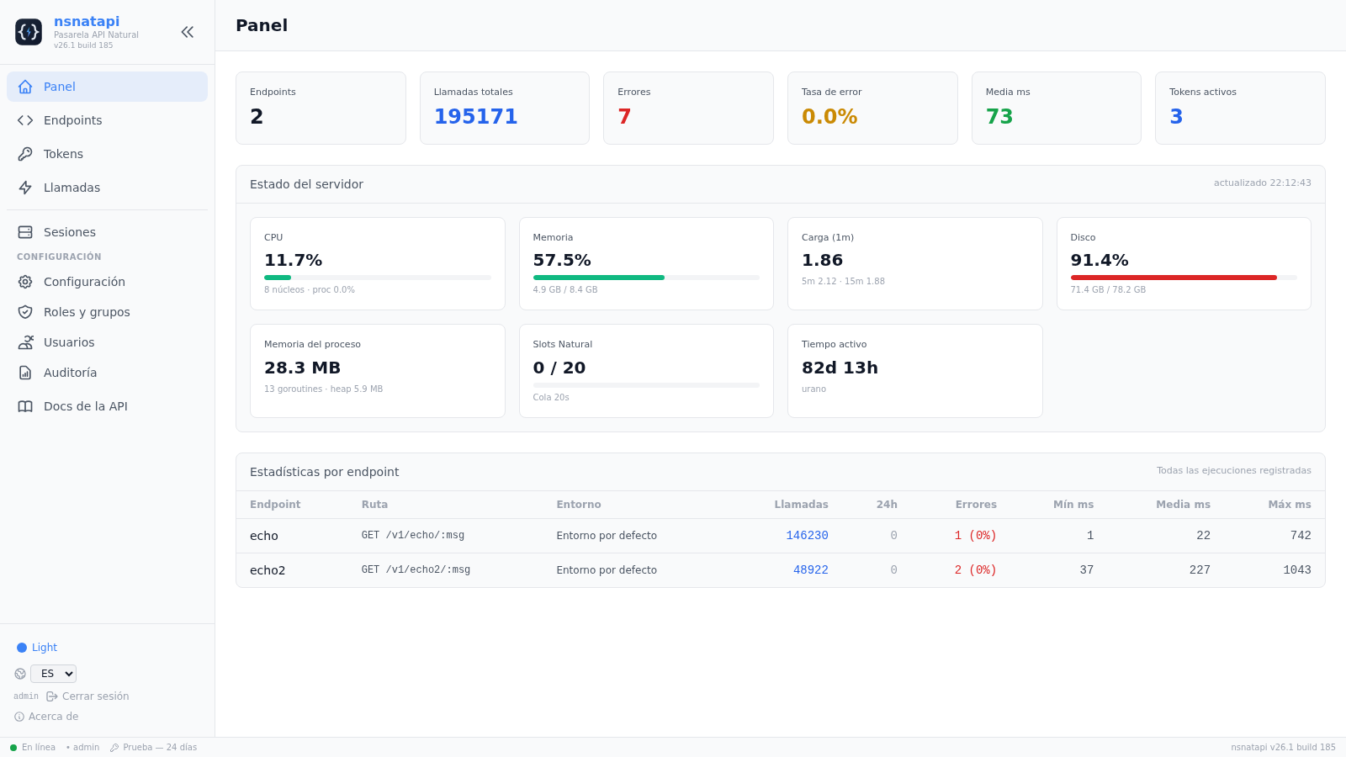
OBSERVABILITY
What happens in Natural, in plain sight
•
Live server telemetry: CPU, memory, load, disk, RSS, heap and goroutines, refreshed every 5 s.
•
Session panel: PID, state, uptime, last call, calls served, errors, latency, CPU and memory per session.
•
Call log with environment, library, execution mode and session PID: every call is correlated with its session.
•
Hot actions: warm up, restart, kill a given session or resize the pool.
All of it from the console, without SSH-ing into the box.
Nacarsoft Soluciones Informáticas S.L. · nacarsoft.com · nsnatapi

Slide 11
CAPACITY
Measured capacity, not promises
SESSION MODE · DEV pool of 4 sessions
BATCH MODE · one process per call
Clients
rps
p50
p95
Errors
Clients
rps
p50
p95
Errors
1
106
7.8 ms
19.5 ms
0
1
8.4
111 ms
191 ms
0
4
251
13.9 ms
31.3 ms
0
4
25.7
148 ms
230 ms
0
8
312
23.1 ms
47.7 ms
0
8
40.0
192 ms
285 ms
0
16
321
46.9 ms
79.9 ms
0
12
42.2
258 ms
483 ms
0
Session certificate: 16 concurrent clients (~320 rps, p95 80 ms, 0 errors)
Batch certificate: 8 concurrent clients (~40 rps, p95 285 ms, 0 errors)
Closed-loop load with no think time and trivial programs: this is the platform ceiling, not the business one. 15-minute soak: 61,225 calls, 0 errors.
Nacarsoft Soluciones Informáticas S.L. · nacarsoft.com · nsnatapi

Slide 12
MULTI-ENVIRONMENT
One endpoint, one environment: DEV, TST and PRD never mix
DEV
6 sessions
TST
2 sessions
PRD
to be defined
NATBP · fuser=22,20 · FUSER /data/ns/fusers/dev
NATTST · fuser=22,30 · FUSER /data/ns/fusers/tst
Own buffer pool and FUSER
Own FUSER + buffer pool
Own FUSER + buffer pool
Own FUSER + buffer pool
✓
Each environment declares its Natural binary, sagenv, buffer pool, NATPARM and FUSER.
The same nsnatapi binary serves all three: the destination changes, not the code.
✓
The endpoint picks the environment; the default environment covers those that do not.
✓
The session pool is sized per environment: 3 sessions in DEV and 8 in TST coexist without mixing.
DEV · TST · PRD
✓
Calls are recorded with their environment, and the Calls page filters by it.
Nacarsoft Soluciones Informáticas S.L. · nacarsoft.com · nsnatapi

Slide 13
USE CASES
Where it pays off from day one
Back-office lookups
Capture and entry
Payment gateways
Balances, policies, catalogues: a query from the web without opening the terminal.
Entry forms writing into Adabas with the business validation inside the program itself.
A POST endpoint with its business rc: the app tells 'rejected' from 'down'.
Mobile radar
ERP / iPaaS integration
Progressive modernisation
High-frequency lookups in session mode, at millisecond cost.
The ERP calls over HTTP; if it speaks JSON, the endpoint publishes typed data.
Migrate endpoint by endpoint, without rewriting the Natural business logic or stopping it.
Nacarsoft Soluciones Informáticas S.L. · nacarsoft.com · nsnatapi

Slide 14
GETTING STARTED
Up and running in four steps
1
Install and start
2
Create the endpoint
3
Deploy the stub
4
Issue a token and call
nsnatapi init ./data
nsnatapi start ./data
POST /api/endpoints
{
method, path_template,
library, program,
environment, fields_json
}
POST /api/endpoints/1/deploy
(ftouch + STOW in the
environment FUSER)
nsnatapi token ./data \
--name java-prd \
--endpoint saldo
curl -H "Authorization: \
Bearer nstm_..." \
http://host:11032/api/ext/
v1/saldo/123
The web console (Configuration, Endpoints, Tokens, Sessions) covers the rest: RBAC, environments, auditing and hot tuning.
Nacarsoft Soluciones Informáticas S.L. · nacarsoft.com · nsnatapi

Slide 15
REQUIREMENTS
What your environment needs
Requirements
Licence
• Linux RHEL 8 or 9 (x86-64).
• Software AG Natural and Adabas client (sagenv), with the buffer pool running.
• FUSER with the business subprograms, readable and writable for deployment.
• A reverse proxy with HTTPS in production (nsnatapi does not serve TLS itself).
• One Natural per environment: DEV, TST and PRD may point at different installs.
• Per-installation licence, with machine fingerprint and validity.
• Without a valid licence, login and the machine API answer 403.
• 30-day trial on install, no key needed.
• List price: €7,900 / €6,320 annual renewal.
The licence is checked at login and on every machine call: the inside of Adabas stays protected.
Nacarsoft Soluciones Informáticas S.L. · nacarsoft.com · nsnatapi

Slide 16
NEXT STEP
Your data is already in Adabas.
Only the door is missing.
NSNatAPI opens it: with tokens, with scope, with auditing and with whichever execution mode you need. Without rewriting your Natural logic and without EntireX.
1. 30-minute demo with your own subprograms
2. Trial in DEV with one real endpoint
3. Rollout to TST and then to PRD
REQUEST INFO · nacarsoft.com
Nacarsoft Soluciones Informáticas S.L. · Adabas / Natural Suite · nsnatapi 26.1 build 185

