Slide 1


NACARSOFT · GESTOR DE FICHEROS WEB
Your server files,
in the browser. No downloads.
Browser
Tablet
Phone
desktop
iPad
iPhone
HTTPS · a single binary
NSFS publishes the file system as a web application: you browse the folders and see the files straight in the browser, from the PC, the tablet or the phone, without downloading anything.
NSFS
web file manager
SEE FEATURES →
Local server
Remote servers
published folders and ACL
SFTP with encrypted credentials
Published folders · In-browser viewer · SFTP connections
Seen in the browser: text, image, PDF, Office, binary and logs
folders · preview · search · sftp · audit

Slide 2
EL PROBLEMA
The server files, reached by downloading
Folders shared over FTP or SCP, files pulled down to the laptop just to open them, and whole directories nobody knows who has touched.
01
Everything by download
02
Loose folders
To read a log you have to pull it, open it locally and upload it back if you need to fix something.
Every workstation decides who gets what. There is no single place to see who can reach what.
03
No identity
04
No trace
Access to a file server is spread across system accounts, with no groups and no roles.
What was downloaded, from where and by whom is not recorded anywhere.
• Downloads and copies
• Per-user permissions
• Zero traceability
Nacarsoft Soluciones Informáticas S.L. · nacarsoft.com · nsfs

Slide 3
QUÉ ES
The server file manager, as a website
NSFS is a self-hosted file manager in a single binary: the administrator publishes the folders and their permissions, and every user browses, previews and works with the files from the browser, with nothing to install.
0
1
downloads to read
binary, no dependencies
✓
Published folders (shares) assigned to groups, with permissions per connection and prefix
✓
In-browser viewer: text, code, image, PDF, Office, binary and live log
6
10
✓
Remote connections over SFTP with the credentials encrypted at rest
languages and 6 themes
per-connection permissions
✓
Content index and full-text search inside the files
Nacarsoft Soluciones Informáticas S.L. · nacarsoft.com · nsfs

Slide 4
ARQUITECTURA
How a file reaches the screen
1
2
3
4
5
Browser
Session and RBAC
Backend
Viewer
Record
The published folder opens in the web, with its ACL and session.
Cookie + JWT: user, group, roles and per-prefix permissions.
LocalFS on the server, or SftpFS over the remote connection.
The content is served to the viewer, never through the user disk.
Every operation lands in the audit log and in the event feed.
⚠ Reading a file is not downloading it: the bytes go from the server to the viewer, not to the user disk.
No FTP
No SCP
A single binary
Nacarsoft Soluciones Informáticas S.L. · nacarsoft.com · nsfs

Slide 5
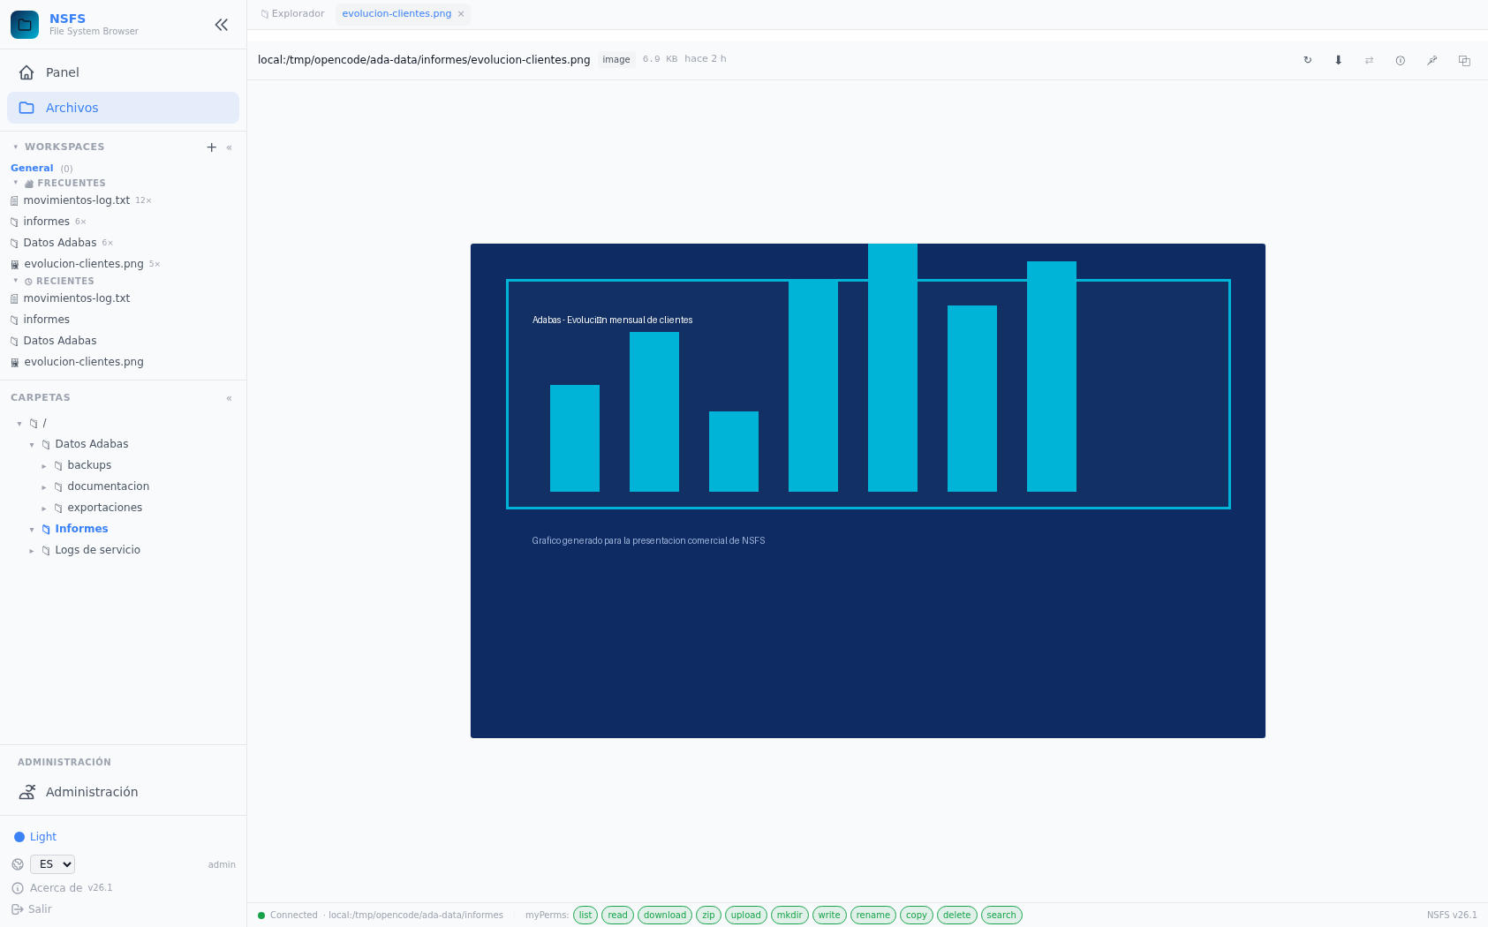
SEE WITHOUT DOWNLOADING
The file opens in the browser
NSFS is not a download browser: the content is rendered in the page itself, with the tools each file type asks for.
Text and code
Image
Monaco with line numbers, word wrap and syntax highlighting.
Shown inline, with zoom and without touching the local disk.
PDF
Office
Full document, with scrolling and search.
Word, Excel and PowerPoint are read in the web, without Office.
Binary
Log
Hexadecimal viewer with patch editing.
Live tail: the log is followed while it is written.
Image viewer: the file is shown in the page itself, with its path, size and date.
Editing and saving on the server is optional: by default, looking leaves no trace and no local copy.
Nacarsoft Soluciones Informáticas S.L. · nacarsoft.com · nsfs

Slide 6
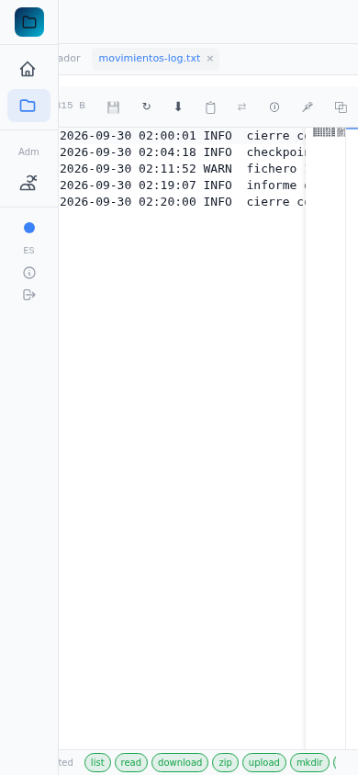
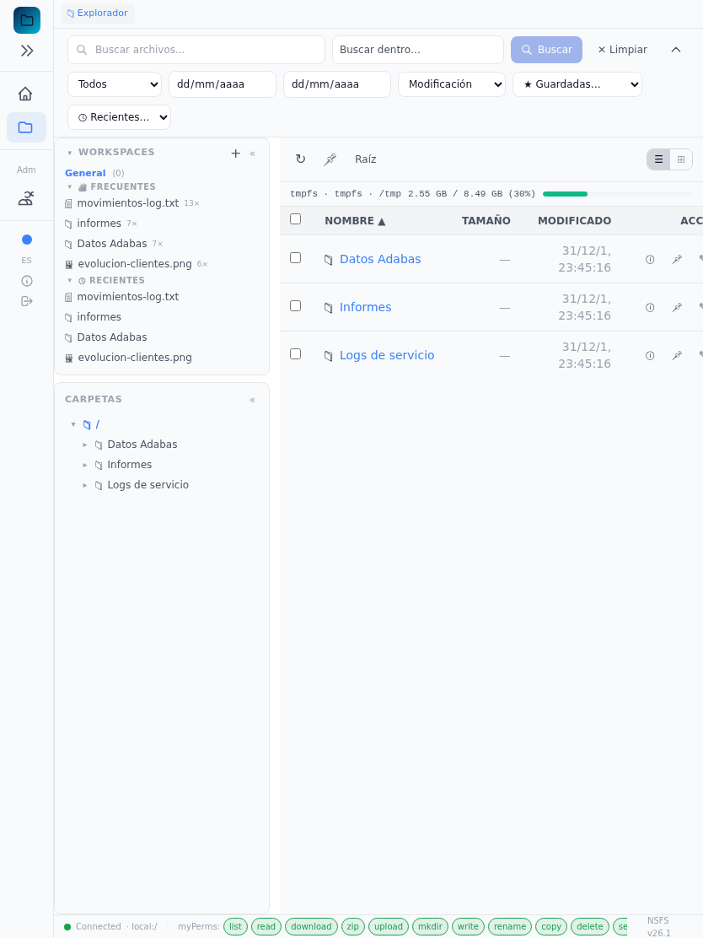
CONEXIONES
From the browser, the tablet or the phone
The very same URL works on the PC, the tablet and the phone
On a narrow screen the sidebar folds and the content takes the width
Files open in tabs: several at once, and you come back to them
No plugins, no file client and no local folder permissions
Browsing and looking require nothing to be installed: just the user session.
Tablet: the folder list with the sidebar folded.
Phone: the log opened on the phone, without downloading it.
Nacarsoft Soluciones Informáticas S.L. · nacarsoft.com · nsfs

Slide 7
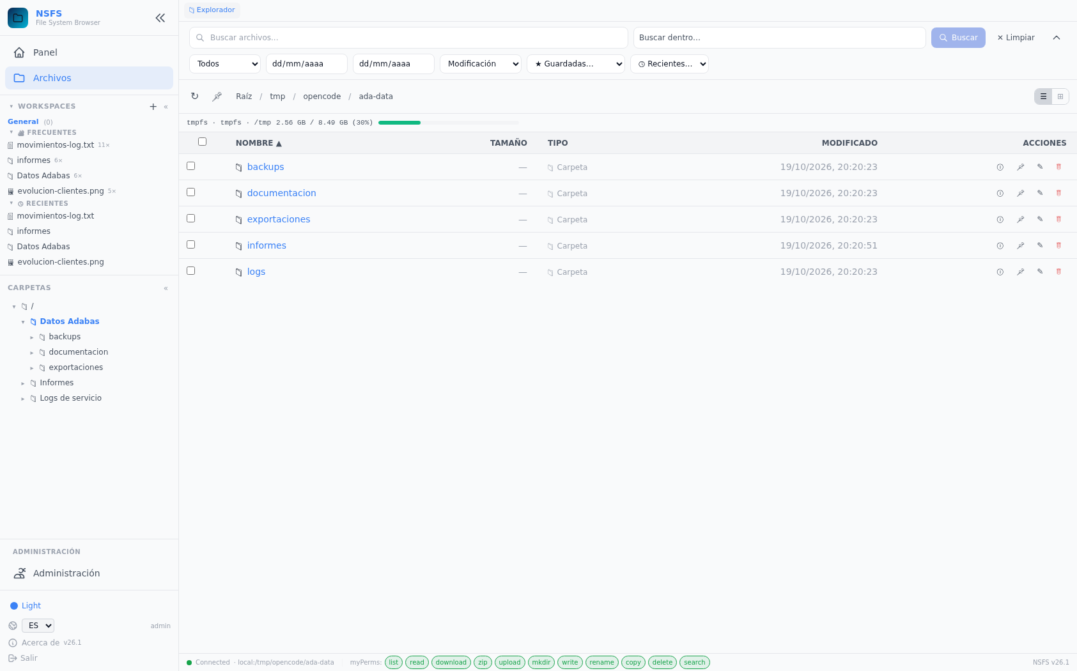
CARPETAS
Published folders: the access is defined once
The administrator creates the folder (id, name, connection and root path)
Assigns it to the groups that should see it
Each group can have different permissions over the same folder
The user only sees what their group allows
Folder paths live in the database, not in the configuration file
Adding a user to a group is the whole access management that is needed.
Explorer: the tree of published folders on the left and the content on the right.
Nacarsoft Soluciones Informáticas S.L. · nacarsoft.com · nsfs

Slide 8
REMOTO
Remote servers over SFTP, nothing to mount
Named connections: host, port, user and authentication
Credentials encrypted at rest with AES-256-GCM
Connection pool with keepalive and automatic reconnect
Credentials are never written to the log
Connection test from the panel itself
Servidor remoto
NSFS
SFTP
cifrado
Otro servidor
One file server, with each team's folders, on the same screen.
AES-256-GCM en reposo · pool con keepalive · nunca en el log
Nacarsoft Soluciones Informáticas S.L. · nacarsoft.com · nsfs

Slide 9
BÚSQUEDA
Search inside the files, not only in their names
Content index: text, log, CSV, JSON, XML, code and Office files
Local index every few minutes, remote one every half hour
Search by name, by content and by date range
Streaming results, without waiting for everything to finish
Detection of external changes (for instance an FTP upload)
Indexador
Extrae el contenido
Buscador
Índice local
Cada 5 minutos
Resultados en streaming, con los permisos del usuario ya aplicados.
Índice SFTP
Cada 30 minutos
Saved searches: the queries you repeat, one click away.
Búsqueda
Por nombre y contenido
Nacarsoft Soluciones Informáticas S.L. · nacarsoft.com · nsfs

Slide 10
OPERACIÓN
Day-to-day file operations
Copy between servers
Move and rename
Package
Work in the background, with progress and cancellation.
In bulk, with a preview of what is going to change.
A ZIP of the folder or the selection, on the spot.
Upload and create
Workspaces
Bookmarks and recents
Drag and drop uploads, and folder creation.
A set of folders and paths, opened in one click.
The folders you use most, always at hand.
Todo lo que se hace con un fichero queda registrado: operación, usuario, ruta y resultado.
Nacarsoft Soluciones Informáticas S.L. · nacarsoft.com · nsfs

Slide 11
SECURITY
Who sees what, and everything is recorded
Access control
Traceability
Data
Users → groups → roles → permissions
Permission per connection and path prefix
Access rules per user and group
No binary admin
JSONL audit log per day
Operation, user, path and result
Live event feed
Log retention and rotation
Encrypted SFTP credentials
Paths jailed to the root
TLS at the reverse proxy
30-day trial and machine license
config.yaml 0600 · bcrypt · JWT HS256 · AES-256-GCM for the remote credentials
Nacarsoft Soluciones Informáticas S.L. · nacarsoft.com · nsfs

Slide 12
GETTING STARTED
From zero to published folders, in three steps
1
Create the environment
REQUIREMENTS
nsfs init /opt/nsfs: it creates config.yaml, the SQLite database, the index and the logs, with the admin user.
Linux (RHEL 8 / RHEL 9)
A single binary, no dependencies
SQLite for state and audit
Reverse proxy with HTTPS in production
Web panel on port 11000
2
Publish the reverse proxy
Terminate TLS at the proxy and forward to https://server:11000. Users come in through the browser.
3
Publish the folders
Administration → Folders: create the folder, pick the connection and the root path, and assign it to the groups.
nsfs init /opt/nsfs → nsfs start /opt/nsfs → https://files.company.local
Nacarsoft Soluciones Informáticas S.L. · nacarsoft.com · nsfs

Slide 13
FREQUENTLY ASKED
The questions we hear most
Is it a download manager?
How is a user onboarded?
No. The goal is to see the file in the browser: the content is served to the viewer, not to the user disk. Downloading is an option, not the normal path.
Administration → Users: the account is created and assigned to a group. The groups are what see the folders and their permissions.
Can it show folders from another server?
What if a user makes a mistake?
Yes: add an SFTP connection with its encrypted credentials and point the published folder at that connection and its root path.
The audit log records every operation with its user, its path and its result, and it can be consulted from the panel.
Can I search inside the files?
Does it need FTP or SSH permissions?
Yes: the indexer extracts the content of text, log, CSV, JSON, XML, code and Office files, so the search finds inside, not only by name.
No. HTTPS only: users come in with their web session, and each group's access to each folder is what you define.
Nacarsoft Soluciones Informáticas S.L. · nacarsoft.com · nsfs

Slide 14
Your files, open
in the browser and under control
Try NSFS with your server: we set it up with your folders and watch it run.
Guided demo
Try it in your environment
Let's talk about your case
nacarsoft.com · support@nacarsoft.com
Nacarsoft Soluciones Informáticas S.L. · nacarsoft.com · nsfs

