Slide 1

NACARSOFT ADABAS SUITE
nsdeploy
Natural Software Deploy
Automated deployment of Natural objects across ADABAS environments.
Web-based, secure, with full traceability of every deployment.
SEE FEATURES →
For Natural teams · ADABAS · SYSOBJH
Nacarsoft Soluciones Informáticas S.L. · nacarsoft.com

Slide 2
THE PROBLEM
Deploying Natural objects shouldn't
be so complex
01
Manual processes
02
No traceability
Hand-run SYSOBJH transfers: loose commands, repetitive steps and human errors.
Nobody knows for sure what was deployed, when, to which environment or by whom.
03
Slow and costly
04
Inconsistent environments
Every deployment eats hours of operations work and blocks the team.
DEV, TST and PRD drift apart through uncontrolled, non-reproducible processes.
Does this sound familiar?

Slide 3
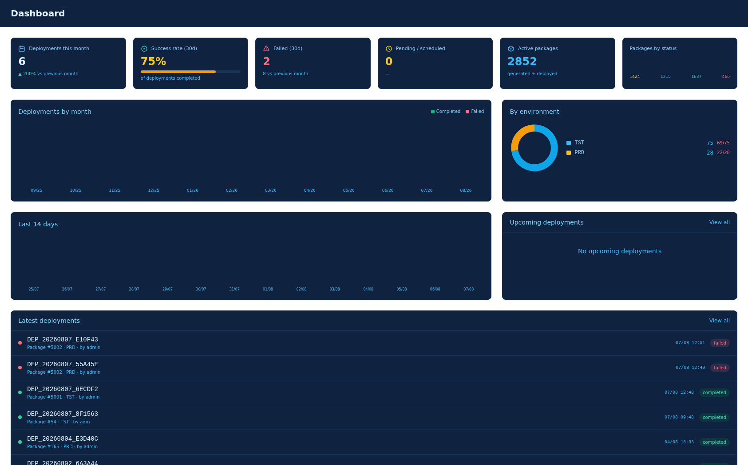
THE SOLUTION
nsdeploy
Web platform for continuous deployment of Natural objects on ADABAS:
build packages, browse FUSER libraries, transfer and deploy in one click.
✓
Full automation
of the pipeline: compile, transfer and deploy
✓
Complete traceability
of every action: who, what, when and result
✓
Multi-environment
DEV → TST → PRD with independent configurations
✓
Access control
through roles, groups and granular permissions
Nacarsoft Soluciones Informáticas S.L. · nacarsoft.com

Slide 4
FEATURES
Everything you need to deploy with confidence
✓
Package Manager
✓
Deploy Pipeline
Packages with automatic ID, ticket and objects grouped by library.
Compile, transfer (SSH) and deploy in a single click.
✓
RBAC
✓
Multi-environment
Users, groups, roles and granular permissions.
DEV, TST, PRD with independent configurations.
✓
FUSER Explorer
✓
Audit
SRC/GP library tree with search and filters.
Immutable record of every deployment and action.
✓
Security
✓
Multi-language
Secure sessions, encrypted passwords and managed SSH keys.
EN/ES interface with 7 visual themes.

Slide 5
PACKAGES
Package management
Each package is a complete deployment unit: identifiable, organised and traceable.
Automatic ID
Objects by library
Flexible import
20260804_LIB1_4F2A9C
Grouped with persistent custom order (▲▼).
Paste LIB= lists from logs or import from the FUSER tree.
date · creator alias · unique suffix
Integrated ticket
Integrity control
External ticket code (JIRA, ServiceNow) on every package.
Dependencies and objects verified before deploying.
Nacarsoft Soluciones Informáticas S.L. · nacarsoft.com

Slide 6
FUSER EXPLORER
Explore the Natural file system
Environment library tree with level-by-level expansion
SRC / GP indicators on every module (source and generated)
Object types: NSP program · NSM map · NSS subroutine · NSC copycode
NS7 dialog · NSA adapter · NSD ddm
Search by library or module and filter by type
Per-environment cache with automatic warm-up (or always fresh)
Library Browser
TST · FUSER
▸
LIB3
4
▾
LIB1
6
▸ prog1
pro
▸ prog2
map
▸ prog3
sub
▸
LIB2
5
▸
LIB4
3
✓ 3 modules · 3 libraries

Slide 7
PIPELINE
Four steps, one click
01
→
02
→
03
→
04
Create Package
Configure Environment
Deploy
Audit
Select objects from the FUSER tree and generate the package with its automatic ID.
SSH server, FUSER paths, NATPARM, SAGENV and buffer pools.
Compiles with Natural, transfers and deploys via SYSOBJH.
Logs, status, history and email notifications.
EN/ES multi-language · Email notifications · Real-time dashboard
Nacarsoft Soluciones Informáticas S.L. · nacarsoft.com

Slide 8
INTEGRATION
Natural / ADABAS deployment
Generates and runs SYSOBJH scripts automatically
SSH connection with keys managed from the UI
Configurable parameters: NATPARM, SAGENV and buffer pools
Local or remote execution (sagenv + natural -batch)
SCANALL: full library verification before upload
Natural / ADABAS environments
DEV
DBID 150
Development
↓
TST
DBID 200
Testing
↓
PRD
DBID 300
Production
Secure transfer via SSH / SCP

Slide 9
SECURITY
Access control and security
RBAC — Role Based Access Control
Security features
User
→
Group
→
Role
→
Permission
✓ Hashed passwords (bcrypt)
✓ Sessions with automatic expiration
✓ SSH keys managed from the UI
✓ Immutable audit logs
✓ Password recovery by email
✓ Permission middleware across the whole API
Predefined roles
Admin
12 permissions · full management
Deployer
5 permissions · deploy and read
User
3 permissions · basic access
Nacarsoft Soluciones Informáticas S.L. · nacarsoft.com

Slide 10
CONFIGURATION
Frictionless environments and configuration
DEV
TST
PRD
Development
Testing
Production
✓ Server and FUSER paths
✓ Own SSH keys
✓ Active cache
✓ Execution buffer pools
✓ NATPARM / SAGENV
✓ Pre-validation
✓ Restricted permissions
✓ Strict auditing
✓ No cache if required
Structured configuration editor in the web · No hand-edited YAML · Apply changes without restarting

Slide 11
OPERATIONS
Built for the day-to-day
✓
Email notifications
✓
Password recovery
SMTP with TLS/STARTTLS or sendmail. Result of every deployment instantly.
Expiring tokens sent automatically by email.
✓
EN/ES multi-language
✓
7 visual themes
Full interface in both languages, instant switching.
Dark, Light, Ocean, Forest, Sunset, High Contrast and Custom.
✓
Real-time dashboard
✓
Batch operations
Deployment status, history and filtered search.
Add and import objects grouped by library in a single call.
Nacarsoft Soluciones Informáticas S.L. · nacarsoft.com

Slide 12
DASHBOARD
All your deployment status in real time
Package overview by status: draft, generated, deployed and failed
Recent packages with environment, status and direct access
Recent deployments with status and actions
Quick access to packages, deployments and configuration

Slide 13
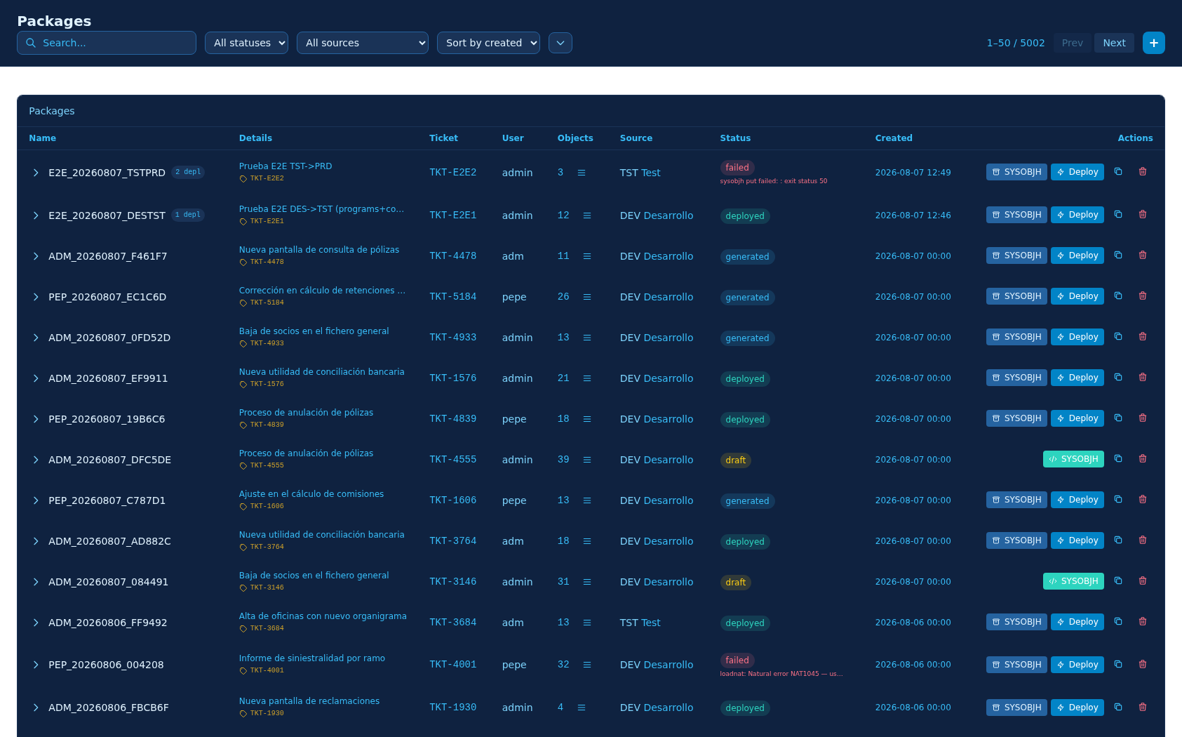
PACKAGES
Build and manage packages from the web
Package list with automatic ID, ticket, user and object count
Filters by status and by environment: DEV, TST, PRD and UAT
Description and source environment of every package
Actions: view modules and deploy via SYSOBJH

Slide 14
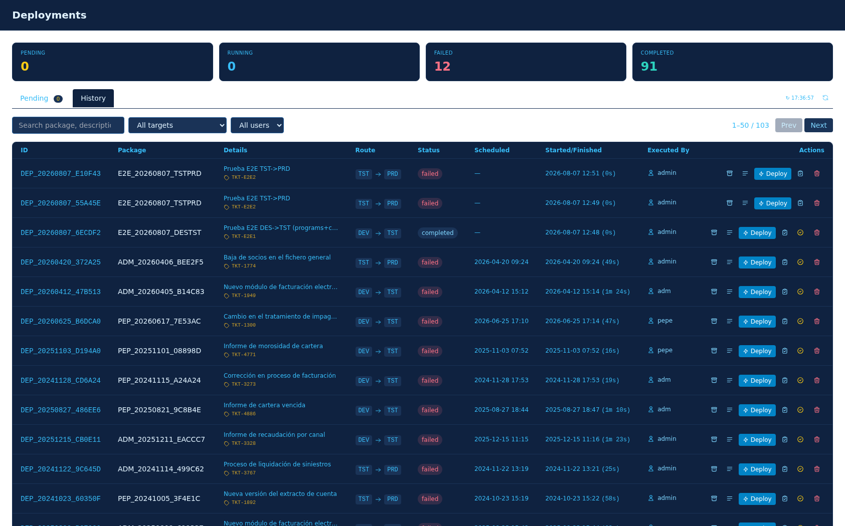
DEPLOYMENT
Deploy in one click and follow every step
Deployment history with ID, package, source, target and user
Filters by status, environment and user
Scheduled deployments with countdown and real duration
Log, load report and catalogation (CATALL) icons

Slide 15
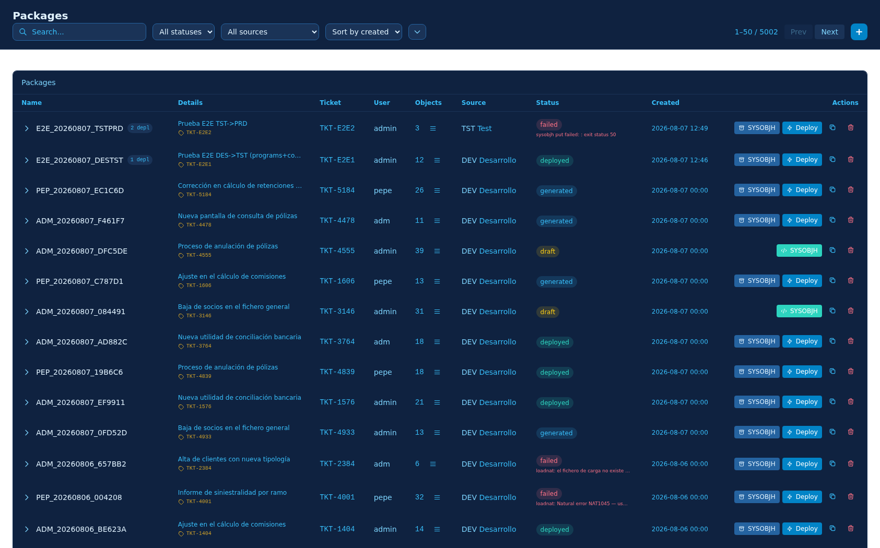
PACKAGE DETAIL
Modules, SYSOBJH files and deployments in one view
FUSER library browser with module selection and types
Buttons by status: Deploy, SYSOBJH Files and Create SYSOBJH
File tab: deployable file, its report and the put script
Package deployments with logs, reports and confirmed delete

Slide 16
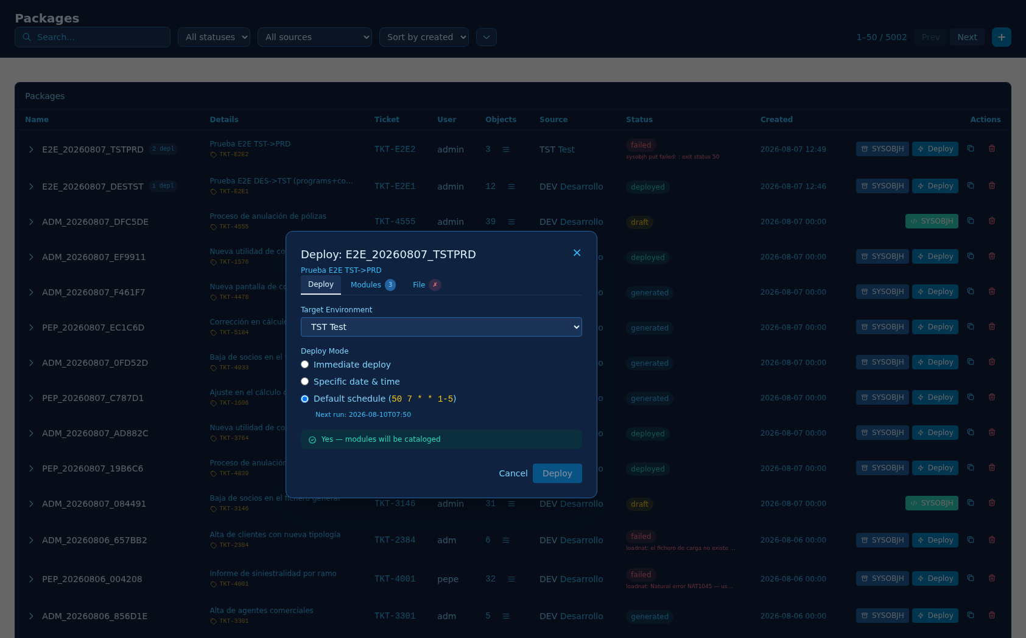
DEPLOY DIALOG
Full options before deploying
Target environment, mode (immediate / date / schedule) and catalogation
Deployable file with its report and the load script (put script)
Target locked when the deployment is already defined
Clear notice of whether modules will be cataloged (CATALL)

Slide 17
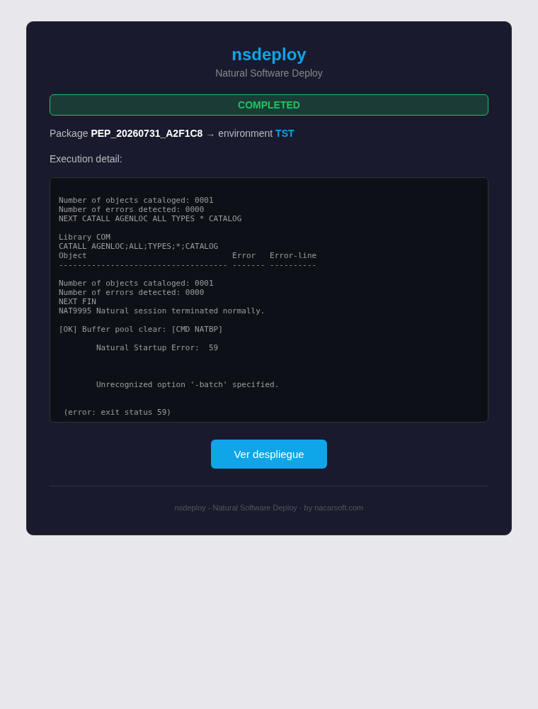
EMAIL NOTIFICATIONS
Automatic notifications for every deployment
On scheduling: package, modules and load date
On execution: full result with log, loaded modules and CATALL
Notifies the user who created the deployment (optional) plus extra emails
Additional emails separated by ';' in the environment settings
Direct «View deployment» link and by nacarsoft.com signature
Nacarsoft Soluciones Informáticas S.L. · nacarsoft.com

Slide 18
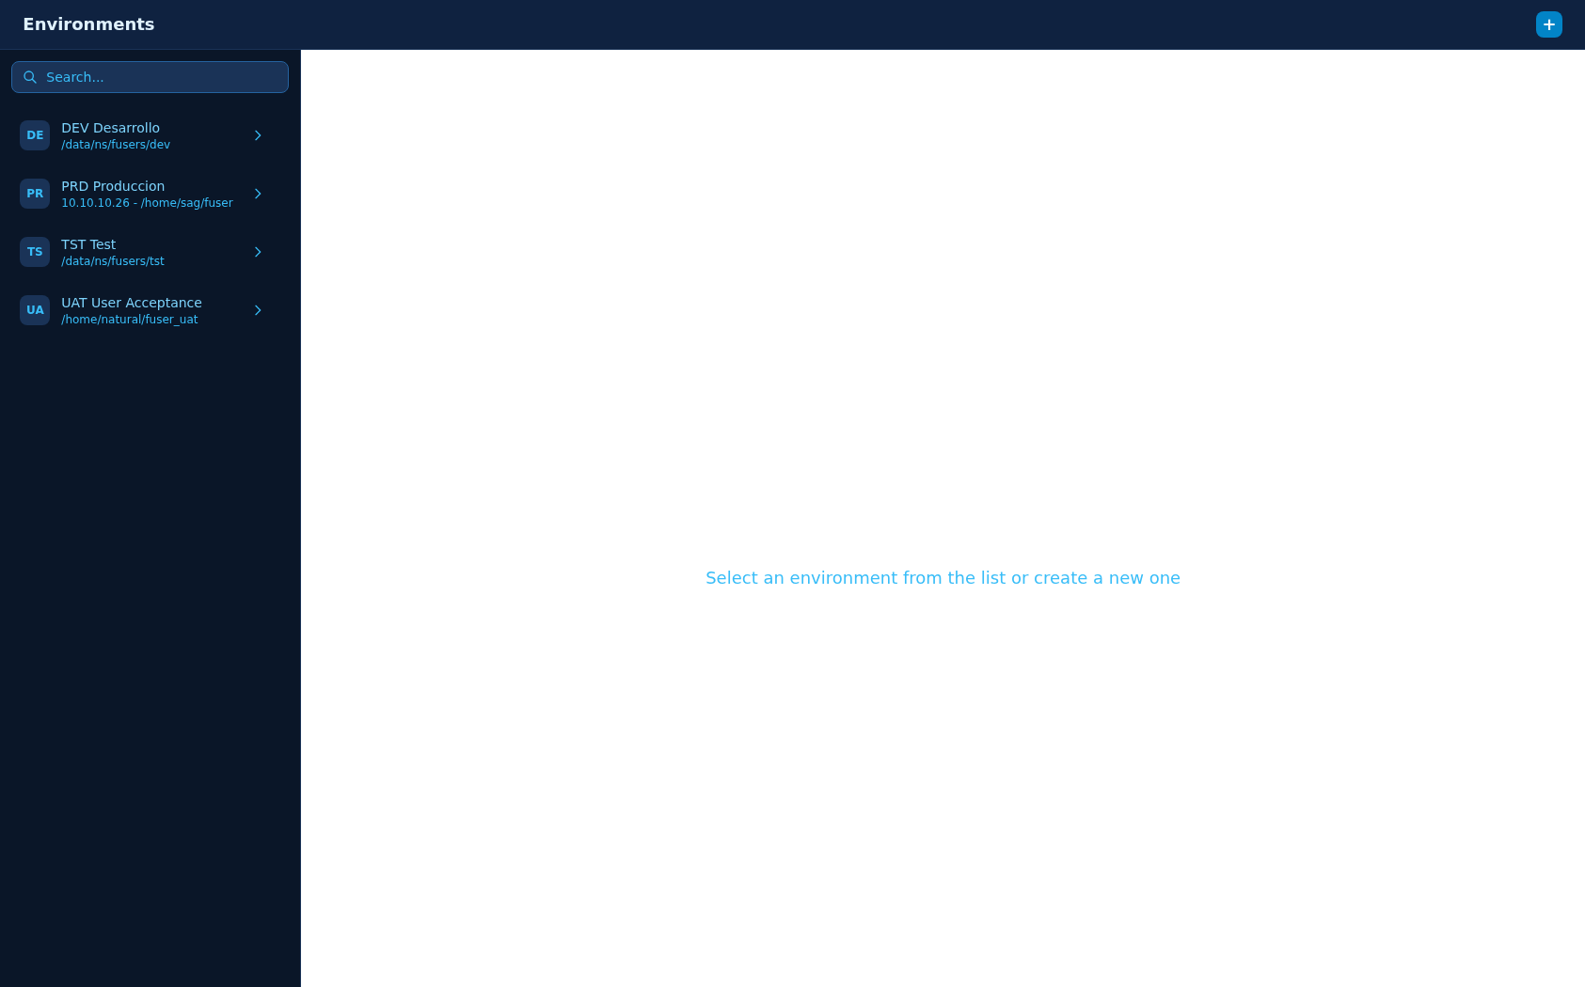
ENVIRONMENTS
Every environment with its full Natural configuration
FUSER, DIRDEV and Natural binary per environment
Load & catalogation: NATPARM, CATALL and batch stack
Notifications: notify the creator and additional emails
Local or remote (SSH) environments with deploy policies

Slide 19
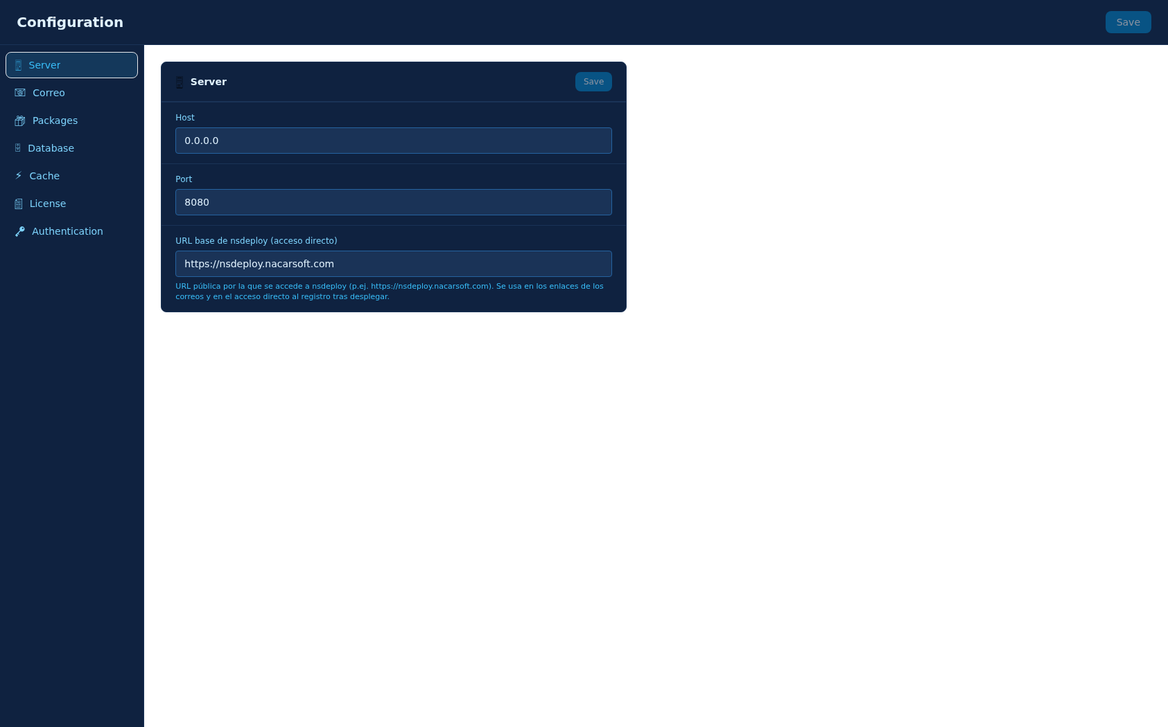
CONFIGURATION
The whole server configured from the web
Public base URL for direct access after deploying (proxy)
Mail: SMTP or sendmail with credentials and sender
Database, cache, license and authentication

Slide 20
INSTALLATION
Install and start nsdeploy in minutes
Requirements
Compile
01
make build → produces build/nsdeploy
Go 1.24+ to compile (or prebuilt Linux/amd64 binary)
Natural + ADABAS with SYSOBJH on the target environments
Access to each environment's FUSER (local or SSH)
Optional: SMTP account for email notifications
Configure
02
config.yaml in build/default (server, environments, mail)
Start
03
./run.sh start · stop · restart · status
Sign in
04
Nacarsoft Soluciones Informáticas S.L. · nacarsoft.com
http://localhost:8080 · administrator login

Slide 21
CONFIGURATION
A single config.yaml defines server, environments and mail
server
auth
database / cache
host, port and public base URL (proxy)
JWT, cookie and session expiry
SQLite database path and FUSER cache
environments
correo
packages
per environment: FUSER, DIRDEV, Natural, NATPARM, CATALL, schedule, notifications
SMTP or sendmail, sender and credentials
root directory, retention and max packages
build/default/config.yaml

Slide 22
WEB CONFIGURATION
Environments, users, roles and mail from the UI
Environments: Natural, load, catalogation and email notifications
Users, groups and roles with granular permissions (RBAC)
Configuration: server, mail (with test email) and base URL
Changes are saved to config.yaml without touching the server

Slide 23
NSDEPLOY IN ACTION
From package to PRD in one click
Automate the deployment of Natural objects on ADABAS and forget manual transfers.
Dashboard · real-time status
Packages · real FUSER objects
Deployments · history and traceability
Package management with real objects from your FUSER libraries
Dashboard with real-time deployment status
Full history: who, what, when and the result of every deployment
Nacarsoft Soluciones Informáticas S.L. · nacarsoft.com

Slide 24
ADVANTAGES
Why Natural teams choose nsdeploy
✓
Removes human error
✓
Full traceability
The whole pipeline —compile, transfer, deploy— is automated and repeated identically every time; goodbye to loose commands and forgotten steps.
Every deployment is recorded with code, executor, dates, duration, full log and cancellation reasons. Audit-ready at any review.
✓
Frictionless multi-environment
✓
Security by design
DEV, TST, PRD and UAT with independent Natural configuration (FUSER, DIRDEV, catalogation, buffer pools and notifications) in a single UI.
RBAC with users, groups and roles with granular permissions; secure sessions, encrypted passwords and managed SSH keys. Only the authorised, only who can.
✓
Faster and more reliable
✓
Low operating cost
One-click deployments from the web: search packages by name, description or ticket, clear states and frictionless retries.
No complex training required: the UI guides every step, generates the SYSOBJH files and emails the result of every deployment.
Nacarsoft Soluciones Informáticas S.L. · nacarsoft.com

Slide 25
HOW IT WORKS
A complete flow, from library to environment
01
Create the package
Automatic name and ticket, source environment and description. Objects are picked from the real FUSER browser.
02
Generate the SYSOBJH files
One click prepares the load file (punch) and the transfer script with the package modules.
03
Deploy to the environment
Choose the target (TST, PRD…), load type and catalogation. The system imports, cleans buffer pools and catalogs.
04
Follow every step
Live deployment log: import, load report, per-module catalogation and buffer pool refresh.
05
Notify and audit
Automatic email with the result and per-module detail; immutable history on the dashboard.
Programs, subprograms, maps, DDMs, copycodes: any Natural object type
Packages can be cloned to reuse selections and cancelled with a recorded reason
Nacarsoft Soluciones Informáticas S.L. · nacarsoft.com

Slide 26
BENEFITS
Measurable results from day one
1 click
3 environments
to deploy a complete package
DEV → TST → PRD managed from a single UI
100%
2 languages
traceability of every deployment and action
EN and ES with 7 visual themes
Fewer errors · Automated pipeline · Full traceability · Multi-environment from day 1
Nacarsoft Soluciones Informáticas S.L. · nacarsoft.com

Slide 27
READY TO
MODERNIZE YOUR
DEPLOYMENTS?
nsdeploy · Natural Software Deploy
CONTACT US →
Nacarsoft Soluciones Informáticas S.L. · hermes@nacarsoft.com · nacarsoft.com

