Slide 1

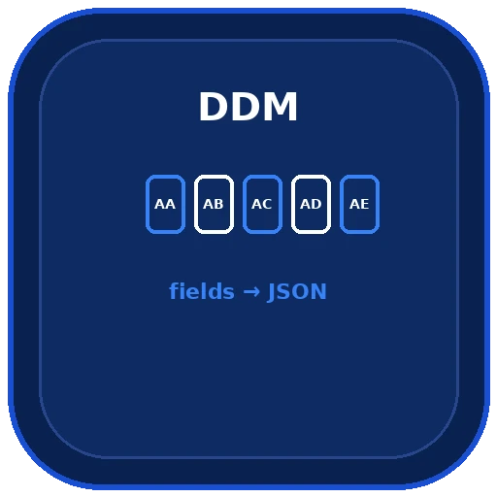
NACARSOFT · DDM TO JSON
Your Natural DDM,
ready for the rest
of the world.
Natural fuser
scan of libraries and files
nsddm walks the Natural fuser and generates the complete dictionary of your Adabas files in JSON: fields, types, formats and indexes, queryable and reusable.
JSON dictionary
fields, types, formats, indexes
SEE THE FEATURES →
fuser scan · JSON · Query without scanning · AI enrichment

Slide 2
THE PROBLEM
The DDM is the key, and it is stuck in the fuser
The dictionary of your installation exists, but nobody can query it from outside the core: not a tool, not a report, not a bulk load.
1
2
3
A fuser nobody can read
Every tool repeats the work
Reorganising files blind
The structure of your files lives in a proprietary format, on a server not everyone can reach.
Extractions, loads and anonymisation all need the DDM… and each one interprets it on its own.
Changing the number or the name of a file without knowing what depends on it.
nsddm turns your DDM into a JSON that can be queried, versioned and reused across the whole suite.
Nacarsoft Soluciones Informáticas S.L. · nacarsoft.com · nsddm

Slide 3
WHAT IT IS
Nacarsoft's DDM to JSON generator
nsddm has two modes. In generation mode it scans the Natural fuser and writes the complete dictionary to JSON. In query mode it works on that already generated JSON, without touching the core.
The result is a machine-readable dictionary shared by nsadafile, nsadaloader, nsadamask and the rest of the suite.
nsddm
DDM (Natural) → JSON
fuser scan by libraries and files
Filters by file number and DBID
Query the JSON without scanning again
Optional AI enrichment
2
0
1
modes: generate and query
libraries to install
JSON shared by everyone
Nacarsoft Soluciones Informáticas S.L. · nacarsoft.com · nsddm

Slide 4
HOW IT WORKS
From the fuser to a dictionary everyone understands
A light scan, a documented JSON and a query mode that never touches the core again.
1 · Scan
2 · Generate
3 · Query
Reads the fuser (SYSTEM library by default) and filters by file or DBID.
Writes the JSON with files, fields, types, formats, indexes and metadata.
Over the generated JSON: listings, filters and field search, with no connection.
With -ia the dictionary is enriched with descriptions and sensitive-data detection.
Nacarsoft Soluciones Informáticas S.L. · nacarsoft.com · nsddm

Slide 5
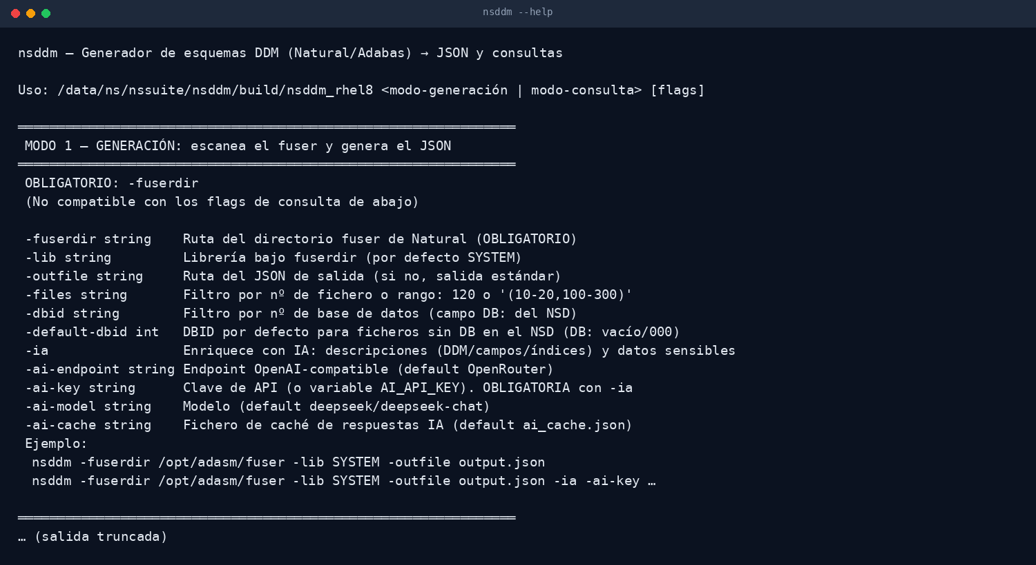
THE TOOL
Two modes, one binary
Generation mode scans the fuser; query mode works on the generated JSON without connecting to the core again.
No dependencies
Filters by file and DBID
Output to file or stdout
Real output of nsddm --help
Nacarsoft Soluciones Informáticas S.L. · nacarsoft.com · nsddm

Slide 6
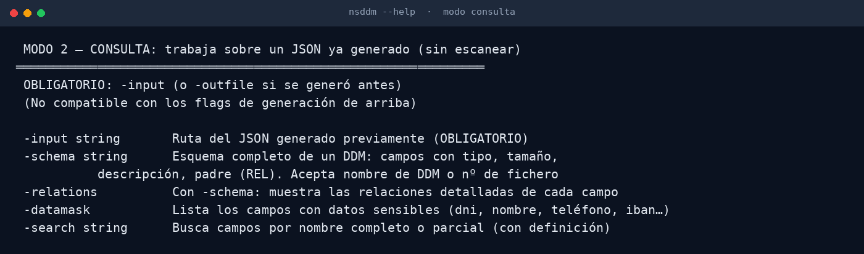
QUERY
The dictionary, without scanning
In query mode nsddm works on the generated JSON: file and field listings, filters and search, with no database connection.
No core connection
Filters by name and type
Versionable JSON
Real excerpt of the nsddm help (query mode)
Nacarsoft Soluciones Informáticas S.L. · nacarsoft.com · nsddm

Slide 7
FEATURES
What it does, point by point
The dictionary is the base of everything else: if the DDM is right, the rest of the tools work.
Full DDM dump
Scan by library
✓
Files, fields, types, formats, length, repeated elements and periodic groups.
✓
-lib to pick the fuser library (SYSTEM by default) and -files to filter ranges.
Flexible filters
Query mode
✓
By file number (120 or (10-20,100-300)) and by DBID, with a configurable default DBID.
✓
Works on the generated JSON: listings and filters with no core connection.
File or stdout output
AI enrichment (-ia)
✓
-outfile writes the JSON where you want; without it, it goes to stdout and can be redirected.
✓
Describes files and fields, detects sensitive data and proposes values, with a response cache.
Light execution
Base of the other tools
✓
No external dependencies and nothing to install: a static, fast binary.
✓
The same JSON is used by nsadafile, nsadaloader and nsadamask to validate and to name fields.
Nacarsoft Soluciones Informáticas S.L. · nacarsoft.com · nsddm

Slide 8
KEY OPTIONS
The parameters used every day
They combine with each other; every other flag is in --help.
-fuserdir <path>
-lib <library>
-outfile <file>
Natural fuser directory. Required in generation mode.
Library under the fuserdir (SYSTEM by default).
Path of the output JSON; if absent, output to stdout.
-files <filter>
-dbid <dbid>
-default-dbid <n>
Filter by file number or range: 120 or '(10-20,100-300)'.
Filter by database (DB field of the NSD).
Default DBID for files with no DB in the NSD.
-ia
-ai-model / -ai-endpoint
Enriches with AI: descriptions and sensitive data (requires -ai-key).
Model and OpenAI-compatible endpoint (OpenRouter by default).
Nacarsoft Soluciones Informáticas S.L. · nacarsoft.com · nsddm

Slide 9
USE CASES
Where it is used every day
The same use cases we solve with customers in banking, healthcare and the public sector.
01
02
03
04
Feeding the tools
Documenting the installation
Auditing the DDM
Planning a migration
Generate the JSON that nsadafile, nsadaloader and nsadamask use to validate and name fields.
A readable inventory of files, fields and formats that you can version.
Detect leftover fields, inconsistent types or differences between environments.
Know exactly what has to be migrated, field by field, before touching anything.
Nacarsoft Soluciones Informáticas S.L. · nacarsoft.com · nsddm

Slide 10
GETTING STARTED
Install and generate the dictionary
Requirements
Install and first run
Linux x86-64 (RHEL 8 or RHEL 9)
Read access to the Natural fuser
Write permission where the JSON is generated
No dependencies: static binary
API key only if you use -ia
# Install the suite
./install.sh --prefix /opt/ns
# Generate the dictionary
nsddm -fuserdir /opt/adasm/fuser \
-lib SYSTEM -outfile ddm.json
# Query the generated JSON
nsddm -config ddm.json -list-files
The generated JSON is the input of the other utilities: keep it under version control with the rest of your configuration.
Nacarsoft Soluciones Informáticas S.L. · nacarsoft.com · nsddm

Slide 11
FREQUENTLY ASKED QUESTIONS
What customers always ask
Does it need the Adabas core?
What about files with no DB?
No. In generation mode it only reads the Natural fuser; in query mode it works on the JSON, with no connection at all.
You can assign a default DBID with -default-dbid, so the JSON comes out complete and usable.
Is it safe to use with AI?
Who consumes the JSON?
AI enrichment is optional (-ia) and the answers are cached in ai_cache.json, so the call is not repeated.
nsadafile, nsadaloader and nsadamask: it gives them logical field names and length validation.
Nacarsoft Soluciones Informáticas S.L. · nacarsoft.com · nsddm

Slide 12
NEXT STEP
Open up your DDM
and put the whole
suite to work.
NSDdm at a glance
fuser scan and JSON output
Query mode with no connection
Filters by file, range and DBID
Base of the other suite utilities
Ask for a demo with your fuser: we show the generated dictionary and the tools that consume it.
REQUEST A DEMO →
nacarsoft.com · support@nacarsoft.com · +34 910 038 502
Nacarsoft Soluciones Informáticas S.L. · nacarsoft.com · nsddm

