Slide 1


NACARSOFT · GESTIÓN DE PROCESOS
Month-end close
Adabas export
>
>
Your batch processes,
queued, controlled and auditable
Nightly backup
ERP import
>
>
NSBatch
nsbatch queues, schedules, runs and audits every process on your server: cron-style control, queues with concurrency, live spool and alerts by email, Telegram or webhook.
dispatcher + spool
SEE FEATURES →
Cron
Queues
Audit
Alert
time rules
concurrency
who and when
mail / TG / hook
Cron control · Queues · Auditing · Notifications
…and every execution is recorded
Queues · jobs · executions · spool · audit · notify

Slide 2
EL PROBLEMA
Batch jobs are launched blind
Loose cron scripts: no concurrency control, no central spool and no idea what is running right now.
01
No order
02
No visibility
A month-end close and a backup fight for the CPU. Whoever arrives first wins.
Nobody knows what runs, since when, under which PID or how long it took.
03
No trace
04
No control
Logs rot in /tmp. The next day there is no way to reconstruct the run.
Anyone launches and anyone deletes. No roles, no permissions, no record.
• Hours of delay
• Unseen errors
• Zero traceability
Nacarsoft Soluciones Informáticas S.L. · nacarsoft.com · nsbatch

Slide 3
QUÉ ES
A process queue manager, mainframe style
nsbatch is Nacarsoft's JES: every job enters a queue, the dispatcher runs it under an isolated PID and its spool stays on disk. It is launched from the web, the CLI, the API or a cron rule; and who did it, and when, is always recorded.
4
9
queues out of the box
RBAC permissions
✓
Queues with priority, concurrency and time windows
✓
Cron-style rules, importing the crontab you already had
6
1
✓
One isolated PID per run: if the process dies, the manager lives on
languages and themes
single binary
✓
Spool on disk with live tail, search and download
Nacarsoft Soluciones Informáticas S.L. · nacarsoft.com · nsbatch

Slide 4
ARQUITECTURA
How a process travels, step by step
1
2
3
4
5
Entry
Queue
Dispatcher
Isolated PID
Spool and record
Web, CLI, REST API or cron rule: the job enters a queue.
SYSTEM, BATCH, FAST, NIGHTLY: priority, concurrency and state.
Honours the queue quota and launches the next job.
Each run executes in its own process group.
Log on disk, live events and an audit of who launched it.
⚠ If a job hangs, the timeout kills its process tree: the dispatcher never blocks.
No external cron
No loose scripts
All in one binary
Nacarsoft Soluciones Informáticas S.L. · nacarsoft.com · nsbatch

Slide 5
TRABAJOS
Four ways to launch the very same job
1
By hand, web or CLI
2
Through the API
nsbatch submit CIERRE --params "--mode full": it queues and returns the execution ID.
POST /api/jobs/{id}/submit: your ERP or Natural queues the job without touching the console.
3
With a cron rule
4
Importing the crontab
Time and days per job, with the next run computed and the option to catch up the missed window.
Paste the crontab you already had: nsbatch parses it and leaves the job scheduled.
What lives in /etc/crontab today moves to the panel: with state, with spool and with alerts.
Nacarsoft Soluciones Informáticas S.L. · nacarsoft.com · nsbatch

Slide 6
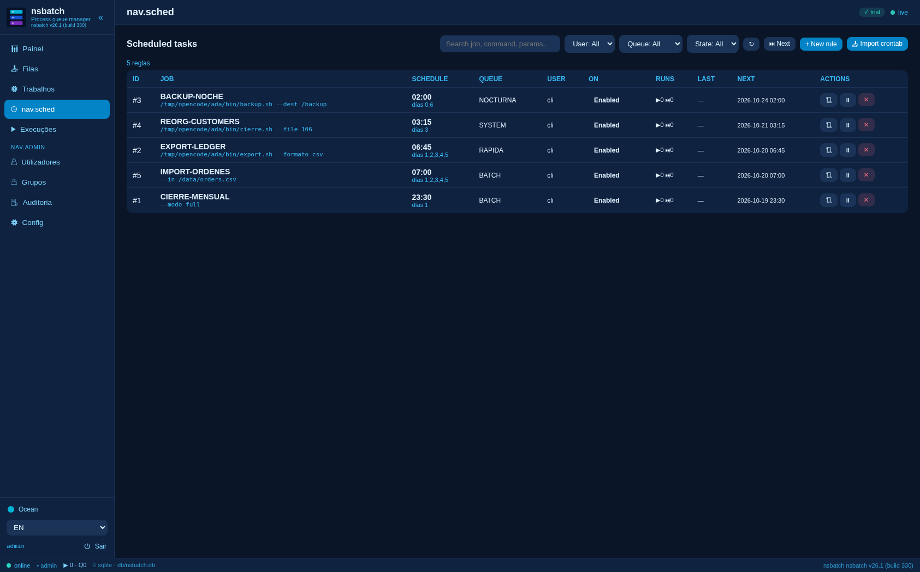
CRON-STYLE CONTROL
Scheduling, but with state and with alerts
One rule per job: time, days of the week and days of the month
Next runs computed and shown in the global view
Catch-up of the missed window when the service starts
Rule history: what ran, when and with which result
Import of the existing crontab and a global view of every rule
⏰ cron
0 2 * * 6 → BACKUP-NOCHE
Scheduled: every rule, its next run, its executions and its history.
sábados y domingos a las 02:00, cola NOCTURNA
Nacarsoft Soluciones Informáticas S.L. · nacarsoft.com · nsbatch

Slide 7
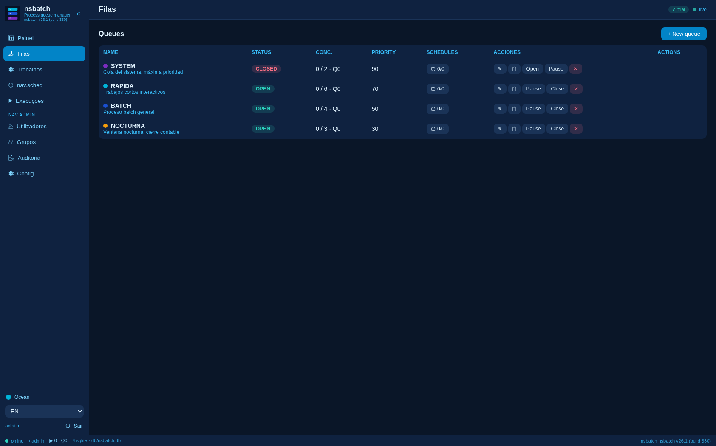
COLAS
Queues with concurrency, priority and colour
SYSTEM
max 2
prio 90
RAPIDA
max 6
prio 70
BATCH
max 4
prio 50
NOCTURNA
max 3
prio 30
OPEN
PAUSED
CLOSED
OPEN ejecuta · PAUSED retiene · CLOSED rechaza
Four queues out of the box: SYSTEM, BATCH, FAST and NIGHTLY
Concurrent-run quota and priority per queue
OPEN, PAUSED and CLOSED: pause or close without losing jobs
Time windows per queue and moving a queued job to another one
Queues: quota in use, priority, colour and queued jobs for each one.
Nacarsoft Soluciones Informáticas S.L. · nacarsoft.com · nsbatch

Slide 8
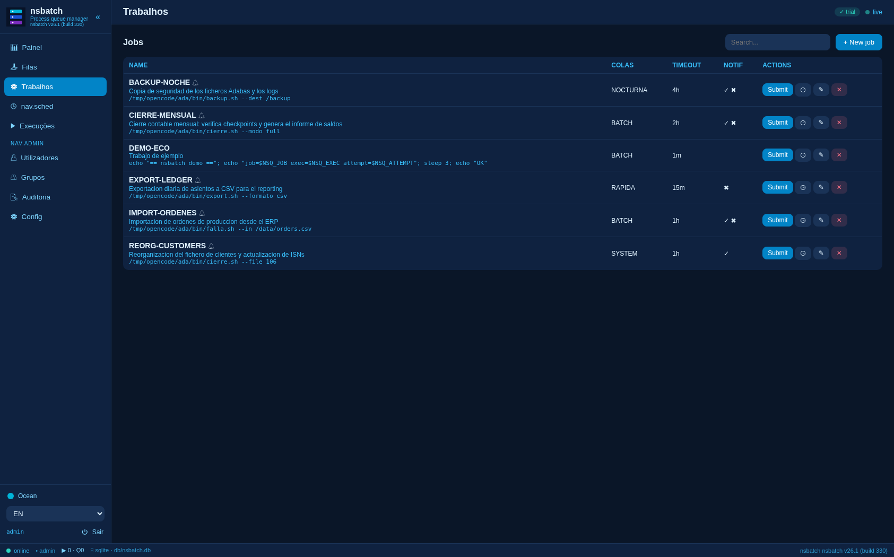
CATÁLOGO
The catalogue: a job is a command and its rules
Command and arguments: the job is a real shell line
Target queue and the parameters of every run
Timeout per job, with a process-tree kill
Alerts on start, on end and on error, with recipients
Retries and re-runs with the very same parameters
CIERRE-MENSUAL
/opt/ada/bin/cierre.sh --modo full
BATCH · timeout 7200s · aviso al terminar y al fallar
The same job can be assigned to several queues: the one the operator picks or the one of its cron rule.
Jobs: command, queue, timeout, alerts and retries for each one.
Nacarsoft Soluciones Informáticas S.L. · nacarsoft.com · nsbatch

Slide 9
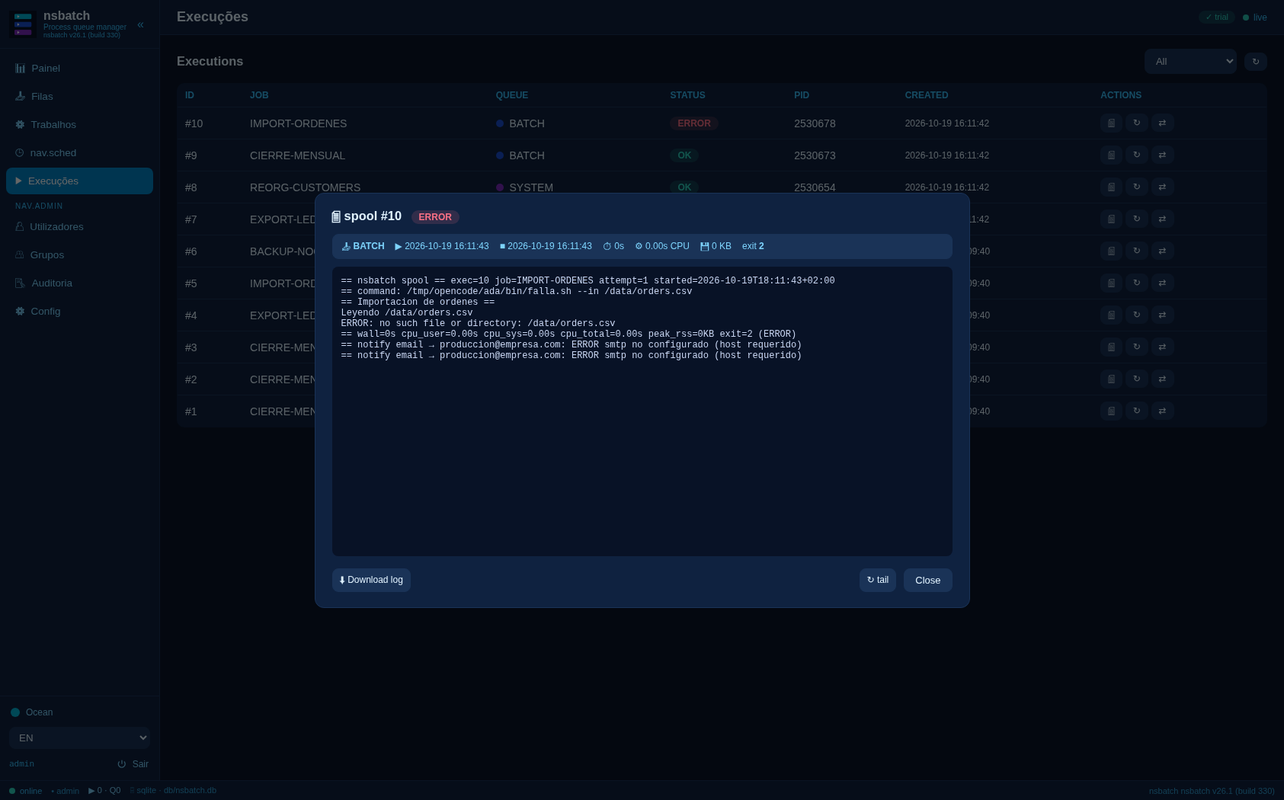
EJECUCIONES
Every execution leaves its spool
QUEUED
HOLD
RUNNING
OK
ERROR
In the queue, waiting its turn
Held by hand
With its own PID
Finished fine
Finished with an error
States: QUEUED, HOLD, RUNNING, OK, ERROR and CANCELLED
One PID per execution and an attempt number
Exit code, wall time, CPU and peak memory
Spool on disk with live tail, search and download
Cancel, hold, move or re-run without leaving the panel
The spool: header with the job, the attempt, the dates and the exit code, plus the full log.
PID 2535367 · exit 0 · wall 2s · mem 1.7 MB
Nacarsoft Soluciones Informáticas S.L. · nacarsoft.com · nsbatch

Slide 10
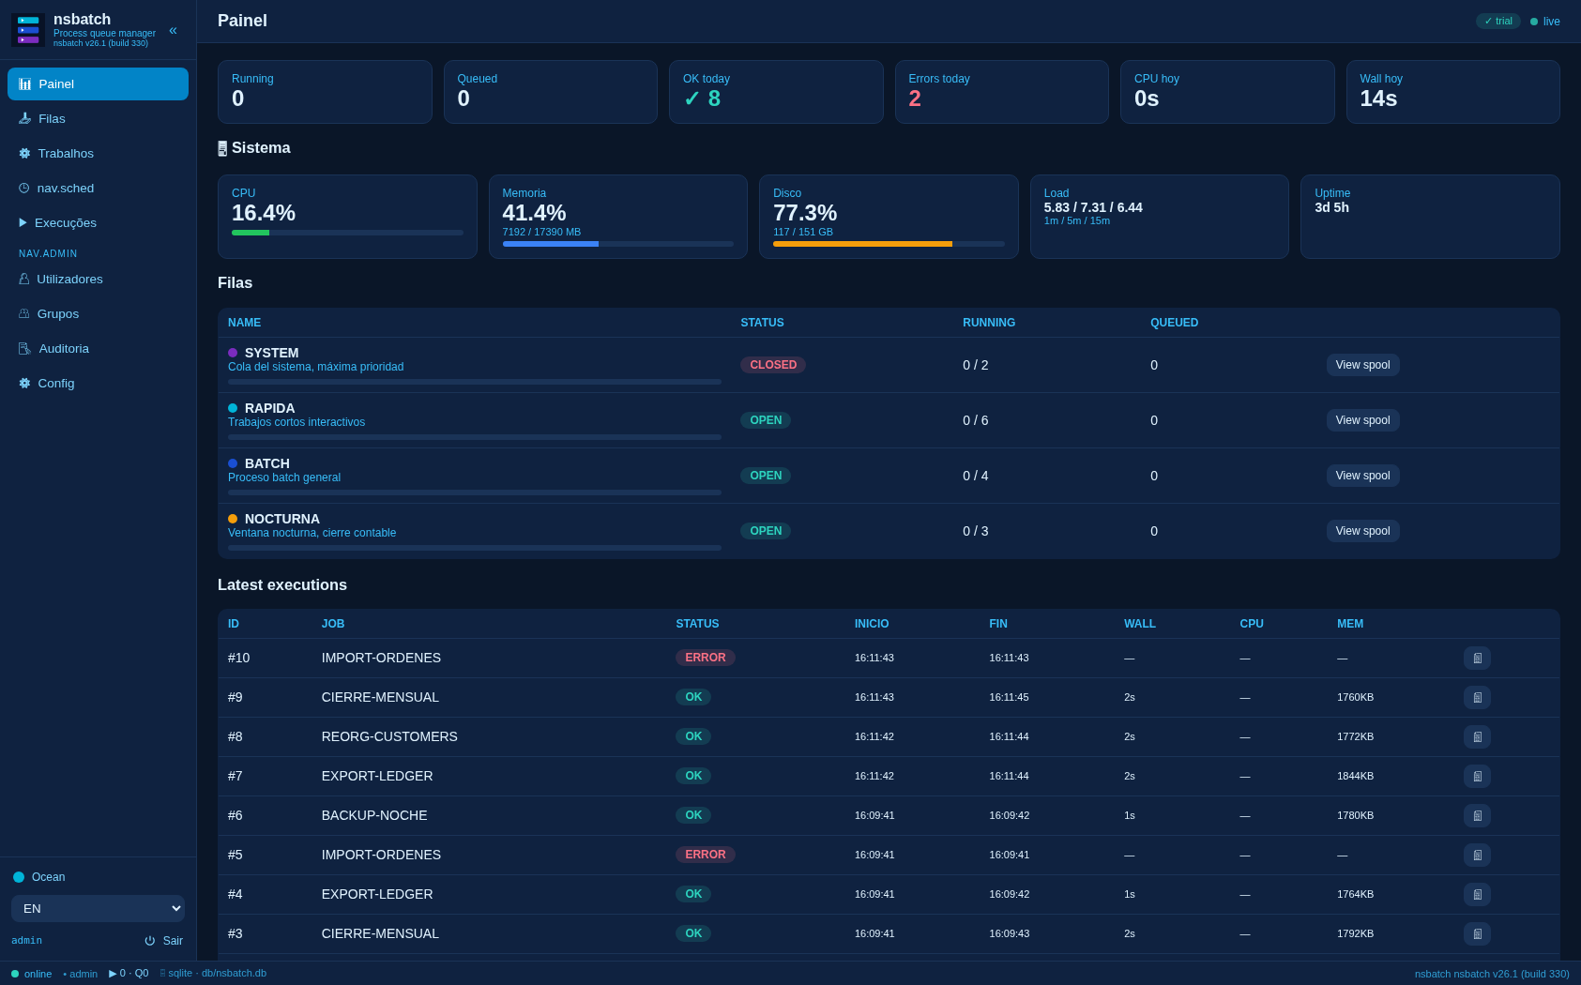
OPERATIONS
The whole state on a single screen
Live KPIs: running, queued, OK and errors today
CPU and wall time today, with the real cost of every job
Per-queue semaphore with the concurrency quota in use
Latest executions with their PID and spool in one click
System state: CPU, memory, disk, load and uptime
Running
Queued
OK today
Errors today
Nacarsoft Soluciones Informáticas S.L. · nacarsoft.com · nsbatch

Slide 11
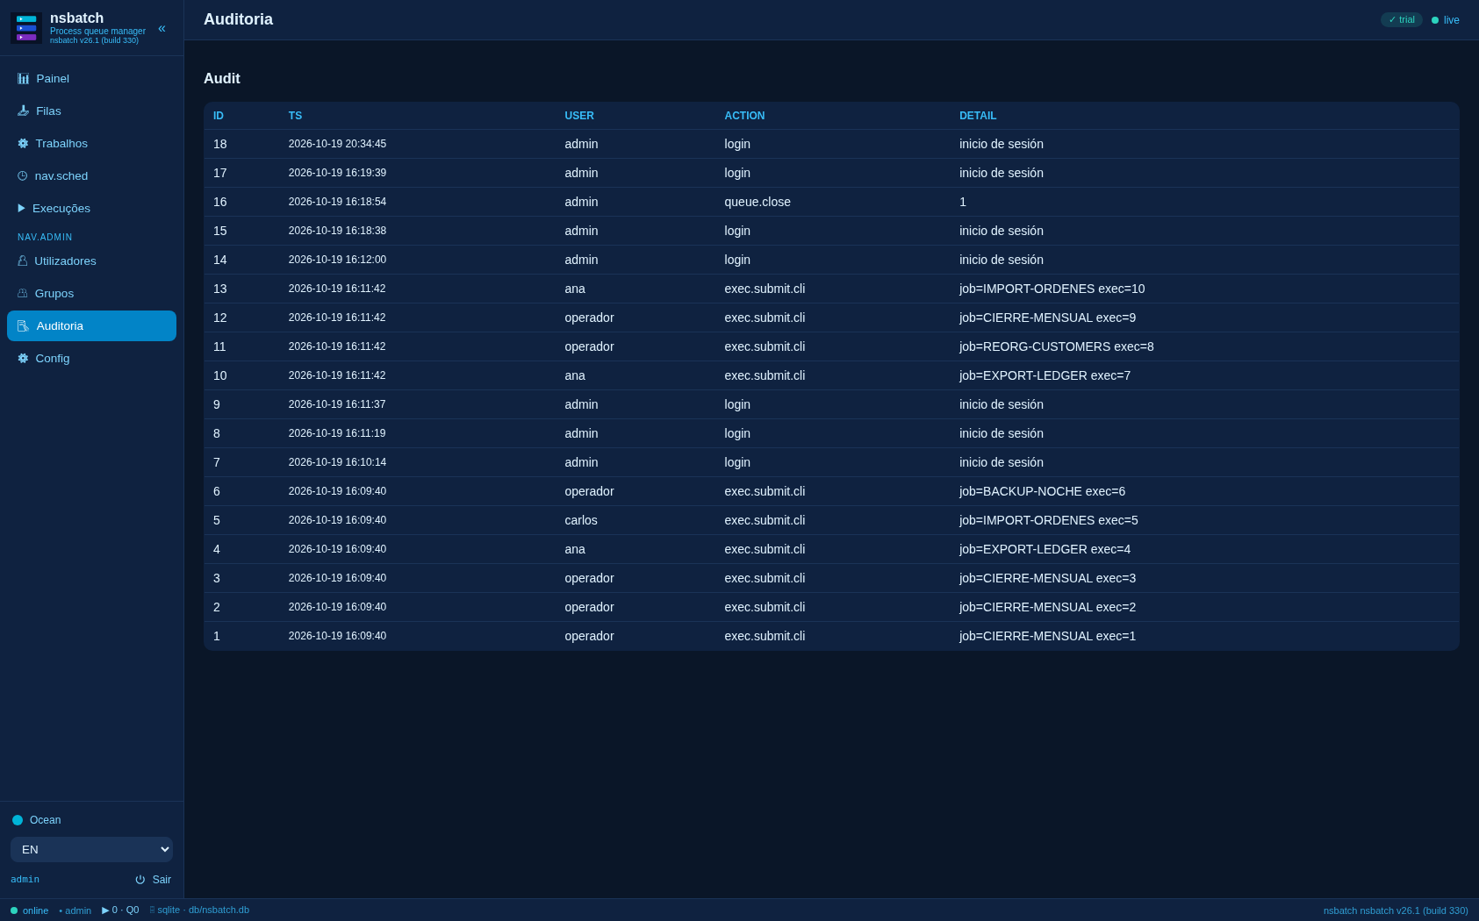
AUDITING
Who launched what, and everything is recorded
Every panel action goes into the audit log
User, action, detail, timestamp and the queue involved
Job and queue creations, state changes and permission changes
Cancellations, re-runs and moves between queues
Search and filter by user, action and date
Audit log: what happened on the server and who did it.
Append-only, with user and IP, and exportable from the panel.
Nacarsoft Soluciones Informáticas S.L. · nacarsoft.com · nsbatch

Slide 12
NOTIFICATIONS
The process tells you when it is done
Every job decides whether to alert on start, on end or only on error. nsbatch sends the alert through the channels you choose and records it in the spool.
Email (SMTP)
Telegram
Webhook
STARTTLS or TLS, with a configurable user and sender. Several recipients per job.
Bot + chat ID: the alert reaches the team phone without setting up any mail server.
POST to the URL you define, with your own headers: it plugs into Slack, Teams or your ITSM.
The execution ends
The alert is built
It goes out
It lands in the spool
OK, ERROR or CANCELLED
job, attempt, params, wall, CPU and exit
email · Telegram · webhook
ok or ERROR per channel
Recipients per job, per user group or the creator of the execution.
Nacarsoft Soluciones Informáticas S.L. · nacarsoft.com · nsbatch

Slide 13
API, CLI AND EVENTS
To plug it into what you already have
CLI
REST
nsbatch submit <job> --params "..."
POST /api/jobs/{id}/submit
nsbatch queues list | create | pause | open | close
GET /api/queues · /api/jobs · /api/executions
nsbatch jobs list | create | update | cron
GET /api/cron · /api/cron/next · /api/cron/import
nsbatch execs [STATE] | cancel | rerun | move | log
GET /api/executions/{id}/log
nsbatch users | groups | roles | audit | dashboard
GET /api/events (live SSE)
The console is one of the ways in: the API and the CLI do the same without a browser.
Nacarsoft Soluciones Informáticas S.L. · nacarsoft.com · nsbatch

Slide 14
SECURITY
Who sees what, and everything is recorded
Access control
Session and access
Traceability
RBAC with 9 permissions
Users, groups and roles
Permission per operation
No binary admin
HS256 JWT in a cookie
Passwords with bcrypt
Recovery by email
Configurable expiry
Audit of every action
User and client IP
Log per queue and per job
Configurable retention
config.yaml 0600 · database 0700 · bcrypt · JWT HS256 · 30-day trial · machine-signed license
Nacarsoft Soluciones Informáticas S.L. · nacarsoft.com · nsbatch

Slide 15
FEATURES
Everything an operator needs
6 themes
Dark, Ocean, Light, Forest, Sunset and high contrast.
6 languages
ES, EN, FR, DE, IT and PT across the UI.
RBAC
Users → groups → roles → permissions. No binary admin.
API + SSE
Script integration: REST submit and live events.
Timeouts
Timeout and process-tree kill per execution.
Retries
Re-run with the same parameters in one click.
Retention
Automatic purge of old spools and execution history.
License
30-day trial and a machine-signed license.
Nacarsoft Soluciones Informáticas S.L. · nacarsoft.com · nsbatch

Slide 16
GETTING STARTED
From zero to queued jobs, in three steps
1
Create the environment
REQUIREMENTS
nstbatch init /opt/nsbatch: it creates config.yaml, the SQLite database, the spool and the admin user.
Linux (RHEL 8 / 9)
A single binary, no dependencies
SQLite for state and spool
Reverse proxy with HTTPS in production
Web panel on port 11050
2
Tune and start
Fill in the JWT secret, the port and the alert channels. Start with nsbatch start.
3
Register the job
Create the queue, the job and its cron rule, or import the crontab you already had.
nsbatch init /opt/nsbatch → nsbatch start /opt/nsbatch → web panel :11050
Nacarsoft Soluciones Informáticas S.L. · nacarsoft.com · nsbatch

Slide 17
FREQUENTLY ASKED
The questions we hear most
Do I have to drop the system cron?
What if a job hangs?
Not necessarily, but you can: nsbatch imports the existing crontab and leaves it scheduled with its state, its spool and its alerts.
The job timeout kills its process tree and the execution goes to ERROR. The dispatcher keeps going with the queue.
Can I run several environments?
Who may launch a job?
Yes: each instance has its own directory, database, spool and port. They are registered by name for quick switching.
Every permission is an operation: submit, cancel, re-run, move, view the spool or manage users. Granted by role and group.
Can it integrate with my ERP?
What does the audit log show?
Yes: the REST API and the CLI expose the same job catalogue. POST /api/jobs/{id}/submit queues the execution.
Every panel action: who queued, who cancelled, who created a queue or changed a permission, with user, time and IP.
Nacarsoft Soluciones Informáticas S.L. · nacarsoft.com · nsbatch

Slide 18
Your processes, queued
and fully accounted for
Try nsbatch with your own jobs: we set it up and watch it run on your data.
Guided demo
Try it in your environment
Let's talk about your case
nacarsoft.com · support@nacarsoft.com
Nacarsoft Soluciones Informáticas S.L. · nacarsoft.com · nsbatch

