Slide 1

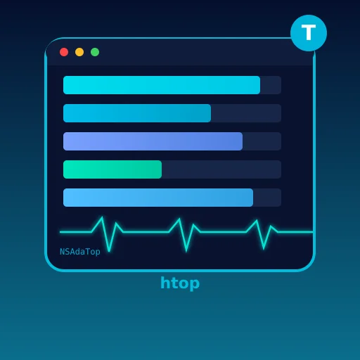
NACARSOFT · ADABAS SESSION MONITOR
See who is using
your Adabas, in
real time.
Adabas core
reading sessions and counters
nsadatop shows the active sessions of your core in the terminal: calls, transactions and users sorted the way you care about, refreshing on its own.
Your terminal
TUI with sorting and filtering
SEE THE FEATURES →
Real-time TUI · Delta metrics · Interactive sorting · Filters

Slide 2
THE PROBLEM
The core is slow, and nobody knows why
On a saturated system the question is always the same: which user, which process and which file are consuming the resources right now.
1
2
3
Blind diagnosis
Isolated snapshots
Tools from another world
"It is slow" says nothing. Without the active sessions, diagnosis is a process of elimination.
One ADASPY every ten minutes says less than a continuous picture of real consumption.
The vendor monitor does not integrate with your scripts or with the way you work.
nsadatop is an htop for your Adabas: in the terminal, live, with the metrics that matter.
Nacarsoft Soluciones Informáticas S.L. · nacarsoft.com · nsadatop

Slide 3
WHAT IT IS
Nacarsoft's Adabas session monitor
nsadatop connects to the core, reads the active sessions and shows them in a terminal interface that refreshes on its own.
It displays calls and transactions per interval (delta), lets you sort by any column, filter by a minimum load and move around with the keyboard. No browser, no server, nothing to install.
nsadatop
Live Adabas sessions
Real-time TUI, htop style
Delta metrics per interval
Sorting by any column
Full keyboard navigation
1
9
10s
binary, no server
sortable columns
default interval
Nacarsoft Soluciones Informáticas S.L. · nacarsoft.com · nsadatop

Slide 4
HOW IT WORKS
From the core to your screen, every few seconds
Reading the active sessions, computing the deltas and refreshing the screen without interfering with anything.
1 · Connect
2 · Read
3 · Delta
Native Adabas client against the given DBID, read-only.
Active sessions with calls, transactions, user, PID and ISN.
Difference with the previous read: what happened in this interval, not accumulated.
The interval is adjusted with the + and - keys, and the minimum-load filter is toggled with f.
Nacarsoft Soluciones Informáticas S.L. · nacarsoft.com · nsadatop

Slide 5
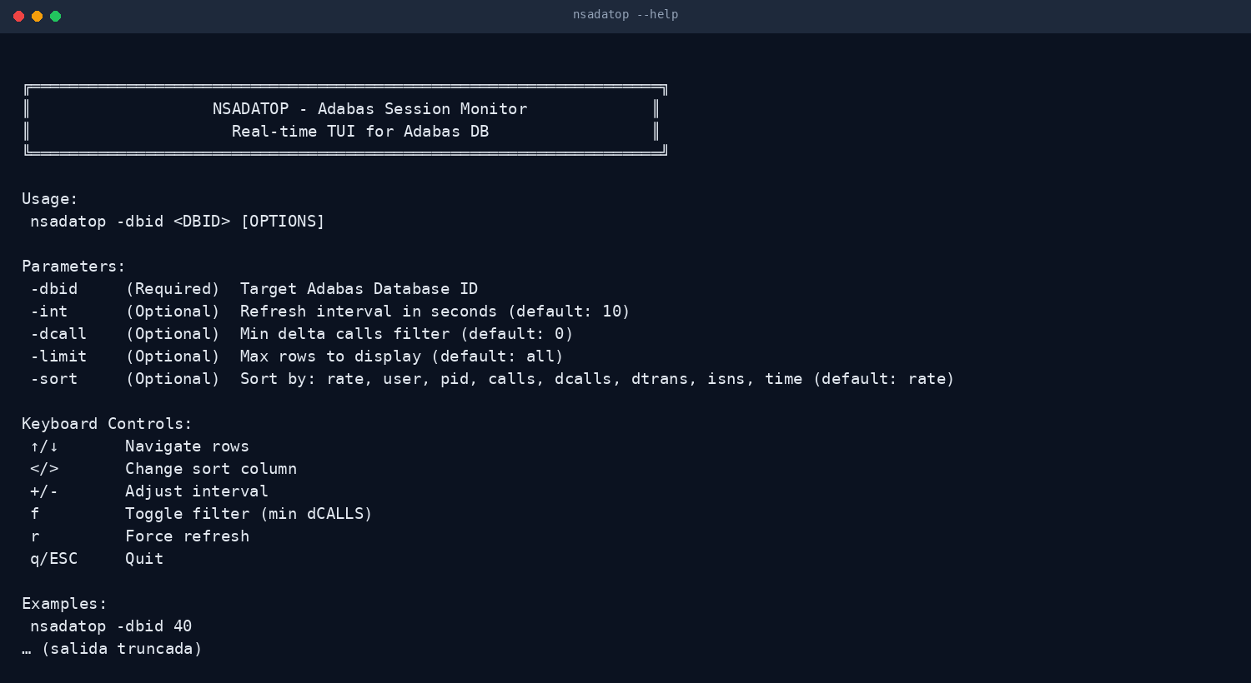
THE TOOL
A TUI, with no server and no browser
One binary that opens against the DBID and shows the screen. No infrastructure, no ports, no agent to maintain.
No web server
No open ports
Ctrl-C and done
Real output of nsadatop --help
Nacarsoft Soluciones Informáticas S.L. · nacarsoft.com · nsadatop

Slide 6
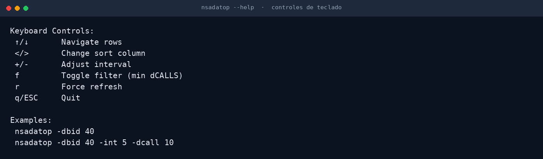
CONTROL
Everything with the keyboard
You navigate, sort and filter without letting go of the keyboard: the fastest tool for diagnosing the critical minutes.
Sort with </>
Filter with f
Refresh with r
Real excerpt of the nsadatop help (keyboard controls)
Nacarsoft Soluciones Informáticas S.L. · nacarsoft.com · nsadatop

Slide 7
FEATURES
What it does, point by point
Built for the moment somebody asks "why is it slow?".
Real-time TUI
Delta metrics
✓
htop style: the screen refreshes on its own and reads at a glance.
✓
Calls and transactions per interval, not accumulated: you see what is happening now.
Interactive sorting
Minimum-load filter
✓
By rate, user, PID, calls, dCALLS, dTRAN, ISN or time, without restarting the tool.
✓
Show only the sessions above a given number of delta calls.
Keyboard navigation
Configurable interval
✓
vim style: move, sort, filter, refresh and quit, all without a mouse.
✓
From 1 to 60 seconds, adjustable on the fly with + and -.
Row limit
No dependencies
✓
Limit the list to the N most relevant sessions when the core has thousands.
✓
Static binary, no configuration, no server and no open ports.
Nacarsoft Soluciones Informáticas S.L. · nacarsoft.com · nsadatop

Slide 8
KEY OPTIONS
The parameters used every day
Every other option is in --help.
-dbid <id>
-int <sec>
-dcall <n>
Adabas database to watch. Required.
Refresh interval in seconds (default 10).
Filters by minimum delta calls (default 0: all).
-limit <n>
-sort <column>
↑ / ↓
Maximum rows displayed (default: all).
rate, user, pid, calls, dcalls, dtrans, isns or time (default rate).
Move through the rows of the table.
</>
+ / - · f · r · q
Change the sorting column.
Adjust the interval, filter, refresh and quit.
Nacarsoft Soluciones Informáticas S.L. · nacarsoft.com · nsadatop

Slide 9
USE CASES
Where it is used every day
The same use cases we solve with customers in banking, healthcare and the public sector.
01
02
03
04
Diagnosing slowness
Maintenance windows
Following a load
Performance testing
See who is consuming the core right now, without asking anyone for a report.
Watch consumption live while a critical process runs.
Check that the night load is progressing and at what rate.
Measure the delta in calls and transactions of a specific scenario.
Nacarsoft Soluciones Informáticas S.L. · nacarsoft.com · nsadatop

Slide 10
GETTING STARTED
Install and watch in five minutes
Requirements
Install and first run
Linux x86-64 (RHEL 8 or RHEL 9)
Native Adabas client (acj) in the PATH
Read access to the database
An ANSI terminal (any Linux)
Product licence or the 30-day trial
# Install the suite
./install.sh --prefix /opt/ns
# Watch database 40 every 5 s
nsadatop -dbid 40 -int 5
# Only the busy sessions
nsadatop -dbid 40 -dcall 100 \
-sort dcalls -limit 20
The licence is resolved from $NS_LICENSE_FILE, next to the product data or in /opt/ns/licenses/. Without one: 30-day trial.
Nacarsoft Soluciones Informáticas S.L. · nacarsoft.com · nsadatop

Slide 11
FREQUENTLY ASKED QUESTIONS
What customers always ask
Does it affect core performance?
Can I see it from my laptop?
No: it only reads session counters, with the same read mechanism any monitor uses. The deltas are computed locally.
Yes: run it over SSH against the server. It opens no port and installs no agent.
What is a delta metric?
Does it work on any terminal?
The difference with the previous read: the number of calls or transactions in this interval, not the total since the session started.
Yes, with any ANSI terminal. It works over plain SSH, and also inside tmux or screen.
Nacarsoft Soluciones Informáticas S.L. · nacarsoft.com · nsadatop

Slide 12
NEXT STEP
When it is slow,
really look at it.
NSAdaTop at a glance
Active sessions in real time
Delta metrics per interval
Sorting and filtering with the keyboard
One binary, no server and no ports
Ask for a demo against your own database: we show the TUI live with the sessions of your own core.
REQUEST A DEMO →
nacarsoft.com · support@nacarsoft.com · +34 910 038 502
Nacarsoft Soluciones Informáticas S.L. · nacarsoft.com · nsadatop

