Slide 1
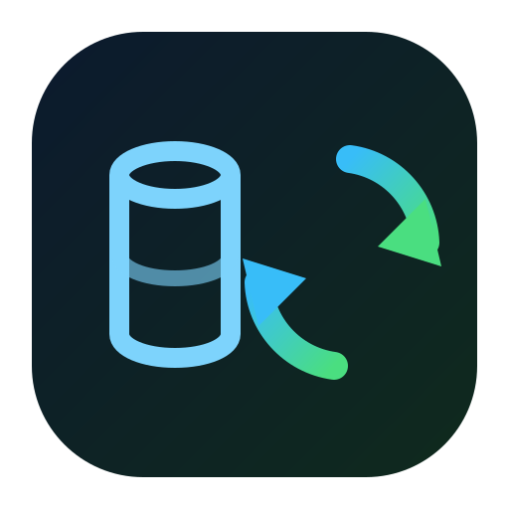










NACARSOFT ADABAS SUITE
ADABAS
Your Adabas data,
live and where you need it
Open Systems
NSAdaSync
broker + workers
NSAdaSync replicates every change in your Adabas files to PostgreSQL, Oracle, MySQL, MongoDB, Elasticsearch or Kafka as it happens.
PostgreSQL
Oracle
MySQL
Relational SQL
Relational SQL
Relational SQL
SEE FEATURES →
MariaDB
SQL Server
SQLite
9 targets · From the nucleus to your data in seconds
Relational SQL
Relational SQL
Local SQL
MongoDB
Elasticsearch
Kafka
NoSQL · documents
Search · indices
Streaming · topics
…and one more target whenever you need it

Slide 2
EL PROBLEMA
Your Adabas data never reaches where it is queried
01
02
03
Batch-only consumption
No streaming
No control
SQL reports are fed by nightly loads: by the time you query it, the data is already stale.
Oracle, MongoDB, Elasticsearch or Kafka do not receive nucleus changes as they happen.
You do not know what has been replicated, what is queued or what failed until you check it by hand.
• Hours of data lag
• Reports over snapshots
• Zero visibility of the flow
Nacarsoft Soluciones Informáticas S.L. · nacarsoft.com · nsadasync

Slide 3
QUÉ ES
Live Adabas replication for SQL, NoSQL and streaming
NSAdaSync is Nacarsoft's Adabas replication service. An exit in the nucleus publishes every change to a persistent broker and the worker of each subscription applies it to the target: SQL, NoSQL, search or streaming.
9
1
supported targets
exit in the nucleus
✓
Minimal UEX4 exit: never blocks, never retries, never touches the network
✓
Embedded broker, in-process, with no TCP ports
0
1
✓
File → table subscriptions mapped from the dictionary
changes lost
web console
✓
Web console with RBAC, auditing and DLQ with replay
Nacarsoft Soluciones Informáticas S.L. · nacarsoft.com · nsadasync

Slide 4
ARCHITECTURE
How a change travels, step by step
1
2
3
4
5
Adabas nucleus
UEX4 exit
FIFO pipe
nsmq broker
Worker per subscription
CLOG + LOGRB: every change is recorded in the transaction log.
One non-blocking writev per record. No blocking, no retries, no network.
Physical rendezvous. With no reader, the exit dumps to the outage journal.
Segmented log on disk, fsync per batch, 10 GB / 72 h retention.
Applies the change and advances the high_water_seq checkpoint.
⚠ With no pipe configured the exit stays inert (fail-closed): the nucleus never blocks waiting for anyone.
The nucleus never leaves the network
No clients to install
All in a single server
Nacarsoft Soluciones Informáticas S.L. · nacarsoft.com · nsadasync

Slide 5
FAN-OUT
One source, nine targets, a single control point
PostgreSQL
Oracle
MySQL
Relational SQL
Relational SQL
Relational SQL
Adabas files
NSAdaSync
DBID + FNR + DDM
(the dictionary)
Broker + workers
per subscription
MariaDB
SQL Server
SQLite
Relational SQL
Relational SQL
Local SQL
MongoDB
Elasticsearch
Kafka
NoSQL · documents
Search · indices
Streaming · topics
Queued
Checkpoint
Live
If the target does not answer, the change waits in the broker.
Every subscription knows exactly where it stands.
When the target is back, the backlog is applied on its own.
→ The same subscription is duplicated onto each target: one source, many consumers.
Nacarsoft Soluciones Informáticas S.L. · nacarsoft.com · nsadasync

Slide 6
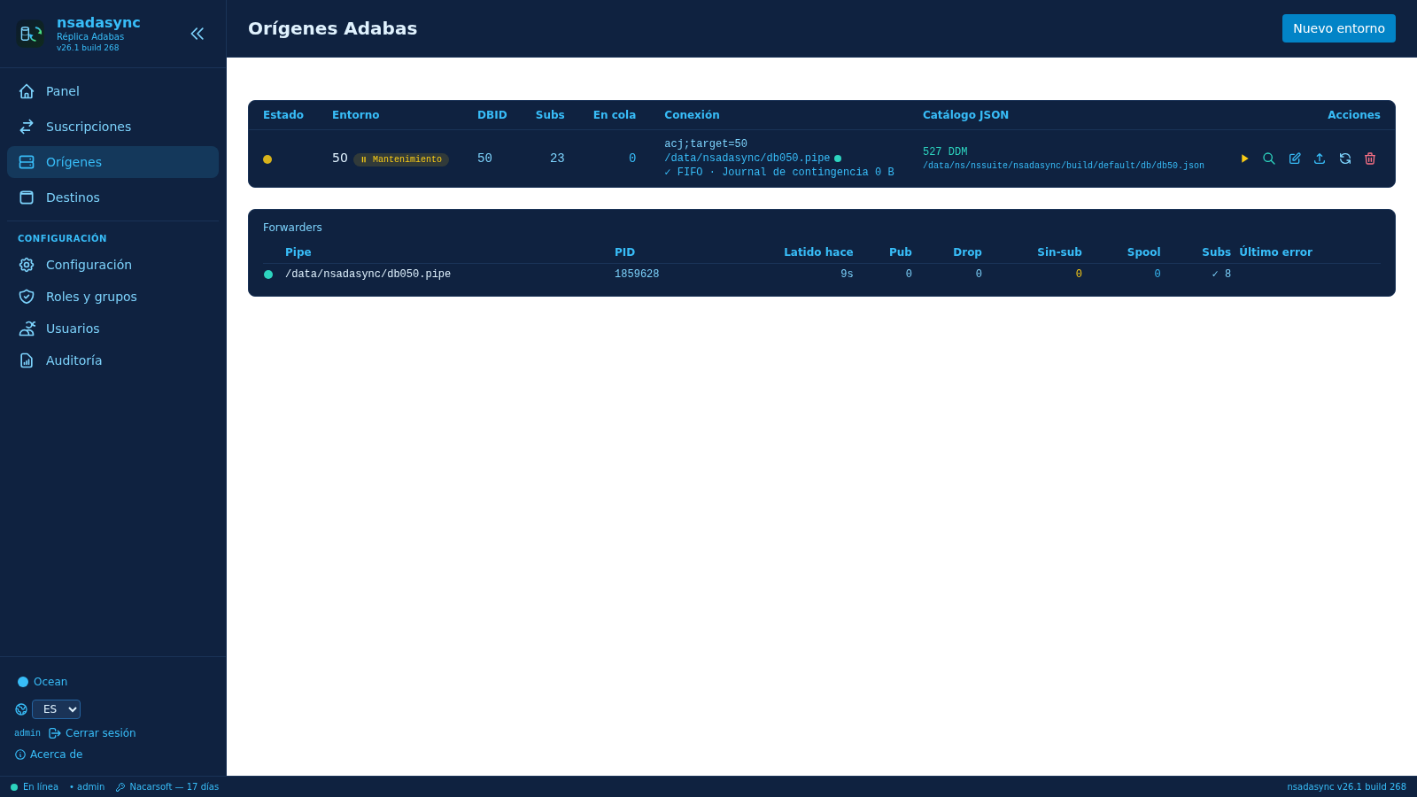
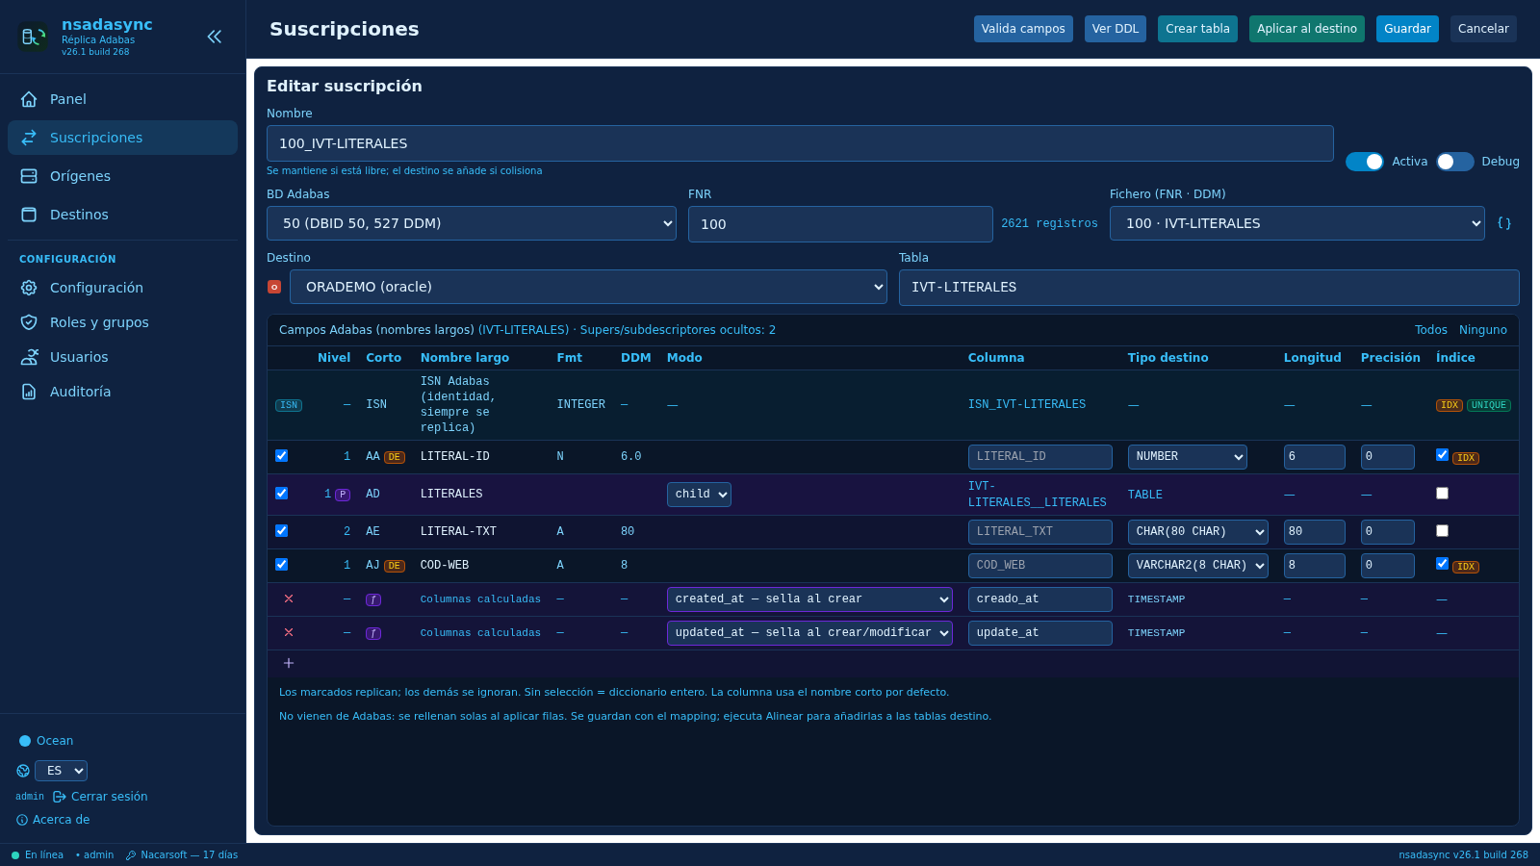
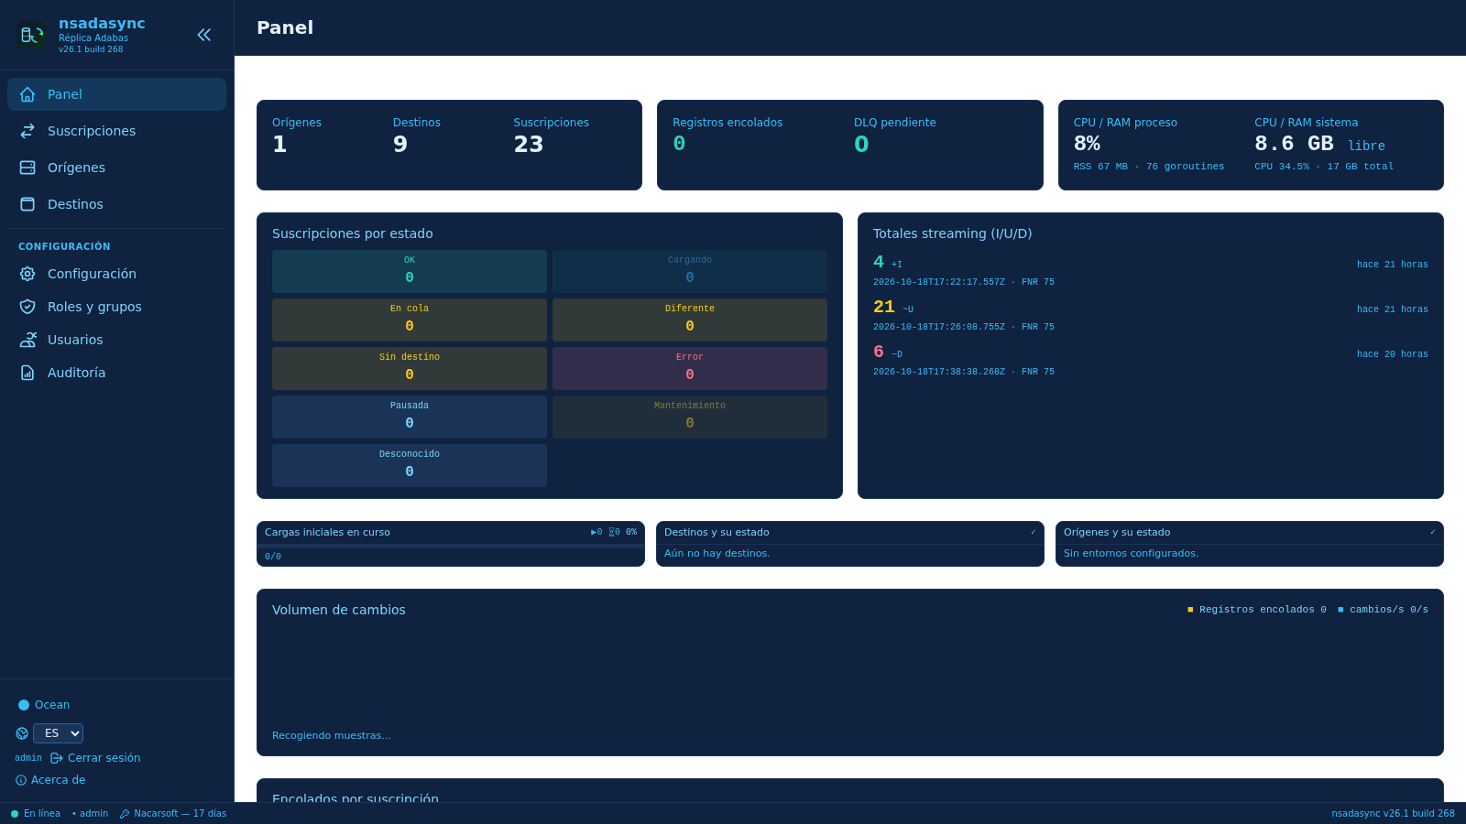
HOW IT WORKS
From the nucleus exit to the target, in three steps
1
2
3
Origin
Subscription
Panel
The Adabas file, its dictionary and the pipe the changes travel through.
The file → table mapping, with your own fields and computed columns.
State, queued records, latency and errors of the whole flow, live.
No nightly scripts and no extractors: one nucleus exit, one persistent broker, and the console does the rest.
Nacarsoft Soluciones Informáticas S.L. · nacarsoft.com · nsadasync

Slide 7
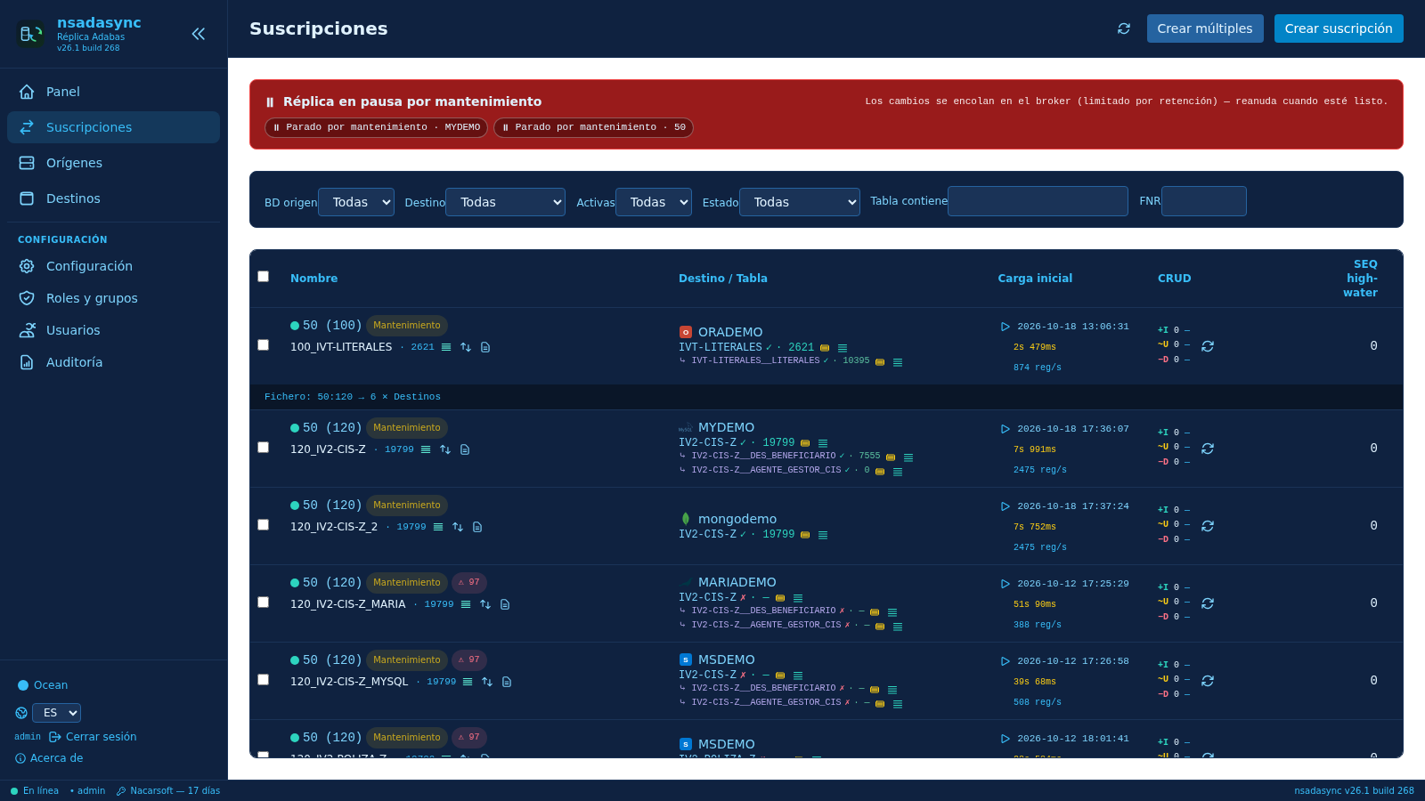
SUBSCRIPTIONS
From an Adabas file to a target table
Source 50 · FNR 106
DDM CLIENTES
Subscription
Target · Table CLIENTES
DDM field mapping to target columns
PE groups: json or child tables
MU fields: json, flat or child
ISN identity with upsert
DDM field | Target column | Type
AA001 | name | VARCHAR(120)
AA002 | surname | VARCHAR(120)
MESES (MU) | MESES_1 … MESES_8 | TEXT
• State per subscription: ok, queued, no target, error
• Last initial load and how long it took
• Insert, update and delete counters
• Control SEQ: where each flow stands
Nacarsoft Soluciones Informáticas S.L. · nacarsoft.com · nsadasync

Slide 8
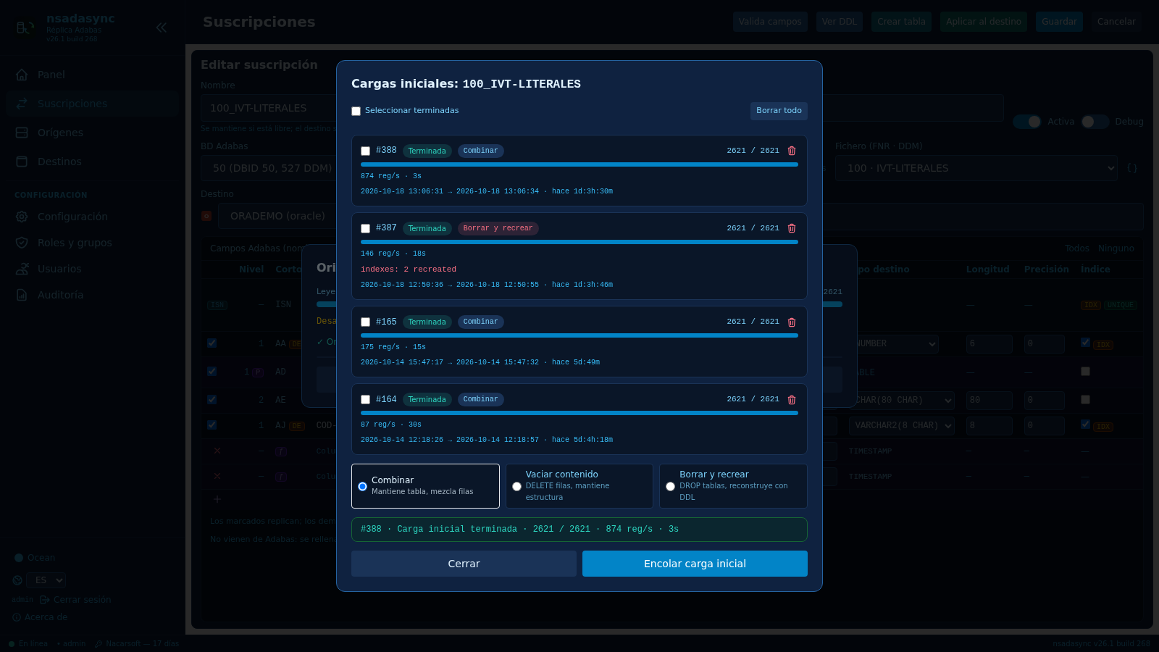
LOAD + STREAMING
The load first, the live stream after
Prepare + DDL preview
Ensure table
Initial load
Live streaming
1
2
3
4
Fields are validated against the dictionary and the DDL is previewed without running it.
Creates the parent table, child tables and indexes on the target.
merge, empty or drop modes, with per-target capacity limits.
Every later change is applied instantly and recorded.
high_water_seq checkpoint
If the process is interrupted, the load resumes from the checkpoint: it never starts over.
✓ Before queuing a load, the target is pinged and the source is checked: if either is down the load is rejected instead of dying halfway.
Initial load wizard: one job with its state, its duration and its record rate.
Nacarsoft Soluciones Informáticas S.L. · nacarsoft.com · nsadasync

Slide 9
SCHEMA CHANGES
The schema can change: no reload needed
A · Adabas changes
A new field in the file or an updated dictionary: reload the dictionary, add the field to the mapping and «Apply to destination» adds the column to the existing table without touching data, counters or checkpoint. Streaming continues.
B · The target changes
If someone adds a column, the upsert respects it. If the table is dropped, the subscription goes «no table» and the worker parks in the broker: recreate it and the backlog resumes. No reload.
C · An unmapped field arrives
The subscription editor: «Validate fields», «View DDL», «Create table» and «Apply to destination».
The apply is rejected with «unmapped fields… check catalog» and the entry goes to the DLQ. Fix the mapping and replay it: no initial load either.
The initial load is only the backfill. From then on, the schema evolves without loading again.
Nacarsoft Soluciones Informáticas S.L. · nacarsoft.com · nsadasync

Slide 10
RESILIENCE
If a target goes down, the data waits. Nothing is lost
Target OK
No answer
Queued
Back online
Resumes
The worker applies the change and advances the checkpoint.
The ping fails; the worker parks itself.
Changes wait in the broker, without polluting the DLQ.
The target becomes reachable again.
The backlog is applied in order, without duplicates.
DLQ with replay
The console says it itself
If the apply really fails, the entry goes to the error queue with its reason. It is inspected and retried. No event is ever lost.
«4 not reachable – the changes are queued in the broker: ELADEMO, MARIADEMO, MSDEMO, kafdemo».
Nacarsoft Soluciones Informáticas S.L. · nacarsoft.com · nsadasync

Slide 11
SCALE AND OPERATIONS
Built for production
1 worker per subscription
Batch 200 with fsync
10 GB / 72 h retention
Isolation: a slow target never blocks the others.
Persisted on disk per batch: nothing is lost on restart.
The broker bounds the disk; purge by topic and by age.
max_loads per target
max_records
Checkpoints per subscription
Loads are serialised or parallelised per target.
Optional record limit per load, for tests and migrations.
Each one knows where it stands and resumes without repeats.
El exit no bloquea · El broker persiste por lote · Cada suscripción se recupera sola
Nacarsoft Soluciones Informáticas S.L. · nacarsoft.com · nsadasync

Slide 12
OPERATIONS
The whole state on a single screen
• Sources and targets with their state and latency
• Initial loads running and queued
• State of every subscription: ok, no target, queued, error
• Streaming totals of insert, update and delete
• Change volume and queued records
Queued per subscription
Change volume
Chain health
Latency per target
Nacarsoft Soluciones Informáticas S.L. · nacarsoft.com · nsadasync

Slide 13
SECURITY
Who sees what, and everything is recorded
Access control
Automation
Traceability
• RBAC with system roles
• Admin, SyncOperators, Viewers
• Groups and users
• Per-area permissions
• Machine tokens nstm_...
• Scope per subscription
• Configurable expiry
• CIDR allowlist
• Audit of every action
• User and client IP
• Per-subscription log
• Configurable retention
config.yaml 0600 · database 0700 · bcrypt · JWT HS256 · CSP headers · reverse proxy with HTTPS
Nacarsoft Soluciones Informáticas S.L. · nacarsoft.com · nsadasync

Slide 14
USE CASES
Where it pays off from day one
Analytics and BI
Event streaming
Oracle, PostgreSQL or MySQL feed reporting live, with no nightly loads and no intermediate files.
Kafka receives one topic per table, keyed by ISN, with tombstones on delete: it converges with compaction.
Search and text
Modern applications
Elasticsearch keeps one index per table, created during the load and fed live.
MongoDB and SQL Server receive documents and rows that feed APIs and applications without touching the nucleus.
→ A single source can feed several targets at once: duplicate the subscription onto the target you need.
Nacarsoft Soluciones Informáticas S.L. · nacarsoft.com · nsadasync

Slide 15
GETTING STARTED
From zero to data in the target, in three steps
1
Enable the exit
REQUIREMENTS
Build libnsadasync.so and set ADAUEX_4, USEREXITS=4, LOGGING=(CB) and LOGRB in the nucleus.
• Linux (RHEL 8 / 9)
• Adabas Open Systems with CLOG and LOGRB
• JSON dictionary per source (≤ 8 MiB)
• Reverse proxy with HTTPS in production
• Web console on port 11035
2
Register the source
nsddm2file JSON dictionary and the pipe_path of the source row.
3
Targets and subscriptions
Create the target with ping and test, ensure-table, initial load and streaming.
nsadasync init ./data → nsadasync start ./data → web console :11035
Nacarsoft Soluciones Informáticas S.L. · nacarsoft.com · nsadasync

Slide 16
FREQUENTLY ASKED
The questions we hear most
Do we have to stop the nucleus?
What if the target goes down?
No. The exit writes one frame per record with a single non-blocking writev. With no reader it dumps to the journal and carries on.
The changes queue in the broker and are applied when it is back. The DLQ only records real apply failures.
And deletes?
How are MU and PE handled?
They travel without after-image: they are applied by ISN, without decoding the record image.
As JSON (default) or as normalised child tables, resolved the same way in the DDL, the load and the apply.
Does it handle large loads?
What can I monitor?
Yes: initial load in batches with resumable checkpoints and per-target capacity limits (max_loads).
Source, target, states, queued records, latency, DLQ and auditing; the broker exposes offsets and checkpoints.
Nacarsoft Soluciones Informáticas S.L. · nacarsoft.com · nsadasync

Slide 17
Your Adabas data,
live wherever you need it
Try NSAdaSync with your own files: we set it up and watch it run on your data.
Guided demo
Try it in your environment
Let's talk about your case
nacarsoft.com · support@nacarsoft.com
Nacarsoft Soluciones Informáticas S.L. · nacarsoft.com · nsadasync

