Slide 1


NACARSOFT · DATA ANONYMISATION
Anonymise your personal
data without breaking
its consistency.
Per-field dictionary
what to mask and in which format
nsadamask replaces personal data with equivalent, valid values: the same original always produces the same replacement, and every field keeps its format.
Valid replacement
DNI, IBAN, card, IP… with a real format
SEE THE FEATURES →
Deterministic · 6 countries · 37 dictionaries · Dry run first

Slide 2
THE PROBLEM
Anonymising cannot just mean "change the numbers"
If the anonymised value does not have a valid format, it stops being useful for testing, stops being reversible and stops being business data.
1
2
3
Replacements that break the format
Loss of traceability
Risk of touching production
A DNI with letters, an IBAN that does not validate: the target system rejects it and the data becomes useless.
A random value on every load makes it impossible to recognise the same customer across two runs.
Anonymising "by eye" over the real file, with no simulation and no record of what changed.
nsadamask anonymises deterministically and with a valid format, and shows you the plan before writing anything.
Nacarsoft Soluciones Informáticas S.L. · nacarsoft.com · nsadamask

Slide 3
WHAT IT IS
Nacarsoft's deterministic anonymiser
nsadamask walks the Adabas files, detects the fields that hold personal data and replaces them with equivalent, valid values for the right country.
The same original always produces the same replacement (deterministic), the format is preserved and everything can be simulated before touching the core.
nsadamask
Anonymisation with a valid format
Deterministic: same original, same replacement
DNI, CPF, RUT, SSN, IBAN, card, IP, MAC…
Country-aware dates: DD/MM/YYYY or MM/DD/YYYY
-simulate: the report before applying
6
37
0
countries with dictionary
format dictionaries
core changes (it simulates)
Nacarsoft Soluciones Informáticas S.L. · nacarsoft.com · nsadamask

Slide 4
HOW IT WORKS
From real data to equivalent data, in three steps
Direct connection to the core with paged reads and multifetch, and writes only when you say so.
1 · Detect
2 · Replace
3 · Write
The dictionary declares which fields are anonymised and with which format and country.
Deterministic value with a valid format: the target system accepts it unchanged.
-apply mode with per-batch transactions; without it, only a report.
The replacement is derived from a seed: repeating the anonymisation gives the same result.
Nacarsoft Soluciones Informáticas S.L. · nacarsoft.com · nsadamask

Slide 5
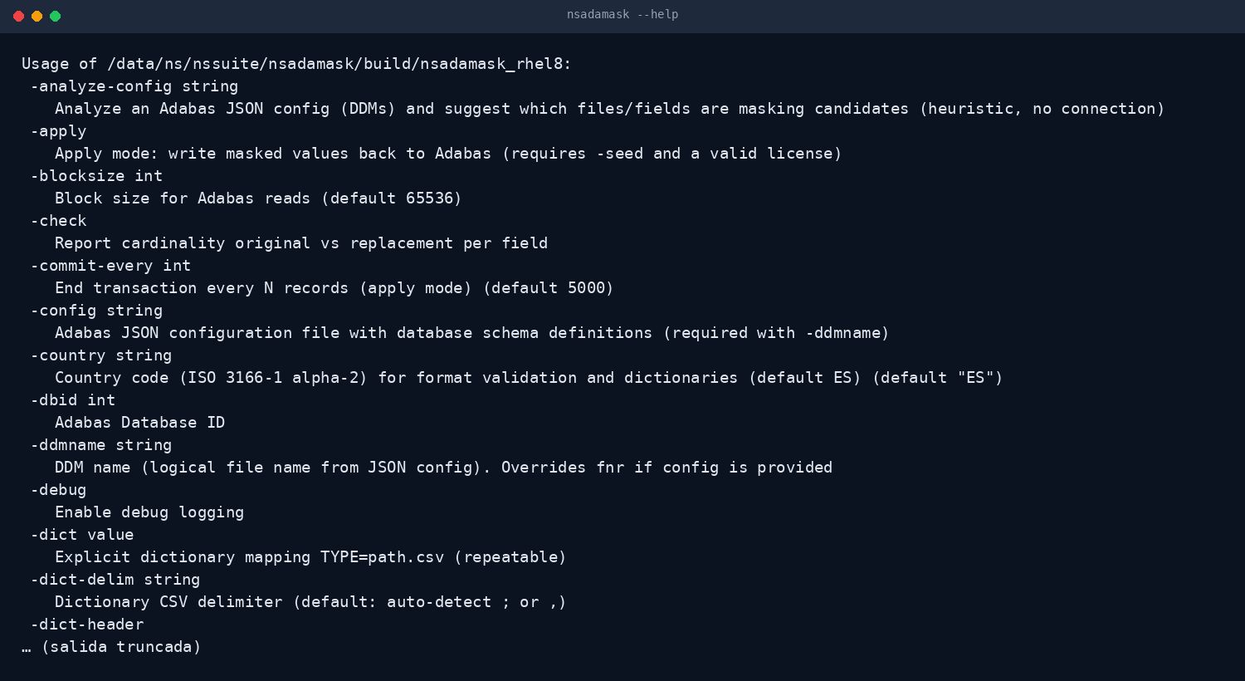
THE TOOL
The whole product is in --help
One binary, no dependencies: the per-country dictionaries, the formats and the working modes are all in the help.
No dependencies
Per-country dictionaries
Simulation by default
Real output of nsadamask --help
Nacarsoft Soluciones Informáticas S.L. · nacarsoft.com · nsadamask

Slide 6
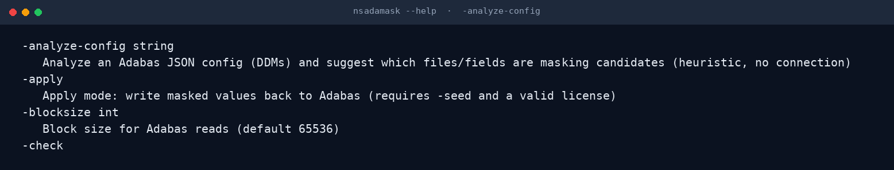
CONTROL
Analysis first, change later
-analyze-config reviews a DDM JSON file and suggests which files and fields are anonymisation candidates, without connecting to the database.
No core connection
Heuristic suggestions
A starting point
Real output of nsadamask -analyze-config
Nacarsoft Soluciones Informáticas S.L. · nacarsoft.com · nsadamask

Slide 7
FEATURES
What it does, point by point
Designed for regulated environments, where anonymised data must still be valid data.
Deterministic anonymisation
Simulation first (-simulate)
✓
The same original value always produces the same replacement, across runs and across files.
✓
A per-field report of what would change, without writing anything at all.
Format preserved
Multi-country
✓
DNI, CPF, RUT, SSN, passport, CIF, CUIT, IBAN, cards, IP, MAC and valid plates.
✓
ES, AR, US, BR, CL and MX with 37 valid-format dictionaries (DNI_AR, TAX_ID_AR, POSTAL_CODE_US...).
Country-aware dates
Direct core connection
✓
DD/MM/YYYY in Spain, MM/DD/YYYY in the US; YYYYMMDD and ISO always accepted.
✓
acj client with paged reads and multifetch: no intermediate files involved.
Cardinality check
Seed and traceability
✓
-check reports the number of original and replacement values per field.
✓
The seed makes the anonymisation reproducible; every change is recorded.
Nacarsoft Soluciones Informáticas S.L. · nacarsoft.com · nsadamask

Slide 8
KEY OPTIONS
The parameters used every day
They combine with each other; every other flag is in --help.
-dbid <id>
-fnr <n> | -ddmname
-config <file>
Source Adabas database. Required in -apply mode.
File by number or by logical DDM name.
JSON configuration with the file definitions.
-analyze-config
-simulate
-apply
Suggests candidate files and fields. Heuristic, no connection.
Report of what would change, without writing anything.
Writes the replaced values (requires seed and licence).
-dict / -dictdir
-country <CC>
Format dictionaries: TYPE=path.csv, repeatable.
ISO 3166-1 alpha-2 country for format validation (default ES).
Nacarsoft Soluciones Informáticas S.L. · nacarsoft.com · nsadamask

Slide 9
USE CASES
Where it is used every day
The same use cases we solve with customers in banking, healthcare and the public sector.
01
02
03
04
Test environments
Statistics and analytics
External suppliers
Audit and expertise
Copy production to pre-production with the personal data replaced.
Analytics over real data without being able to identify the person.
Hand over a file with a valid format and no identifiable data.
Document which fields are anonymised and with which criteria.
Nacarsoft Soluciones Informáticas S.L. · nacarsoft.com · nsadamask

Slide 10
GETTING STARTED
Install and anonymise in five minutes
Requirements
Install and first run
Linux x86-64 (RHEL 8 or RHEL 9)
Native Adabas client (acj) in the PATH
Write access (only in -apply mode)
Per-country format dictionaries
Product licence or the 30-day trial
# Install the suite
./install.sh --prefix /opt/ns
# See what would be anonymised
nsadamask -dbid 40 -fnr 120 \
-config ddm.json -simulate
# Apply (reproducible seed)
nsadamask -dbid 40 -fnr 120 \
-config ddm.json -seed 42 -apply
The licence is resolved from $NS_LICENSE_FILE, next to the product data or in /opt/ns/licenses/. Without one: 30-day trial.
Nacarsoft Soluciones Informáticas S.L. · nacarsoft.com · nsadamask

Slide 11
FREQUENTLY ASKED QUESTIONS
What customers always ask
Is the data still valid?
Can the anonymisation be repeated?
Yes: the replacement respects the field format (DNI, IBAN, card, IP), so the target system accepts it exactly as before.
Yes: with the same seed you get exactly the same result. It is deterministic.
Does it write to the core?
Which dictionaries are available?
Only in -apply mode. With -simulate it produces the report and changes nothing at all.
37 dictionaries for 6 countries (ES, AR, US, BR, CL, MX), and you can add your own CSV dictionaries.
Nacarsoft Soluciones Informáticas S.L. · nacarsoft.com · nsadamask

Slide 12
NEXT STEP
Anonymise your data
and still have
business data.
NSAdaMask at a glance
Deterministic replacement with a valid format
6 countries and 37 dictionaries
Dry run before touching the core
Direct connection with paged reads
Ask for a demo with a real file: we show the field report and the result with a valid format.
REQUEST A DEMO →
nacarsoft.com · support@nacarsoft.com · +34 910 038 502
Nacarsoft Soluciones Informáticas S.L. · nacarsoft.com · nsadamask

