Slide 1

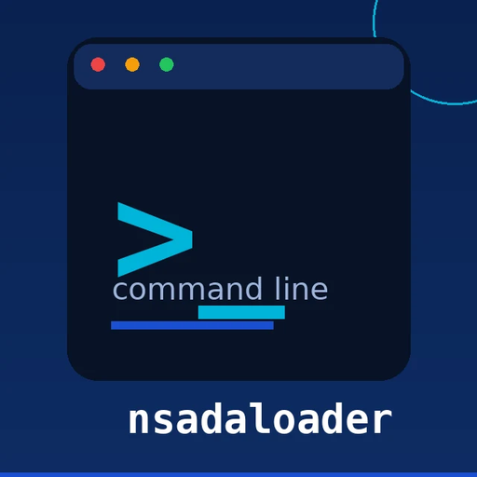
NACARSOFT · BULK ADABAS LOAD
Load your data
into Adabas without
writing it by hand.
JSON · CSV · XML
auto-detected by extension
nsadaloader loads records from JSON, CSV, TSV or XML straight into your Adabas files: STORE, UPDATE and DELETE, with MU fields, PE groups and per-batch control.
Adabas file
STORE, UPDATE or DELETE
SEE THE FEATURES →
STORE · UPDATE · DELETE · JSON · CSV · XML · Configurable batches

Slide 2
THE PROBLEM
Loading data by hand does not scale
Every new file to load means the same work: a program, a transaction, a list of errors and two days of testing.
1
2
3
One-off loaders
Errors that only show in production
No traceability
A development per file, per format and per corner case, with nothing reusable.
Truncated fields, MUs that do not fit, transactions left half-way.
A file loaded half-way and not a single log explaining what happened.
nsadaloader turns loading into a repeatable process, with a dry run and a trace for every record.
Nacarsoft Soluciones Informáticas S.L. · nacarsoft.com · nsadaloader

Slide 3
WHAT IT IS
Nacarsoft's bulk Adabas loader
nsadaloader reads an input file, validates it against the DDM and writes the records into Adabas in per-batch transactions, with a trace of every operation.
It handles STORE, UPDATE and DELETE, MU fields, PE groups and logical DDM names. With -dry-run you see exactly what it is going to do before it touches the core.
nsadaloader
File → Adabas, under control
JSON, CSV, TSV and XML, auto-detected
STORE, UPDATE and DELETE in batch
Native MU fields and PE groups
-dry-run: simulate before writing
4
3
1
input formats
operations
full trace
Nacarsoft Soluciones Informáticas S.L. · nacarsoft.com · nsadaloader

Slide 4
HOW IT WORKS
From the input file to the core, under control
Validation first, transaction per batch and a trace: nothing is written blindly.
1 · Read
2 · Validate
3 · Write
Format auto-detected (JSON, CSV, TSV, XML) and loaded in batches.
Fields checked against the DDM: lengths, MU, PE and mandatory fields.
Transactions of N records (-batch) with a per-record trace and an exit code.
With -dry-run no transaction is opened: you see the plan before running it.
Nacarsoft Soluciones Informáticas S.L. · nacarsoft.com · nsadaloader

Slide 5
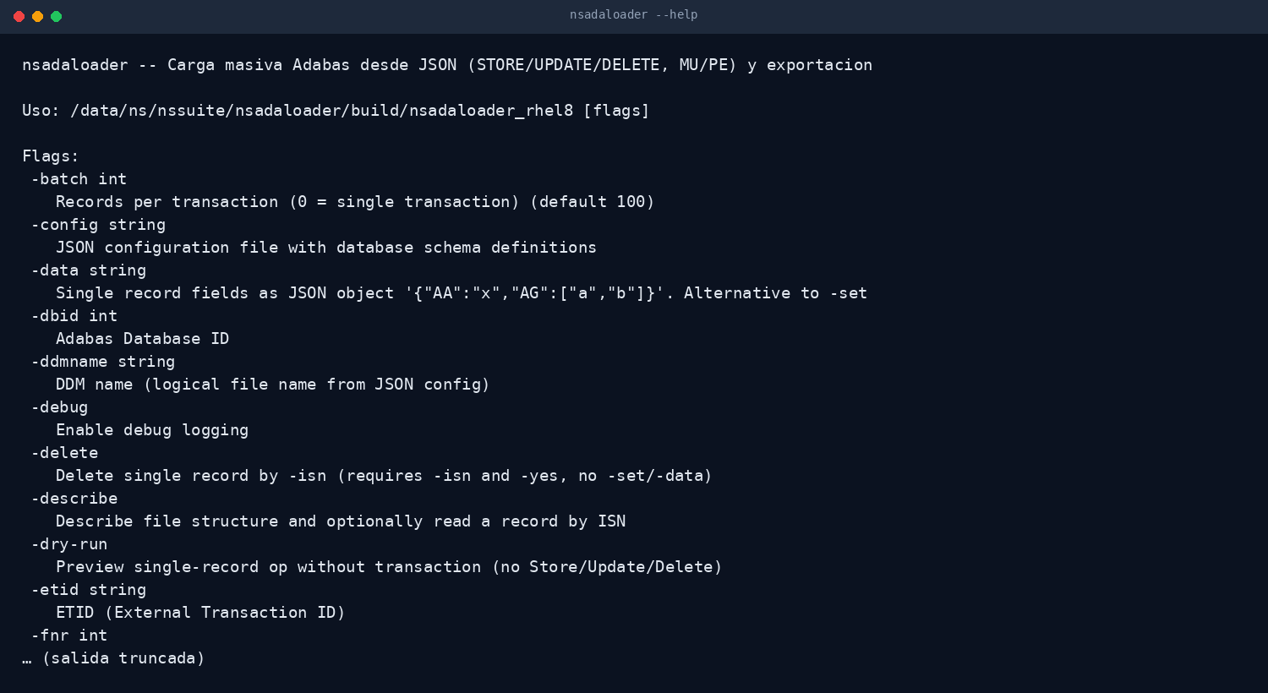
THE TOOL
One loader, every input
The same binary for JSON, CSV, TSV and XML, with extension auto-detection and validation against the DDM.
No custom development
DDM validation
Per-batch transactions
Real output of nsadaloader --help
Nacarsoft Soluciones Informáticas S.L. · nacarsoft.com · nsadaloader

Slide 6
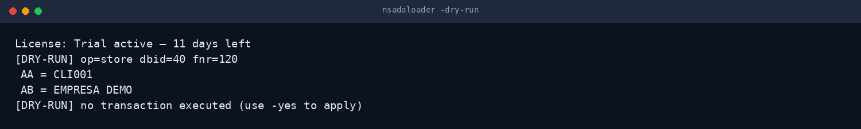
CONTROL
Simulate first, load later
-dry-run shows the operation, the values and the target file without opening a single transaction against the core.
Plan before running
No transactions
Per-record trace
Real output of nsadaloader with -dry-run
Nacarsoft Soluciones Informáticas S.L. · nacarsoft.com · nsadaloader

Slide 7
FEATURES
What it does, point by point
Built for migrations and tests, with the same control as in production.
Four input formats
STORE, UPDATE and DELETE
✓
JSON, CSV, TSV and XML with extension auto-detection, no configuration.
✓
Insert, update and delete by ISN within the same load.
MU fields and PE groups
Simulation (-dry-run)
✓
Native support for repeated elements and periodic groups, no tricks.
✓
See the operation and its values without running any transaction.
Per-batch transactions
Logical DDM names
✓
-batch controls the size of each transaction (100 records by default).
✓
With the nsddm configuration, fields are named as in the DDM.
Templates with -describe
JSON export
✓
Describes the file structure and reads a record by ISN, read-only.
✓
-output dumps the file to JSON: also useful to extract and to test.
Nacarsoft Soluciones Informáticas S.L. · nacarsoft.com · nsadaloader

Slide 8
KEY OPTIONS
The parameters used every day
They combine with each other; every other flag is in --help.
-dbid <id>
-fnr <n> | -ddmname
-input <file>
Target Adabas database. Required.
File by number or by logical DDM name (requires -config).
Input file: JSON, CSV, TSV or XML.
-set | -data
-dry-run
-batch <n>
A single record as pairs or as a JSON object.
Simulates the operation without opening a transaction.
Records per transaction (0 = a single transaction).
-describe
-output <file>
Describes the file structure and reads a record by ISN.
Exports the file to JSON instead of writing to Adabas.
Nacarsoft Soluciones Informáticas S.L. · nacarsoft.com · nsadaloader

Slide 9
USE CASES
Where it is used every day
The same use cases we solve with customers in banking, healthcare and the public sector.
01
02
03
04
Migrating a file
Fixing data
Environment testing
Loading reference data
Initial load of an Adabas file from the export of another system.
Mass UPDATE of specific fields over thousands of records, with a dry run first.
Load a subset of data into the test environment and delete it afterwards.
Load catalogues and reference tables validated against the DDM.
Nacarsoft Soluciones Informáticas S.L. · nacarsoft.com · nsadaloader

Slide 10
GETTING STARTED
Install and load in five minutes
Requirements
Install and first run
Linux x86-64 (RHEL 8 or RHEL 9)
Native Adabas client (acj) in the PATH
Write access to the database
Product licence or the 30-day trial
DDM in JSON (nsddm) for logical names
# Install the suite
./install.sh --prefix /opt/ns
# Simulate a load
nsadaloader -dbid 40 -input clients.json \
-fnr 120 -dry-run
# Load for real (in batches)
nsadaloader -dbid 40 -input clients.json \
-fnr 120 -batch 500 -yes
The licence is resolved from $NS_LICENSE_FILE, next to the product data or in /opt/ns/licenses/. Without one: 30-day trial.
Nacarsoft Soluciones Informáticas S.L. · nacarsoft.com · nsadaloader

Slide 11
FREQUENTLY ASKED QUESTIONS
What customers always ask
Does it write straight into the core?
What if a record fails?
Yes, in per-batch transactions, and with -dry-run you can see beforehand exactly what it will write.
It is recorded in the trace with the ISN and the reason, and the process returns an exit code other than zero.
Does it support MU and PE fields?
Do I need the DDM?
Yes, natively: repeated elements and periodic groups with the same semantics as the DDM.
Not to work by file number. With the JSON from nsddm you can use logical field names and validate the load.
Nacarsoft Soluciones Informáticas S.L. · nacarsoft.com · nsadaloader

Slide 12
NEXT STEP
Load your data
without writing a single
line of your own code.
NSADALoader at a glance
JSON, CSV, TSV or XML input
STORE, UPDATE and DELETE in batch
Native MU fields and PE groups
-dry-run before touching the core
Ask for a demo with your DDM and your input file: we show the simulation and the real load against your database.
REQUEST A DEMO →
nacarsoft.com · support@nacarsoft.com · +34 910 038 502
Nacarsoft Soluciones Informáticas S.L. · nacarsoft.com · nsadaloader

