Slide 1

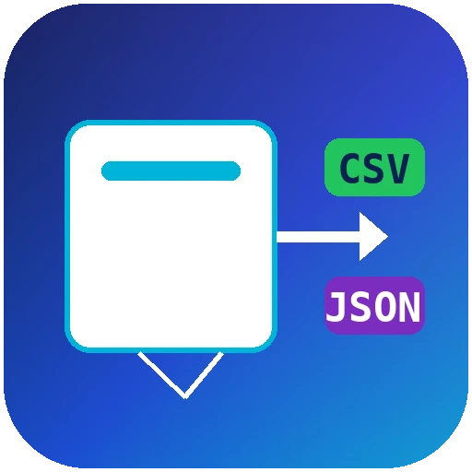
NACARSOFT · ADABAS TO FILE
Get your Adabas data
into CSV, JSON or XML.
Without touching production.
Adabas file
paged, non-blocking reads
nsadafile extracts records from Adabas files in read-only, non-blocking mode with a single command. Millions of records, no locks, no core downtime.
CSV · JSON · XML
one command, your format
SEE THE FEATURES →
No locks · No core downtime · CSV · JSON · XML · TAB · RECORD

Slide 2
THE PROBLEM
Getting data out of Adabas should not hurt
Extracting information from the core usually means either custom scripts or taking the system down while the extract runs.
1
2
3
The core gets blocked
Every query is a new build
Formats everywhere
Extracts stress the files: locks, queues and waits that end up as incidents in production.
One custom script per need, nothing reusable, no documentation.
CSV here, JSON there, XML in the report: every consumer ends up writing its own converter.
nsadafile turns extraction into a safe, repeatable command-line operation.
Nacarsoft Soluciones Informáticas S.L. · nacarsoft.com · nsadafile

Slide 3
WHAT IT IS
Nacarsoft's Adabas to file extractor
nsadafile connects through the native Adabas client in read-only mode and extracts exactly the records you ask for, in the format you want, at the pace the system allows.
It never writes to the core, never takes locks and needs no development: one binary, one command, one output file. It fits scripts, cron jobs and integration pipelines.
nsadafile
Adabas → file, read-only mode
No locks: paged and non-blocking reads
SQL, Adabas search, ISN or DDM name
CSV, JSON, XML, TAB or RECORD output
Field auditing with -checkfields
0
6
1
writes to the core
output formats
command
Nacarsoft Soluciones Informáticas S.L. · nacarsoft.com · nsadafile

Slide 4
HOW IT WORKS
From the core to your file, in one command
Native connection, impact-free reads and output straight into the format your systems consume.
1 · Connect
2 · Select
3 · Output
Native Adabas client (acj) against the given DBID, always read-only.
By ISN, Adabas search, DDM name or a full SQL query.
Paged extraction with multifetch, dumped in the chosen format, lock-free.
The core keeps serving traffic while you extract: it is a read, not a maintenance window.
Nacarsoft Soluciones Informáticas S.L. · nacarsoft.com · nsadafile

Slide 5
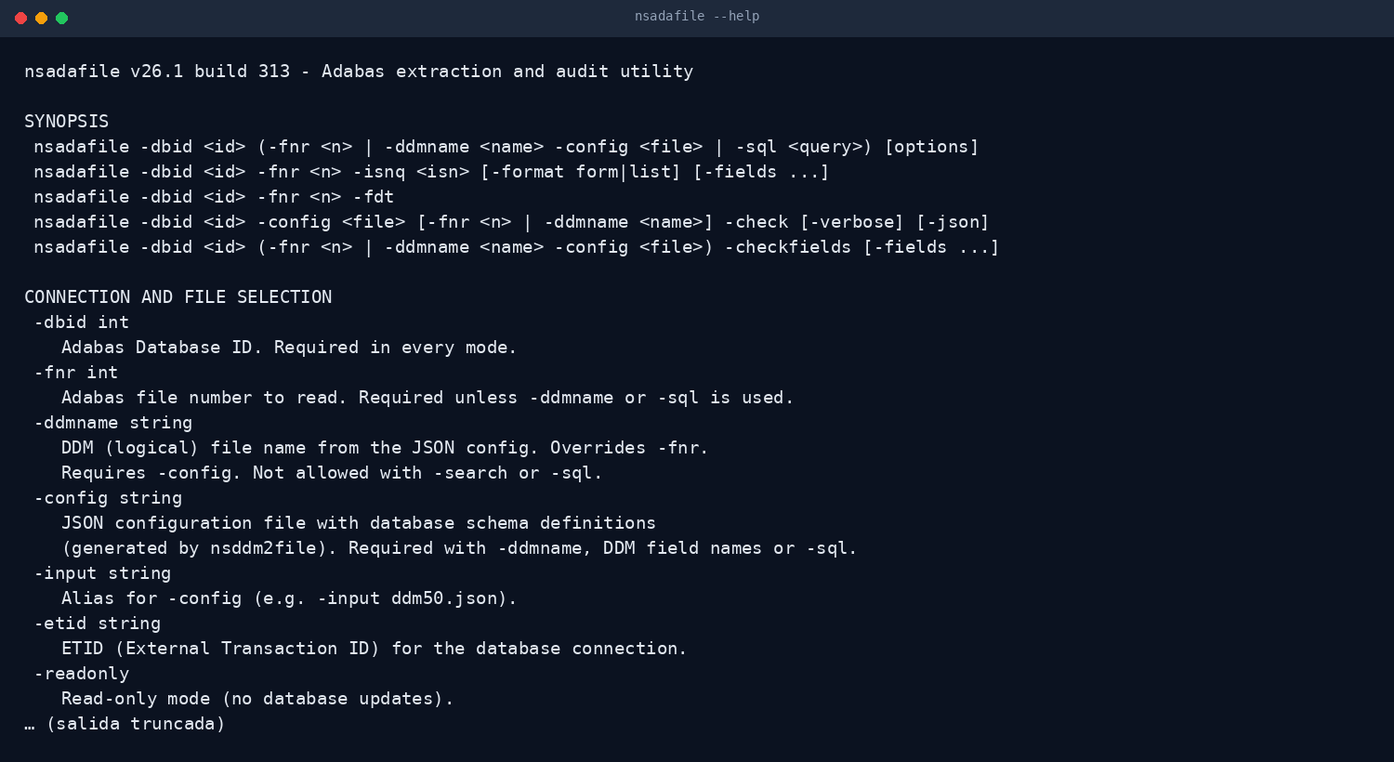
THE TOOL
The whole product is in --help
One utility, no dependencies, no prior configuration. The manual is the program's own help.
No client installation
No DSN or profiles
No libraries to maintain
Real output of nsadafile --help
Nacarsoft Soluciones Informáticas S.L. · nacarsoft.com · nsadafile

Slide 6
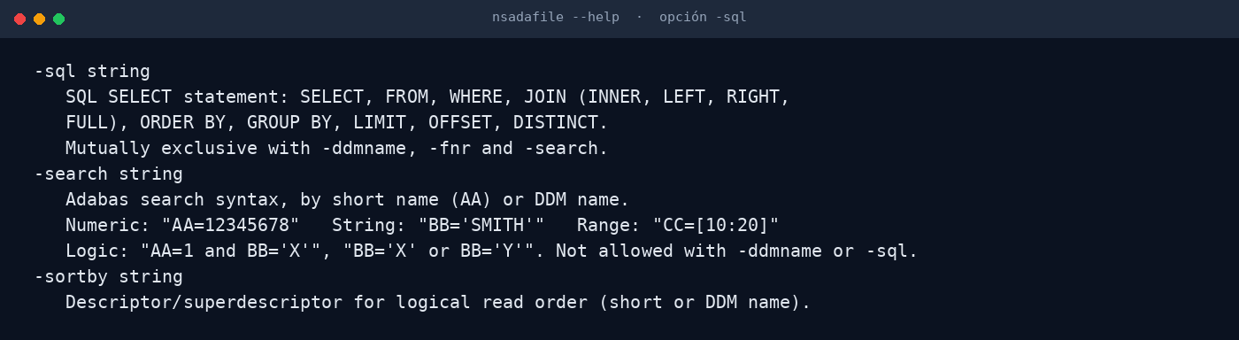
DATA SELECTION
Full SQL, not just "export everything"
Besides ISN, Adabas search and DDM name, nsadafile understands SQL: SELECT, JOIN, WHERE, GROUP BY, ORDER BY, LIMIT and DISTINCT.
JOIN across files
Filters and aggregations
LIMIT for sampling
Real excerpt of the nsadafile help (-sql option)
Nacarsoft Soluciones Informáticas S.L. · nacarsoft.com · nsadafile

Slide 7
FEATURES
What it does, point by point
Built for the daily work of a data team or a DBA.
Six output formats
Field and ISN selection
✓
CSV, JSON, XML, tab-delimited (TAB) and record (RECORD), plus file output.
✓
Extract only the columns you need and optionally include the ISN of each record.
Optimised search
SQL queries
✓
Adabas search syntax by short name or DDM name, with AND and OR logic.
✓
SELECT with JOIN, WHERE, GROUP BY, ORDER BY, LIMIT, OFFSET and DISTINCT.
Field auditing (-checkfields)
Non-blocking mode
✓
Finds the records whose values exceed the length defined in the DDM.
✓
Paged reads with multifetch: the core keeps serving your users.
Record limit
Execution trace
✓
Run sample extractions for testing without touching the whole file.
✓
Elapsed time and system information reported at the end of the run.
Nacarsoft Soluciones Informáticas S.L. · nacarsoft.com · nsadafile

Slide 8
KEY OPTIONS
The parameters used every day
They combine with each other; every other flag is in --help.
-dbid <id>
-fnr <n> | -ddmname
-isnq <isn> | -search
Source Adabas database. Required in every mode.
File by number or by logical DDM name (requires -config).
A single ISN or an Adabas search with AND/OR logic.
-sql <query>
-fields <list>
-checkfields
SELECT with JOIN, WHERE, GROUP BY, ORDER BY and LIMIT.
Fields to extract (short or DDM name), comma separated.
Auditing: checks that fields do not exceed the definition.
-format <csv|json…>
-limit <n>
Output format: csv, json, xml, tab (list) or record (form).
Maximum number of records to process (0 = no limit).
Nacarsoft Soluciones Informáticas S.L. · nacarsoft.com · nsadafile

Slide 9
USE CASES
Where it is used every day
The same use cases we solve with customers in banking, healthcare and the public sector.
01
02
03
04
Feeding a data lake
Auditing and counts
Migrating a file
Supporting users
Nightly extraction to CSV or Parquet for the data team, without touching the core.
SQL counts and validation for reconciliations and month-end closes.
Full dump to JSON as a first step of a migration or a test.
A user asks for their data: extracted in a minute, fully traceable.
Nacarsoft Soluciones Informáticas S.L. · nacarsoft.com · nsadafile

Slide 10
GETTING STARTED
Install and extract in five minutes
Requirements
Install and first run
Linux x86-64 (RHEL 8 or RHEL 9)
Native Adabas client (acj) in the PATH
Read access to the database
Product licence or the 30-day trial
No extra libraries, no configuration
# Install the suite
./install.sh --prefix /opt/ns
# Extract a file to CSV
nsadafile -dbid 40 -fnr 120 \
-output clients.csv
# SQL query with JOIN
nsadafile -dbid 40 -sql "SELECT a.AB \
FROM 120 a JOIN 130 b ON a.AB = b.AB"
The licence is resolved from $NS_LICENSE_FILE, next to the product data or in /opt/ns/licenses/. Without one: 30-day trial.
Nacarsoft Soluciones Informáticas S.L. · nacarsoft.com · nsadafile

Slide 11
FREQUENTLY ASKED QUESTIONS
What customers always ask
Does it block the core?
Do I need the DDM?
No. Reads are paged and non-blocking; the file keeps accepting user operations while you extract.
Not to work by file number. The DDM (JSON) is only needed for logical field names or SQL queries.
What about the licence?
Can it run in cron?
Each product has its own perpetual licence. Without one, the tool runs in trial mode for 30 days.
Yes. It is a dependency-free binary: it drops into scripts, cron jobs and pipelines like any other command.
Nacarsoft Soluciones Informáticas S.L. · nacarsoft.com · nsadafile

Slide 12
NEXT STEP
Get your data out
without moving a single
byte of the core.
NSAdaFile at a glance
Extraction to CSV, JSON, XML, TAB and RECORD
Read-only: zero locks, zero impact
Filters by ISN, Adabas search and SQL
Field auditing with -checkfields
Ask for a demo with your own DDM and your own file: you will see the real extraction running against your database.
REQUEST A DEMO →
nacarsoft.com · support@nacarsoft.com · +34 910 038 502
Nacarsoft Soluciones Informáticas S.L. · nacarsoft.com · nsadafile

